Slide 1



Slide 2


Slide 3

Our School Vision:

Slide 4
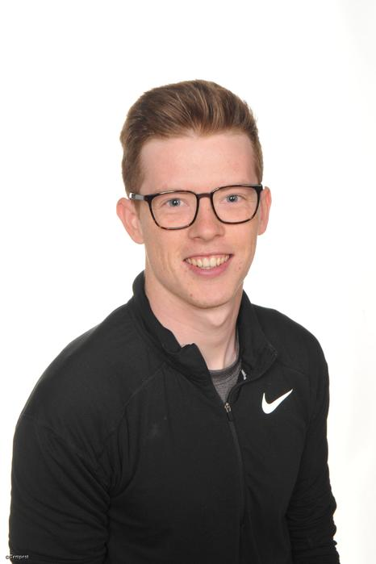
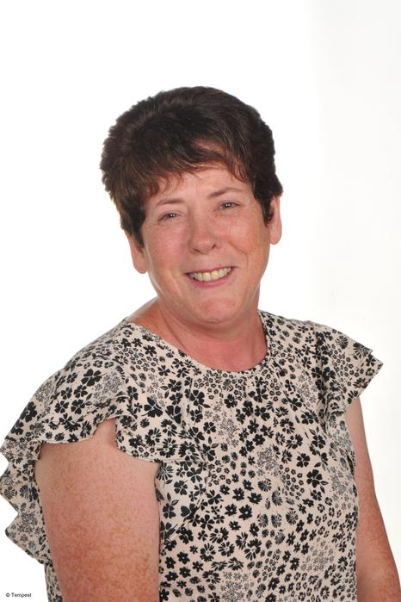
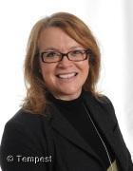
Year 4 staff
Mrs Edwards
Afternoon class TA
Mon-Thurs
Mrs Day
Morning class TA
Lunchtime supervisor
Mr Vernon
Year 4 Class Teacher

Slide 5
School website
We will be using and updating our school website and class page frequently over the year. Please keep up to date of any announcements and photos. https://www.stphilipssouthport.com/
Contact details are on the homepage so if you are needing to get in contact with school-
admin@sps.sefton.school
vernona@sps.sefton.school

Slide 6

Medical
Any medication updates – please let us know of any changes
If your child needs any prescribed medication, a medical form needs to be filled in at the office before we are able to administer it.
Thank you

Slide 7


Housekeeping!
Please name all clothing!
PE is on Tuesday and Thursday – no jewellery
Please make sure your child has a water bottle each day
Healthy snacks can be brought in for morning break time – fruit, vegetable sticks, cereal bars (no sweets or nuts please).

Slide 8
Uniform
BOYS WINTER UNIFORM
GREY TROUSERS (NO OTHER COLOUR)
WHITE SHIRT
NAVY LONG SLEEVED JUMPER
SCHOOL TIE
DARK COLOURED SCHOOL SHOES.
DARK SOCKS
GIRLS WINTER UNIFORM
NAVY SKIRT OR PINAFORE DRESS
WHITE BLOUSE
NAVY LONG SLEEVED CARDIGAN
SCHOOL TIE
NAVY TIGHTS / NAVY OR WHITE SOCKS
DARK COLOURED SCHOOL SHOES.
Find the full uniform
list on our website

Slide 9
Attendance and punctuality
It is crucial for children to arrive on time to school. Children’s activities start at 8:45 which is either spellings and grammar or Maths key skills. If they are late- they are missing learning time.
If your child is being collected at the end of the day, please arrive on time for 3:20pm.
Swimming Thursdays is 3:30pm pick up
Please do not allow children on the adventure playground before and after the school day.
Please note that no term time holidays will be authorised and fines will be in place.

Slide 10


Slide 11
Attendance…
First Response
If your child is absent you must contact the school office by telephone or email to report your child's absence giving clear details of the reason for absence. Failure to do so means that our First Response kicks in and if we cannot get hold of you and we are unable to make contact with you via your emergency contact details, it might be necessary for a senior leader to come to your house!
This is part of our safeguarding response to ensure everyone is safe and well. As you can imagine, a home visit takes up a lot of time and it is usually the case that families have forgotten to call us.

Slide 12
Cashless school payments
https://schoolgateway.co.uk/help/
As much as possible we are a cashless school now!

Slide 13
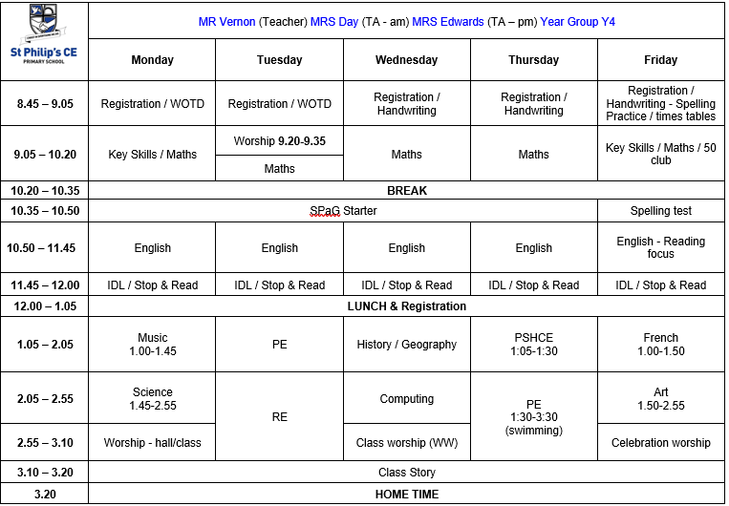
Class Timetable

Slide 14
Curriculum
Curriculum map/newsletter is on our website.

Slide 15
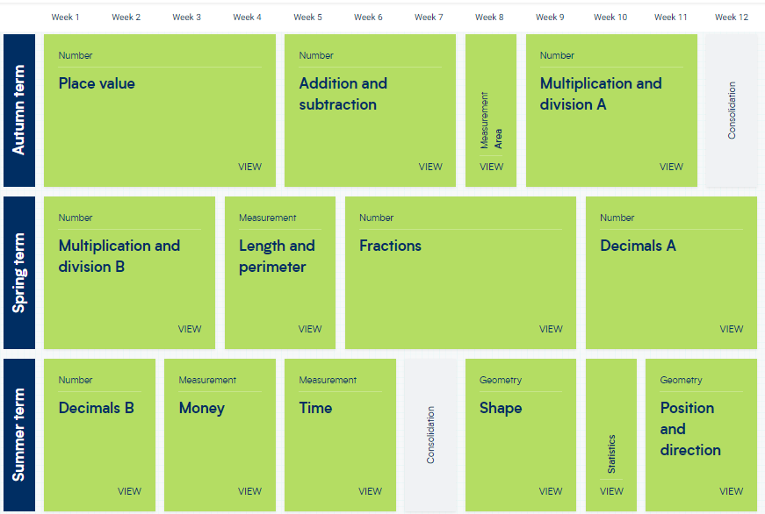
White Rose resources – Maths mastery

Slide 16

Assessment

Slide 17


Slide 18

Year 4 - band 6

Slide 19
Homework
Homework will be given out on a Friday.
Spelling test on the following Friday.
Homework to be given in by Tuesday. Please let us know if any homework is too difficult so we can give a little extra help at school.
Please help your child to learn their spellings and tables each week.

Slide 20


Times tables
As you will be aware, we have the Government multiplication check In June 2023.
All children will be sitting a test up to 12x12 with a 6 second timer testing their rapid recall.
Children must practise their times tables daily. Even if they think they know them- they must be quick to recall them.
There are also various sites to use:
https://www.youtube.com/watch?v=4BLZKOjNKfk

Slide 21
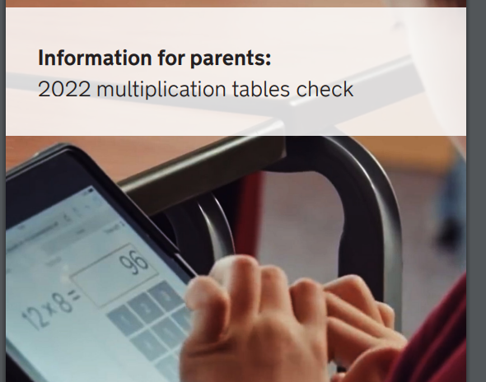
Multiplication Briefing
Thursday 29th September 2022

Slide 22

Spellings
We are having a huge emphasis on spellings this year. Children need to be practising their spellings daily and not for a spelling test.
In Year 4, children need to be able to spell words from the Year 3 and 4 curriculum list. They must show they can spell these words correctly in their writing.

Slide 23
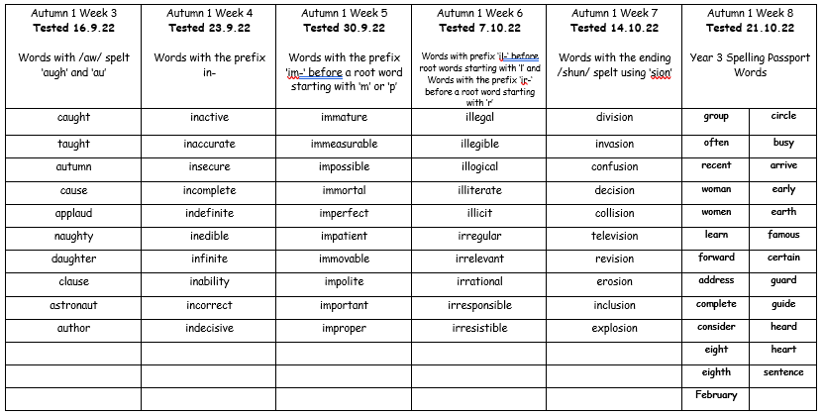
Spelling Passports

Slide 24


Slide 25
Reading at home:
Reading Journals
Children will be expected to write their own reading comments in their reading records and homework book reviews section.
3 times a week

Slide 26
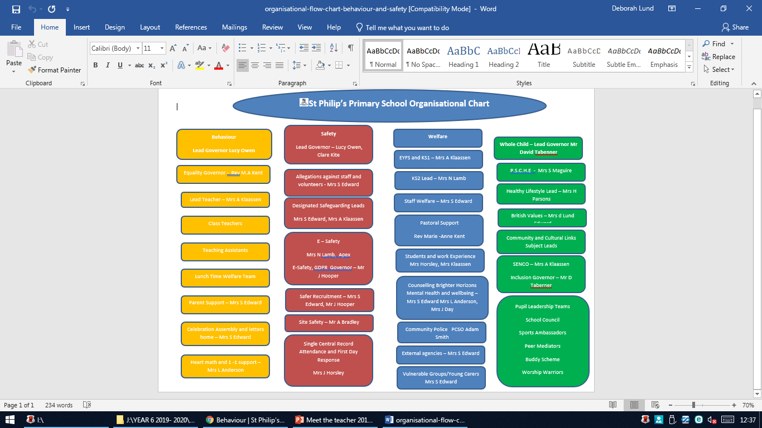

Slide 27
ST PHILIP’S CE PRIMARY SUPPORT TRIANGLE
SENDCO - Mrs Klaassen
SEN Support
Targeted Support
Enhanced Quality First,
Quality First – Universal Offer for all
High Needs Funding
EHCP’s
Specialist

Slide 28



Behaviour and
Good To Be Green
Very high expectations
Manners
Greetings
Can do attitudes

Slide 29
Behaviour and
Good To Be Green
No specific Golden Time on a Friday afternoon but classes will be rewarded for behaviour which follows our school standards.
10 Green week certificates being given still
Red cards- letter home to parents on a Friday
Yellow cards- miss some of break time.

Slide 30
St Philip’s Standards
Be Ready
Be Respectful
Be Responsible
Fantastic Walking

Slide 31

Fantastic Walking
Walking properly makes you feel great.
We are going to be doing fantastic walking, All THE TIME!
Head up
Arms by your sides
Slow pace.

Slide 32
Responsibilities
+ worship, worship warriors, school council, health champions, eco warrior.
Manners
Cutlery
Please and thank you’s
Listening skills / attentiveness
Rich seems and golden threads

Slide 33
School Trips…
Dates to be confirmed…
Local visits to Southport for Geog and science
Crosby
Payment plans will be available. Please contact the office if you think you would benefit from this

Slide 34
Permissions letter
Please ensure you inform the school of any medical requirements, referrals, changes to photo permissions and school lunches are sent in on time

Slide 35

Parent’s evening:
Wed 19th Oct 2022

Slide 36

Please check your filters

Slide 37


Slide 38
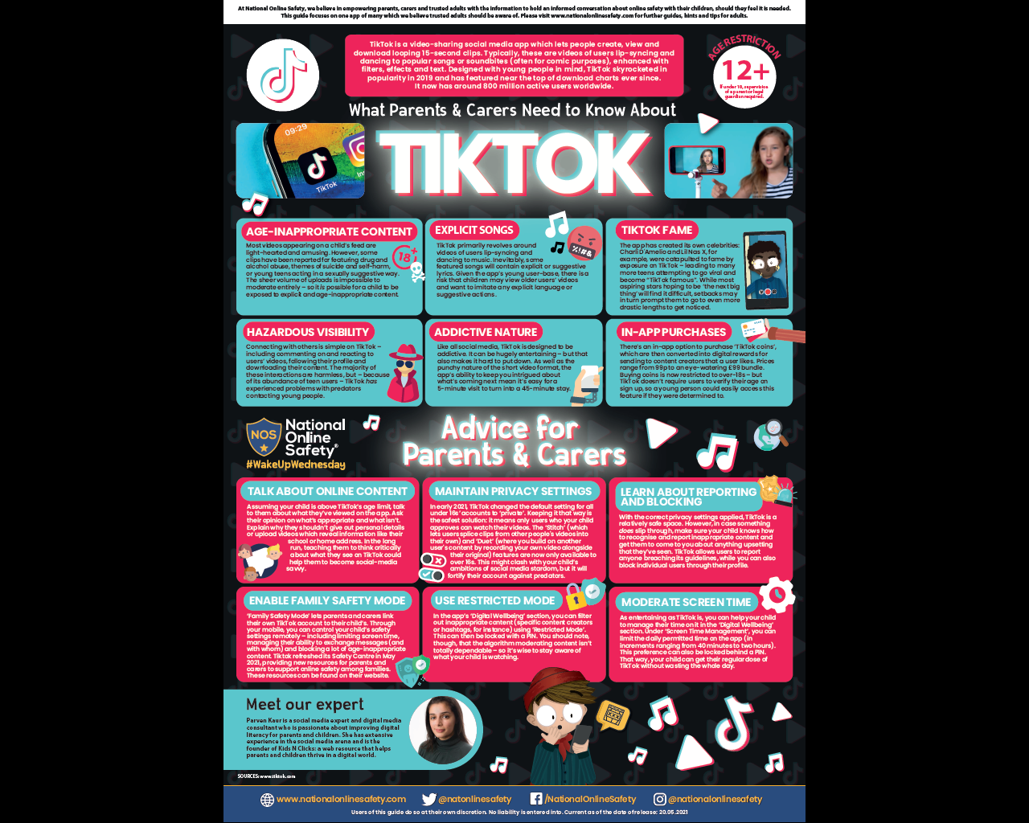

User friendly guides on all areas of ICT, gaming, social media and top tips for online safety.
To sign up please download the app, chose parent as your role and make use of the advice and support offered plus the online training support.

Slide 39

Volunteers are very welcome!

Slide 40

We will be in touch!
Check website for information:
http://www.stphilipssouthport.com/
and St Philip’s Twitter!

