Slide 1



Slide 2


Slide 3

Our School Vision:

Slide 4
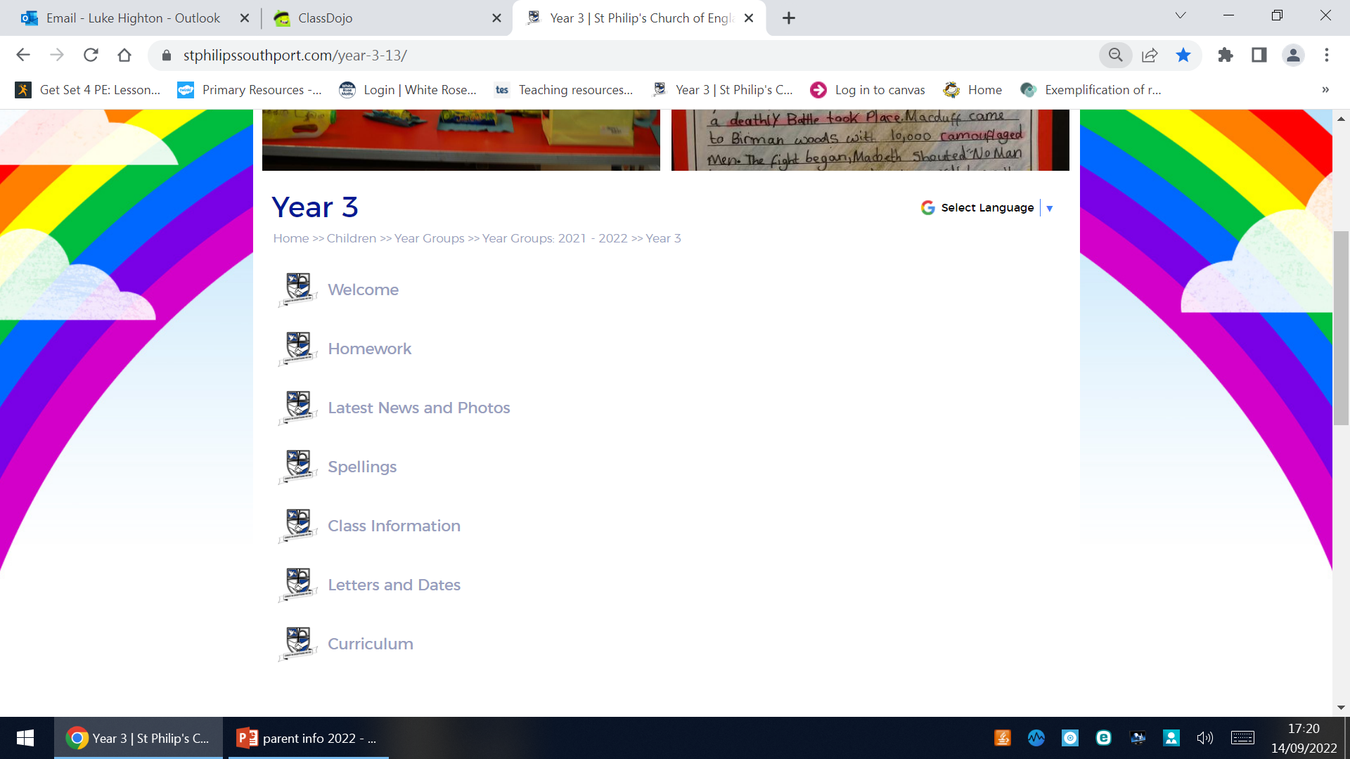


Slide 5
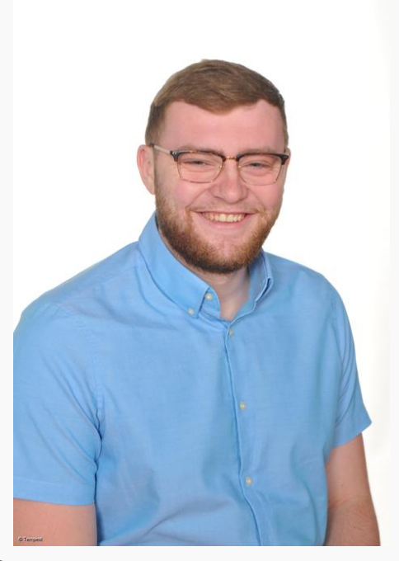
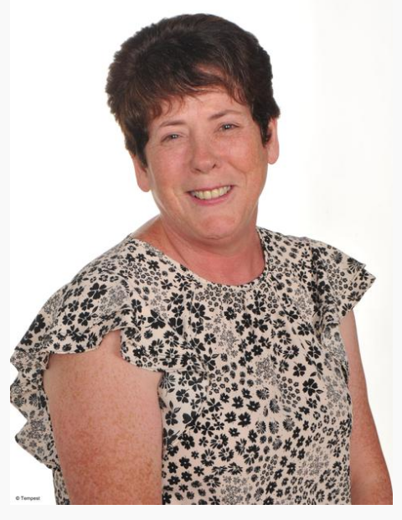
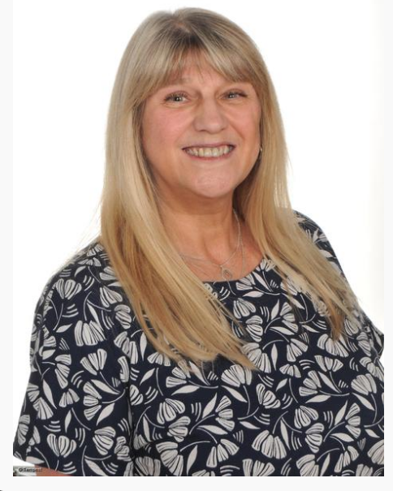
Year 3 staff
Mr Highton – Every day class teacher
Mrs Edwards – Every morning class TA
Miss Afford – PPA Cover Tuesdays

Slide 6
School website
We will be using and updating our school website and class page frequently over the year. Please keep up to date of any announcements. https://www.stphilipssouthport.com/
Things such as spellings, homework, announcements and letters will be on there throughout the year.
Contact details are on the homepage so if you are needing to get in contact with school-
admin@sps.sefton.school
hightonl@sps.sefton.school

Slide 7
Newsletter
Every Friday there is our school newsletter that contains lots of important information about school like dates etc.
We also put in there the nice things that happen that week and also Star of the Week, Behaviour Buddy, Writing award and You’ve been spotted

Slide 8

Medical
Any medication updates – please let us know of any changes
If your child needs any prescribed medication, a medical form needs to be filled in at the office before we are able to administer it.
Thank you

Slide 9


Housekeeping!
Please name all clothing
PE is on Monday and Thursday afternoons- no earrings
Please make sure your child has a water bottle each day
Healthy snacks can be brought in for morning break time – fruit, vegetable sticks, cereal bars (no sweets or nuts please).

Slide 10
Uniform
Please could all clothing items labelled before coming into school
BOYS WINTER UNIFORM
GREY TROUSERS (NO OTHER COLOUR)
WHITE SHIRT
NAVY LONG SLEEVED JUMPER
SCHOOL TIE
DARK COLOURED SCHOOL SHOES.
DARK SOCKS
GIRLS WINTER UNIFORM
NAVY SKIRT OR PINAFORE DRESS
WHITE BLOUSE
NAVY LONG SLEEVED CARDIGAN
SCHOOL TIE
NAVY TIGHTS / NAVY OR WHITE SOCKS
DARK COLOURED SCHOOL SHOES.
Find the full uniform
list on our website

Slide 11
Attendance and punctuality
It is crucial for children to arrive on time to school. Children’s activities start at 8:45 which is either spellings and grammar or Maths key skills. If they are late- they are missing learning time.
If your child is being collected at the end of the day, please arrive on time for 3:20pm.
Please do not allow children on the adventure playground before and after the school day.
Please note that no term time holidays will be authorised and fines will be in place.

Slide 12


Slide 13
Attendance…
First Response
If your child is absent you must contact the school office by telephone or email to report your child's absence giving clear details of the reason for absence. Failure to do so means that our First Response kicks in and if we cannot get hold of you and we are unable to make contact with you via your emergency contact details, it might be necessary for a senior leader to come to your house!
This is part of our safeguarding response to ensure everyone is safe and well. As you can imagine, a home visit takes up a lot of time and it is usually the case that families have forgotten to call us.

Slide 14
Cashless school payments
https://schoolgateway.co.uk/help/
As much as possible we are a cashless school now!

Slide 15
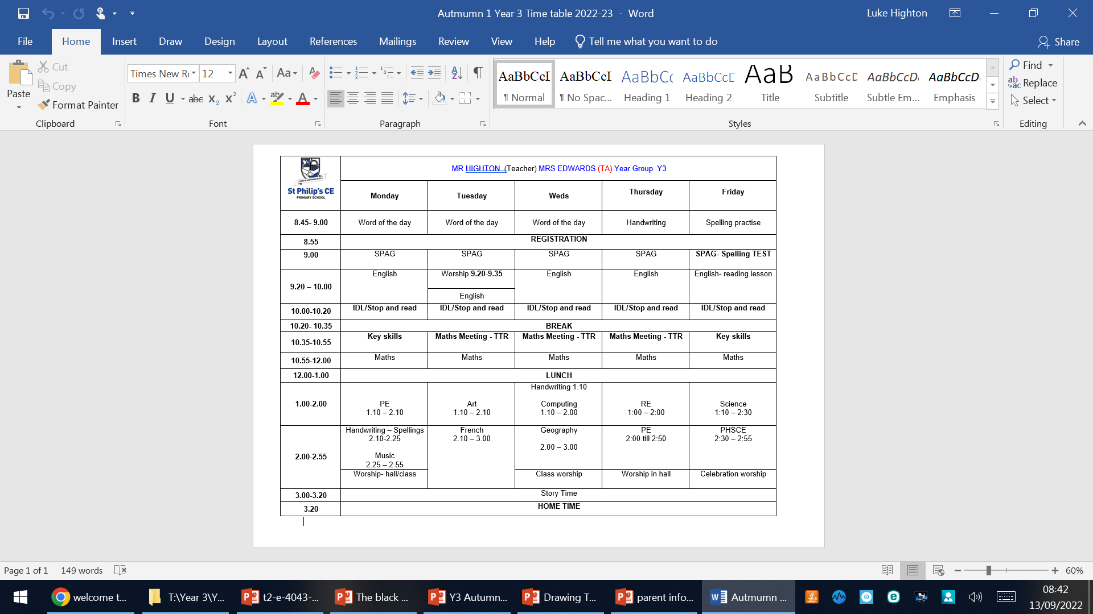
Class Timetable

Slide 16
Curriculum
Curriculum map is on our website and curriculum newsletter is also emailed out to you at the start of each term!

Slide 17
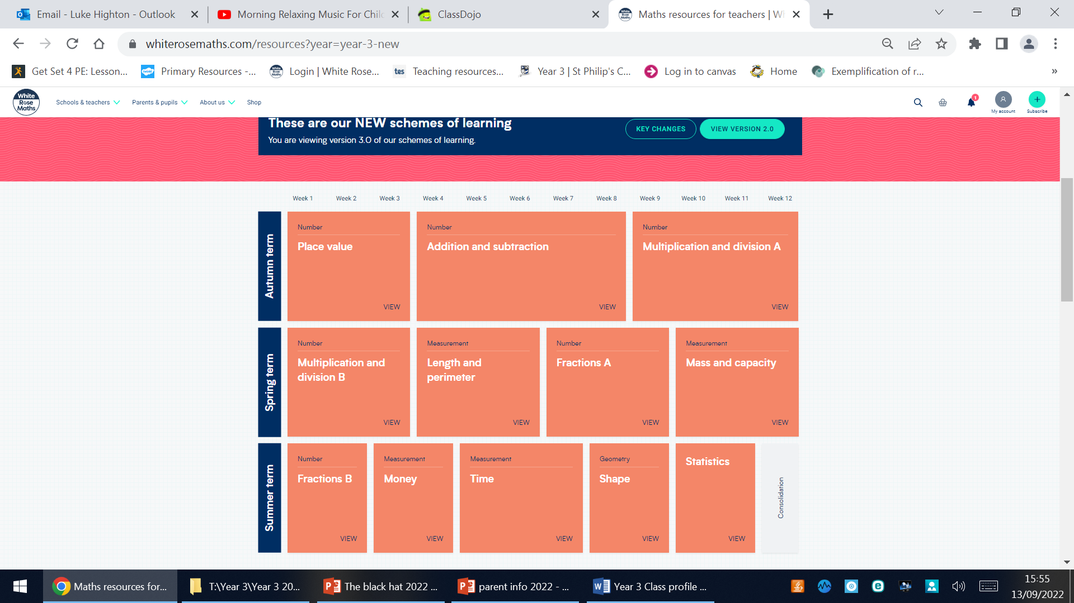
White Rose resources – Maths mastery

Slide 18

Assessment

Slide 19


Slide 20

Year 6- band 6

Slide 21
Homework
Homework will be given out on a Friday.
Spelling test on the following Friday.
Children are set in Year 3 each week:
A page of Maths Homework from their booklet
A 60 second reading comprehension
A book journal of one or two sentences about what they are reading
Spellings to be tested next Friday
The last three will be stuck into their purple homework books
Homework to be given in by Wednesday. Please let us know if any homework is too difficult so we can give a little extra help at school.
Please help your child to learn their spellings and tables each week.

Slide 22

Spellings
We are having a huge emphasis on spellings this year. Children need to be practising their spellings daily and not for a spelling test.

Slide 23


Slide 24


Times tables
As you will be aware, we have the Bronze, Silver and Gold badges in school.
Children must practise their times tables daily. Even if they think they know them- in Year 4 there is a National Multiplication check done which is very important so the more secure in tables they can be this year that will help massively.
There are also various sites to use:
https://www.youtube.com/watch?v=4BLZKOjNKfk

Slide 25
Reading at home:
Reading Journals
Children are expected to read their school reading book at home every night as well as in school.
If you could record this in their journal and when they hand in their journals we know their book needs to be changed

Slide 26
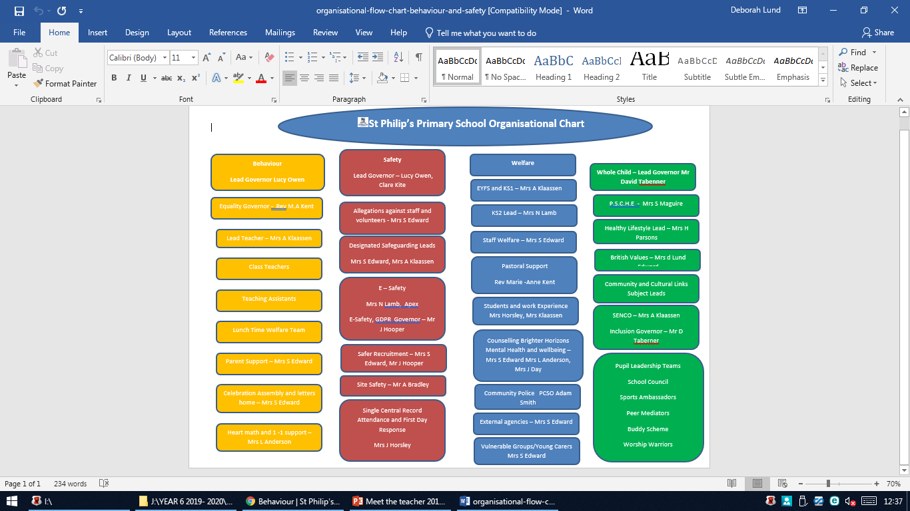

Slide 27
ST PHILIP’S CE PRIMARY SUPPORT TRIANGLE
SENDCO - Mrs Klaassen
SEN Support
Targeted Support
Enhanced Quality First,
Quality First – Universal Offer for all
High Needs Funding
EHCP’s
Specialist

Slide 28



Behaviour and
Good To Be Green
Very high expectations
Manners
Greetings
Can do attitudes

Slide 29
Behaviour and
Good To Be Green
No specific Golden Time on a Friday afternoon but classes will be rewarded for behaviour which follows our school standards.
10 Green week certificates being given still
Red cards- letter home to parents on a Friday
Yellow cards- miss some of break time.

Slide 30
St Philip’s Standards
Be ready
Be Respectful
Be Responsible
Fantastic Walking

Slide 31

Fantastic Walking
Walking properly makes you feel great.
We are going to be doing fantastic walking, All THE TIME!
Head up
Arms by your sides
Slow pace.

Slide 32
School Trips…
Liverpool World museum or Eco Centre
Local visits to Southport
Trip to Crosby Lakeside in the summer term
Dates: TBC

Slide 33

Parent’s evening:
To be confirmed…

Slide 34

Please check your filters

Slide 35


Slide 36


User friendly guides on all areas of ICT, gaming, social media and top tips for online safety.
To sign up please download the app, chose parent as your role and make use of the advice and support offered plus the online training support.

Slide 37

Volunteers are very welcome!

Slide 38

Check website for information:
http://www.stphilipssouthport.com/
and Twitter!

Slide 39
Any Questions?

