Slide 1



Slide 2


Slide 3

Our School Vision:

Slide 4
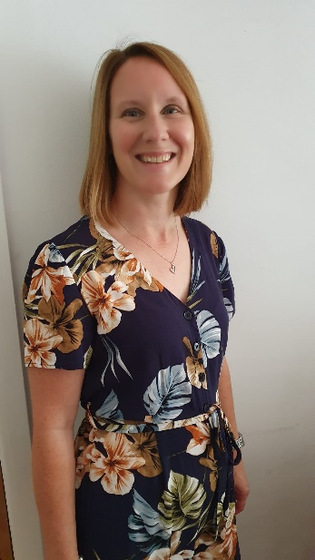
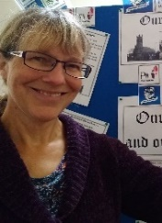
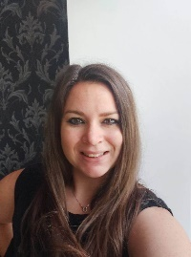
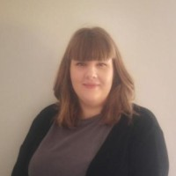
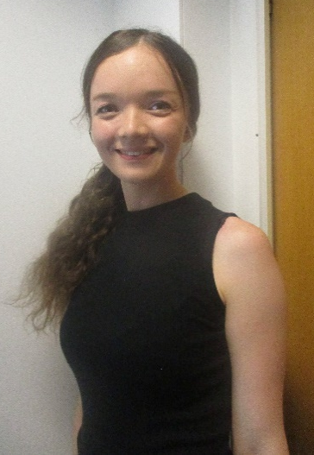
Year 6 staff
Mrs Warham Weds and Fri all day
Thurs am and
Mrs Cooper Mon- Thurs in class
Mrs Lund –4 mornings and Tues afternoon
Miss Halfpenny
Every day
Miss Baker
Every day

Slide 5
School website
We will be using and updating our school website and class page frequently over the year. Please keep up to date of any announcements. https://www.stphilipssouthport.com/
Contact details are on the homepage so if you are needing to get in contact with school-
admin@sps.sefton.school
coopere@sps.sefton.school
warhame@sps.sefton.school

Slide 6

Medical
Any medication updates – please let us know of any changes
If your child needs any prescribed medication, a medical form needs to be filled in at the office before we are able to administer it.
Thank you

Slide 7


Housekeeping!
Please name all clothing
PE is on Monday and Wednesday afternoons- no earrings
Please make sure your child has a water bottle each day
Healthy snacks can be brought in for morning break time – fruit, vegetable sticks, cereal bars (no sweets or nuts please).

Slide 8
Uniform
BOYS WINTER UNIFORM
GREY TROUSERS (NO OTHER COLOUR)
WHITE SHIRT
NAVY LONG SLEEVED JUMPER
SCHOOL TIE
DARK COLOURED SCHOOL SHOES.
DARK SOCKS
GIRLS WINTER UNIFORM
NAVY SKIRT OR PINAFORE DRESS
WHITE BLOUSE
NAVY LONG SLEEVED CARDIGAN
SCHOOL TIE
NAVY TIGHTS / NAVY OR WHITE SOCKS
DARK COLOURED SCHOOL SHOES.
Find the full uniform
list on our website

Slide 9
Attendance and punctuality
It is crucial for children to arrive on time to school. Children’s activities start at 8:45 which is either spellings and grammar or Maths key skills. If they are late- they are missing learning time.
If your child is being collected at the end of the day, please arrive on time for 3:20pm.
Please do not allow children on the adventure playground before and after the school day.
Please note that no term time holidays will be authorised and fines will be in place.

Slide 10


Slide 11
Attendance…
First Response
If your child is absent you must contact the school office by telephone or email to report your child's absence giving clear details of the reason for absence. Failure to do so means that our First Response kicks in and if we cannot get hold of you and we are unable to make contact with you via your emergency contact details, it might be necessary for a senior leader to come to your house!
This is part of our safeguarding response to ensure everyone is safe and well. As you can imagine, a home visit takes up a lot of time and it is usually the case that families have forgotten to call us.

Slide 12
Cashless school payments
https://schoolgateway.co.uk/help/
As much as possible we are a cashless school now!

Slide 13
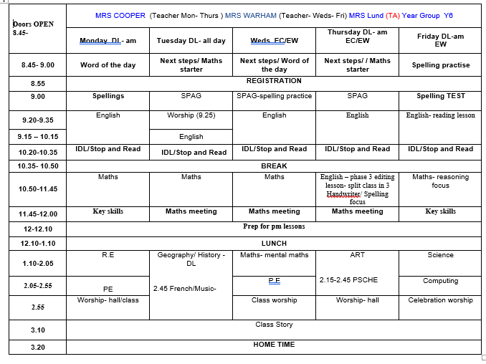
Class Timetable

Slide 14
Curriculum
Curriculum map/newsletter is on our website.

Slide 15
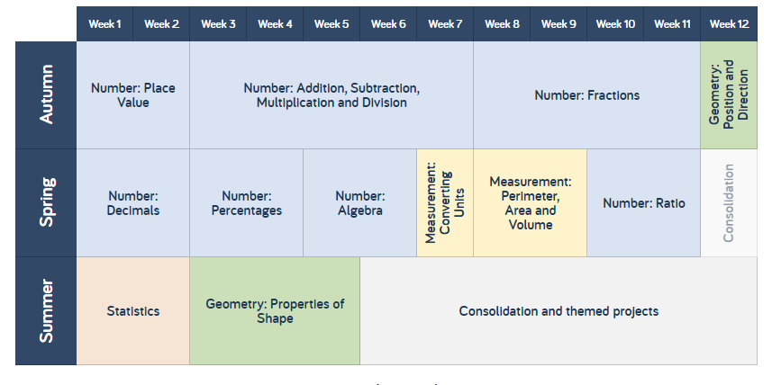
White Rose resources – Maths mastery

Slide 16
Subject ladders
We have English ladders for you to download on our website. Please read them and refer to them throughout the year as they show the expectations for your child in Year 6.
Pre-teaching / revision resources
https://www.stphilipssouthport.com/curriculum-16/

Slide 17

Assessment

Slide 18


Slide 19

Year 6- band 6

Slide 20
Homework
Homework will be given out on a Friday.
Spelling test on the following Friday.
Homework to be given in by Wednesday. Please let us know if any homework is too difficult so we can give a little extra help at school.
Please help your child to learn their spellings and tables each week.

Slide 21

Spellings
We are having a huge emphasis on spellings this year. Children need to be practising their spellings daily and not for a spelling test.
In Year 6, children need to be able to spell words from the Year 3 and 4 curriculum list as well as the Year 5 and 6. They must show they can spell these words correctly in their writing.
Spelling sheet for this half term has been sent home already and is on the class web page.

Slide 22
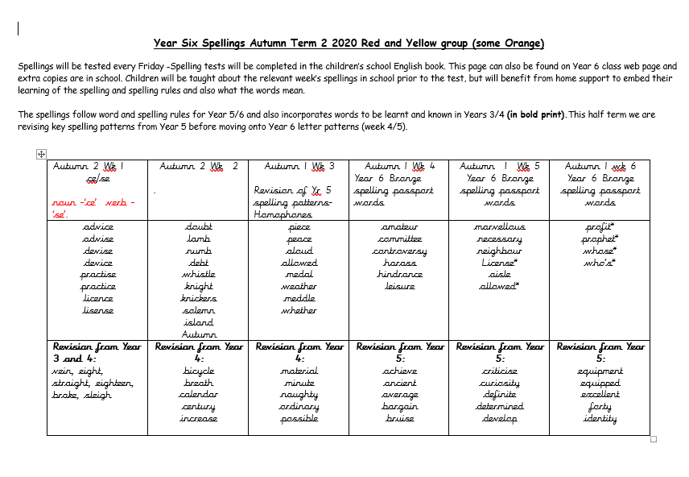

Slide 23
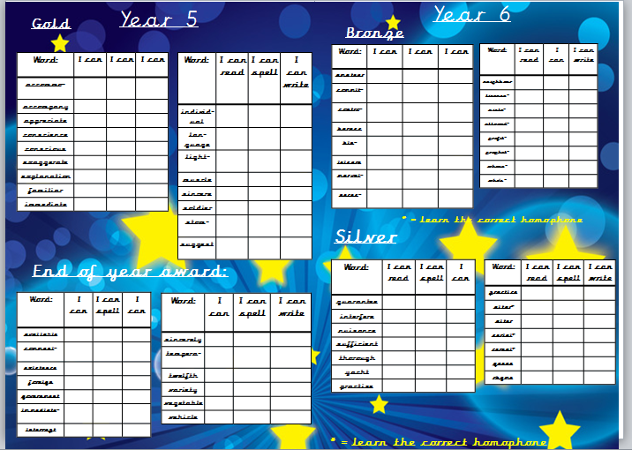

Slide 24


Slide 25
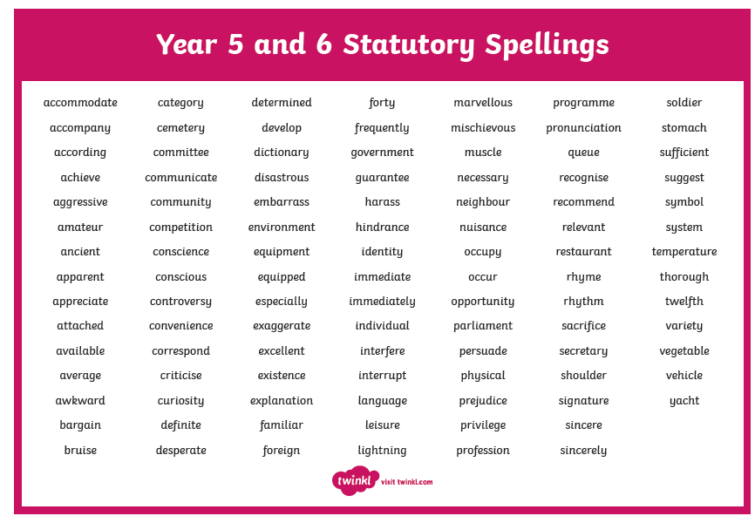

Slide 26


Times tables
As you will be aware, we have the Bronze, Silver and Gold badges in school.
Children must practise their times tables daily. Even if they think they know them- by Year 6 they must be quick to recall them.
There are also various sites to use:
https://www.youtube.com/watch?v=4BLZKOjNKfk

Slide 27
Reading at home:
Reading Journals
Children will be expected to write their own reading comments in their Reading log book each day.
Reading recommenders

Slide 28
Children’s greatest fear regarding year 6 was:
SATS
We’ve tried to reassure them that they’ll be ready for them when they do them.
It’s never as bad as they think it will be – we make them feel special during SATS week.
Some children even enjoy the challenge!
.
The SATs tests will take place throughout the week:
Monday 8th May 2023 – Thursday 11th May 2023

Slide 29
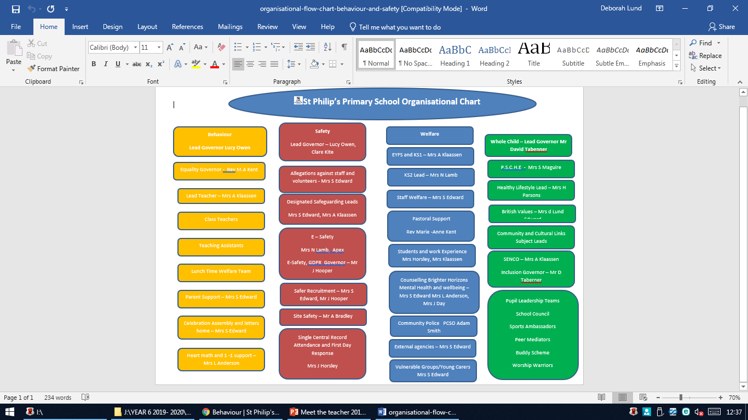

Slide 30
ST PHILIP’S CE PRIMARY SUPPORT TRIANGLE
SENDCO - Mrs Klaassen
SEN Support
Targeted Support
Enhanced Quality First,
Quality First – Universal Offer for all
High Needs Funding
EHCP’s
Specialist

Slide 31



Behaviour and
Good To Be Green
Very high expectations
Manners
Greetings
Can do attitudes

Slide 32
Behaviour and
Good To Be Green
No specific Golden Time on a Friday afternoon but classes will be rewarded for behaviour which follows our school standards.
10 Green week certificates being given still
Red cards- letter home to parents on a Friday
Yellow cards- miss some of break time.

Slide 33
St Philip’s Standards
Be ready
Be Respectful
Be Responsible
Fantastic Walking

Slide 34

Fantastic Walking
Walking properly makes you feel great.
We are going to be doing fantastic walking, All THE TIME!
Head up
Arms by your sides
Slow pace.

Slide 35

Walking home
If you would like your children to walk home from school on their own, please could you write a letter explaining the days fully and sign it. This is for the safety of your children as they will be let out at the end of the day by a number of different teachers.
Thanks for your co-operation.

Slide 36


Responsibilities
History Ambassadors, News Champions, Reception Buddies.
Thurs 20th October 9am- Buddy assembly

Slide 37
School Trips…
Liverpool Cathedral
Local visits to Southport
Winmarleigh residential

Slide 38
Permissions letter
Please ensure the letter regarding PG certificate material, local trips that don’t involve voluntary contributions and photo permission for education related websites beyond school, has been returned to school.

Slide 39

Parent’s evening:
To be confirmed…

Slide 40

Please check your filters

Slide 41


Slide 42
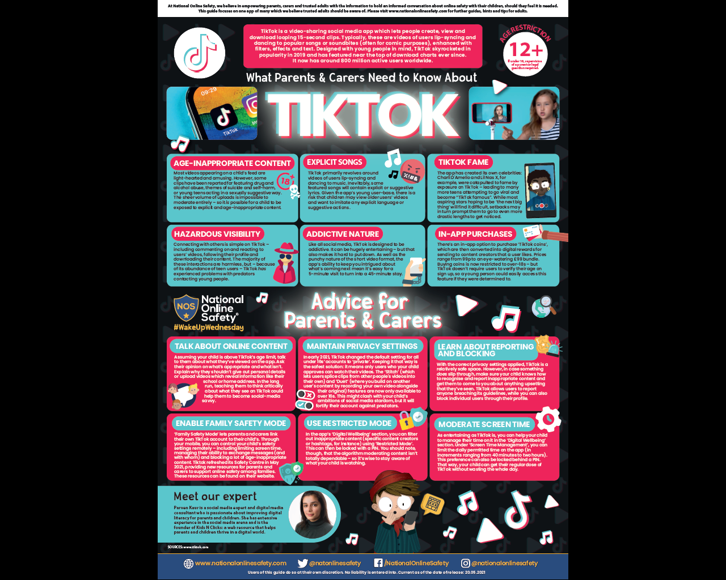

User friendly guides on all areas of ICT, gaming, social media and top tips for online safety.
To sign up please download the app, chose parent as your role and make use of the advice and support offered plus the online training support.

Slide 43

Volunteers are very welcome!

Slide 44

Check website for information:
http://www.stphilipssouthport.com/
and Twitter!

