Slide 1
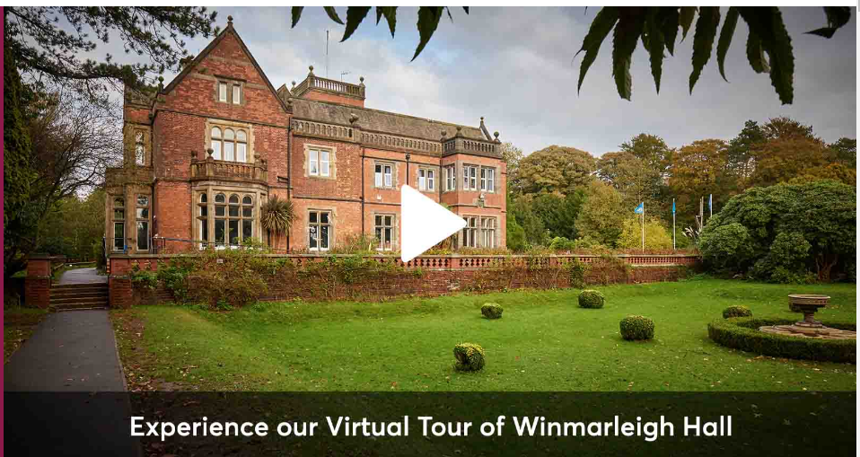
PGL visit- Winmarleigh
Weds 21st June- Fri 23rd 2023

Slide 2
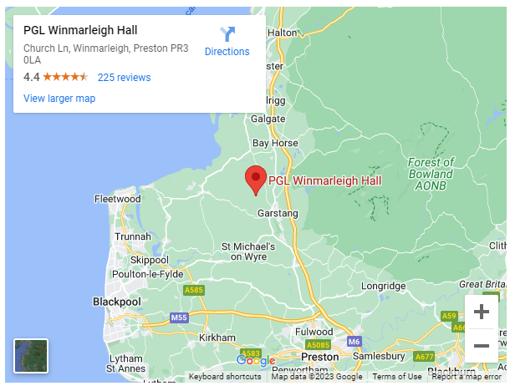
Where is Winmarleigh?
https://www.pgl.co.uk/en-gb/adventure-holidays/centres/winmarleigh-hall

Slide 3
Weds 21st June
Please drop the children at school at 9 am with their luggage, bedding and packed lunch for the Weds. We will leave school at 10.15 am.
They will come into the hall- be given a luggage label to tie onto their bag, hand in any named medication and money.

Slide 4
Who is going?
Mrs Cooper
Mrs Klaassen – responsible for medicine
Mr Highton
Miss Halfpenny
Children are in 3 groups for activities.

Slide 5
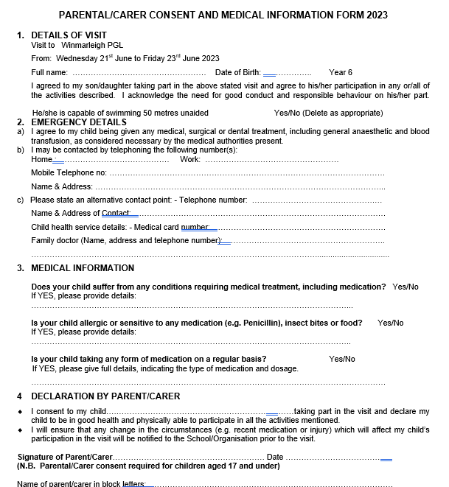
Medical forms
We must have a medical form for every child- if possible please complete after the meeting today.
Medicines include travel tablets.

Slide 6
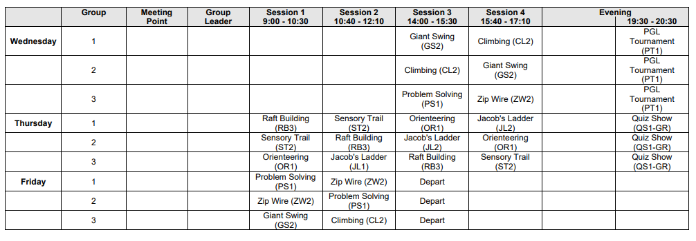
Activities

Slide 7
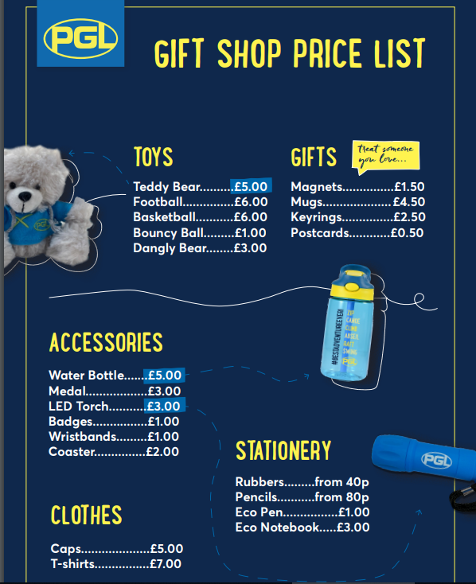
Money
There is a small tuck shop on site- the children can bring up to £10 to spend.
Please put in a named envelope and this will be kept safe by staff until it is our turn to use the shop.

Slide 8
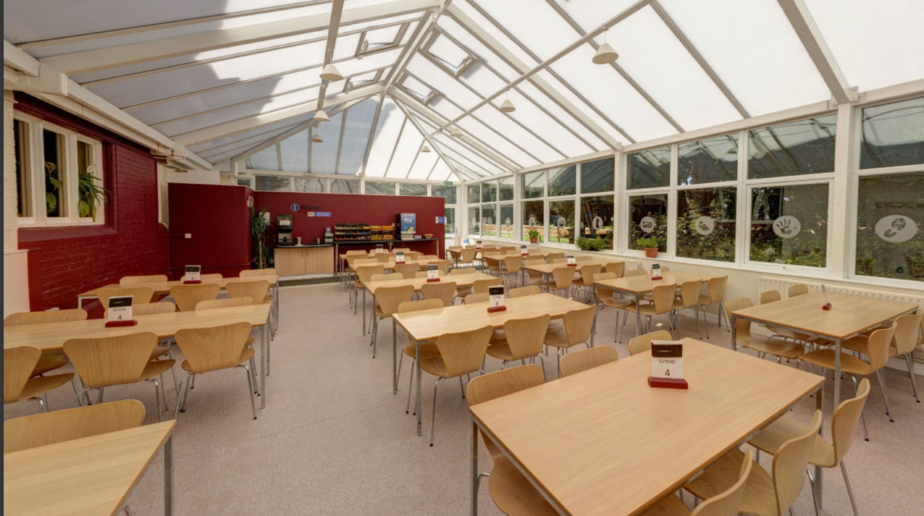
Food https://www.pgl.co.uk/en-gb/school-trips/menus-and-food
There is plenty of choice and plenty of it!
Please do not pack any extra snacks in their bags.
The only food they need is their packed
lunch for the first day- please ensure
they have a named refillable water
bottle with them.

Slide 9
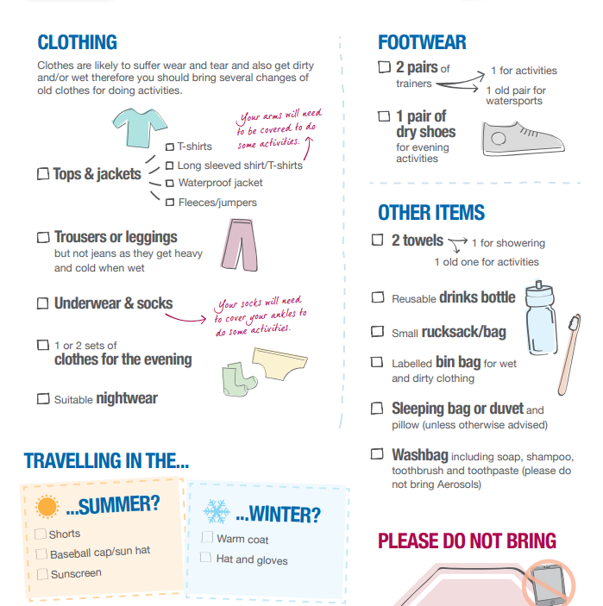
Kit list

Slide 10
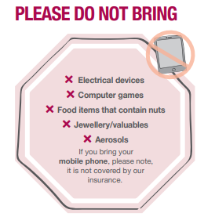
Please name everything!
No phones are allowed! Any problems we will contact you.
Wifi is not good there- we will try and tweet photos but it is not always possible.
Please ensure you have given Twitter permission.

Slide 11
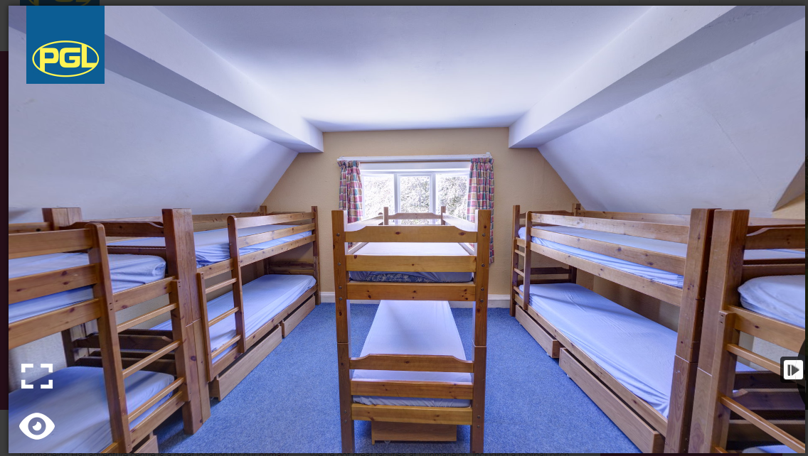
Rooms and groups
Children have picked two children to be in room/group with- they will definitely be with one of them. They will not know groups or rooms until we get there.
Rooms are big-
6, 8 , 10 children. https://www.pgl.co.uk/en-gb/school-trips/ primary-schools/centres/winmarleigh-hall

Slide 12

Fri 23rd June
The coach will leave PGL at approximately 1:30 pm to travel back to school.
Any delays we will phone school- we usually get back by 3.30 pm.

Slide 13


