Slide 1

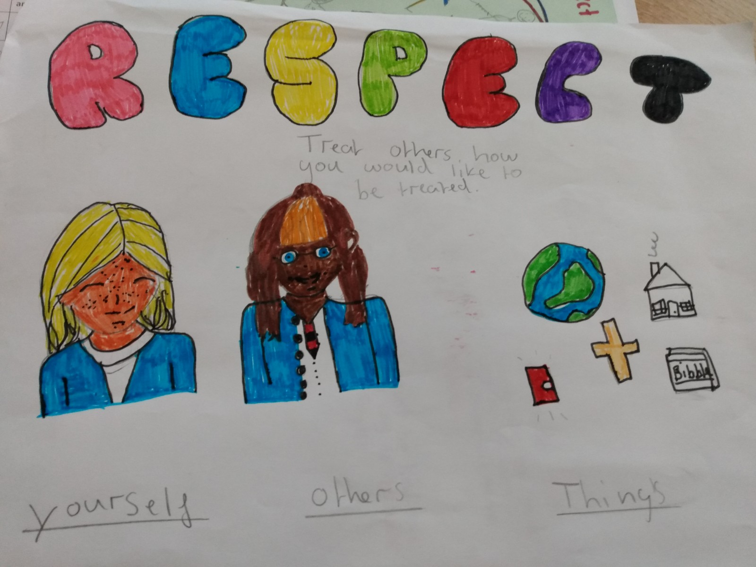

Black History Month: an inspirational figure
Last time we looked at how 200 years ago black people in Africa were taken to become slaves in the Americas
We learned how this country was involved in that…that this country did not show respect to people that were taken like this

Slide 2
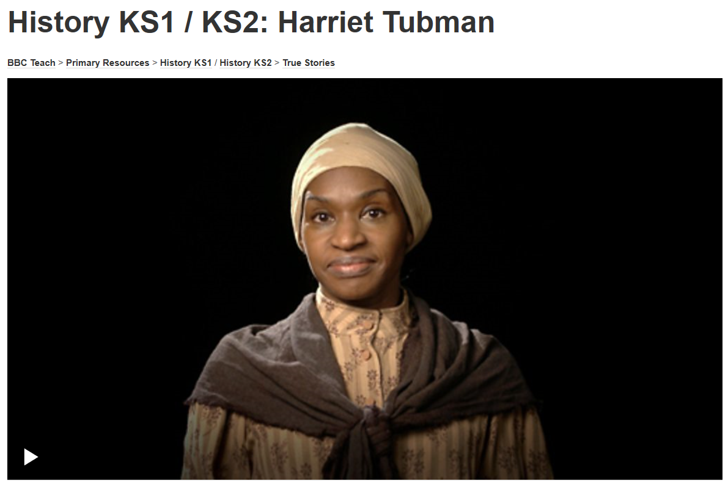
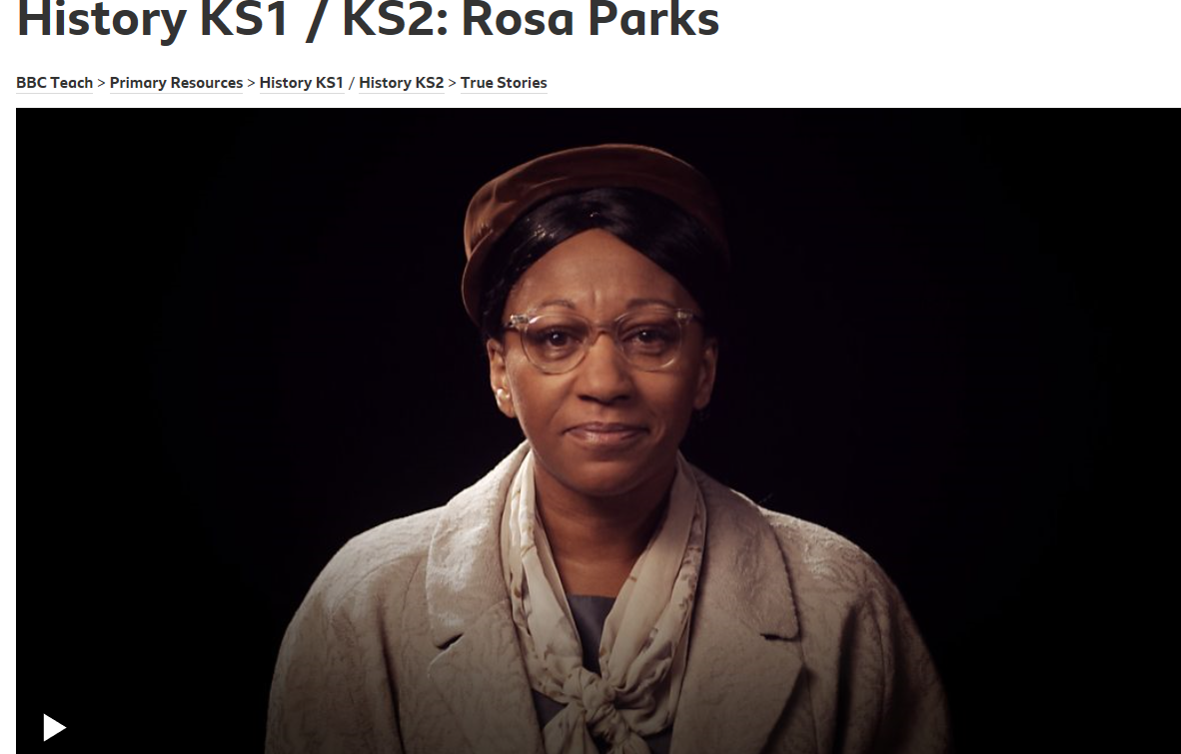
Today we are going to learn about a very brave woman who risked her life make lives better for those were being treated unfairly
https://www.bbc.co.uk/teach/class-clips-video/true-stories-harriet-tubman/zbh8mfr
https://www.bbc.co.uk/teach/class-clips-video/history-ks1-ks2-rosa-parks/z7rtvk7

Slide 3

So…reflect back: the past has been unfair
It could have stayed like this
How did things change?

Slide 4
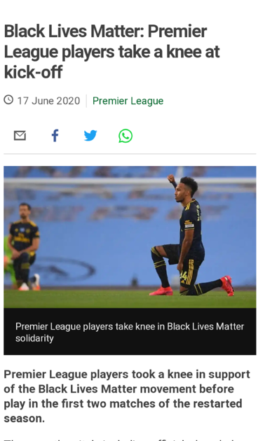
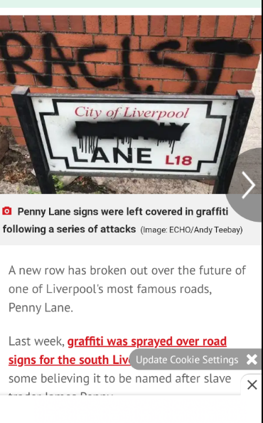
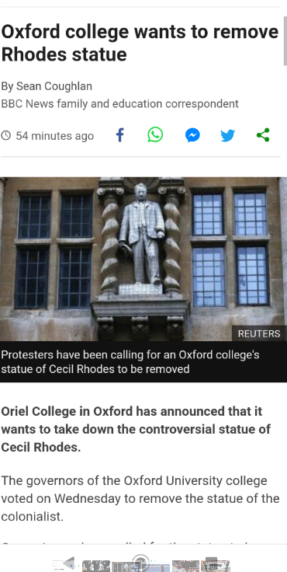
Most people agree that people should be treated equally…how to get the change to make that happen is more controversial…we are free to express our opinions in this country (individual liberty)…within the rule of law

Slide 5

Prayer
Dear Lord
Thank you for people brave enough to make change happen
Thank you that they acted to make things fairer
Help me to act in my life to be fair to those around me and to do something when I see unfairness
Thank you that I live in a country where we are free to make a difference to try and get things to be fair
Amen

