Slide 1
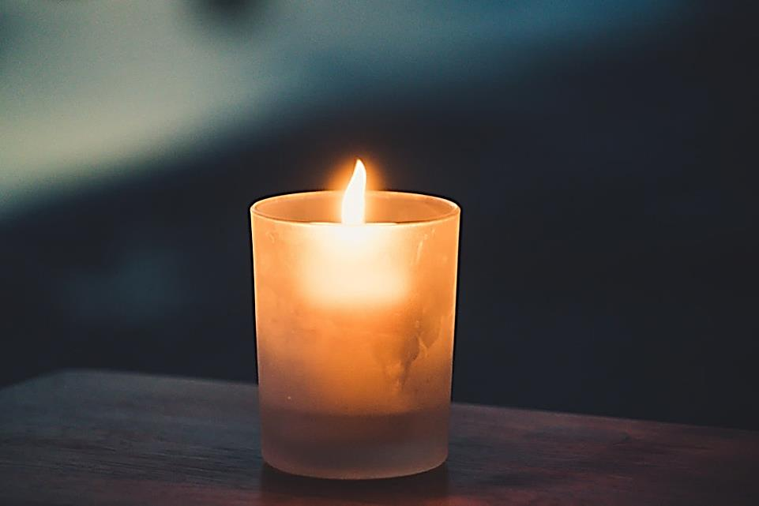

Welcome to worship
Gabriel

Slide 2

The Lord is here
His Spirit is with us
Sasha

Slide 3
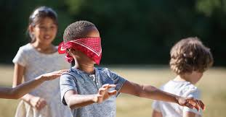
Game-guess the object!
Imagine what it would
be like to be blind?
Taliyah

Slide 4
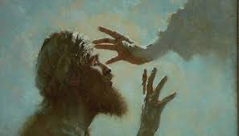

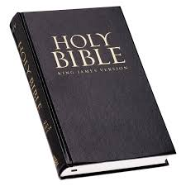
A window– looking at the world in new ways. Learning about situations.
Robert

Slide 5
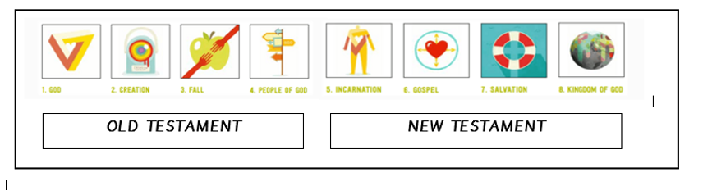
A window– looking at the world in new ways. Learning about situations.
https://www.youtube.com/watch?v=QBx_Fuuai5c
Robert

Slide 6

A mirror– looking inside me– how do I feel about it? What does it mean for me?
Lain
How do you think Bartimaeus felt about being unable to see?
Gabriel
How would you feel if you were unable to see?
How did Bartimaeus feel when he knew Jesus was coming?
Sasha
How did Bartimaeus feel when Jesus healed him?
Taliyah

Slide 7
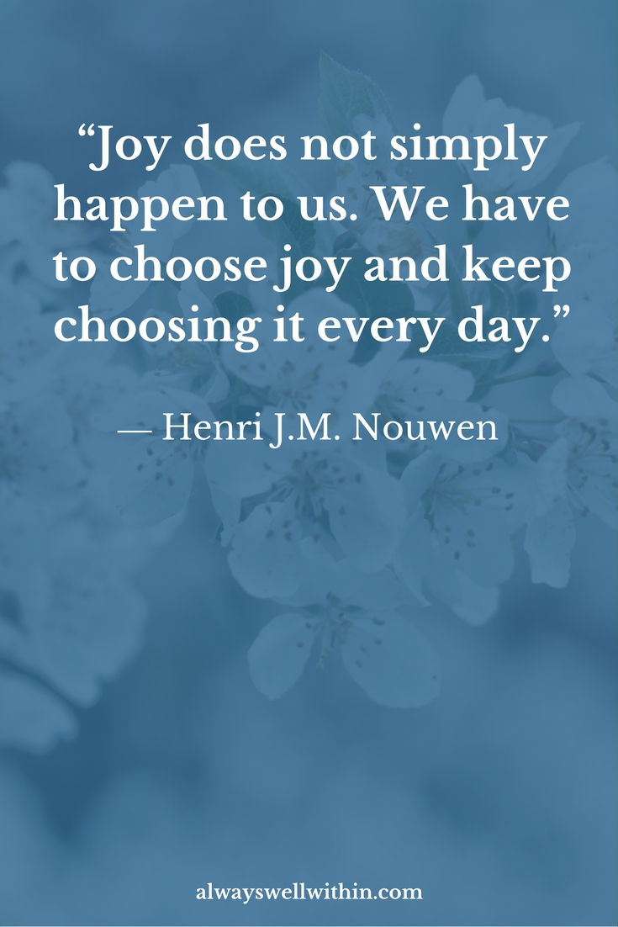
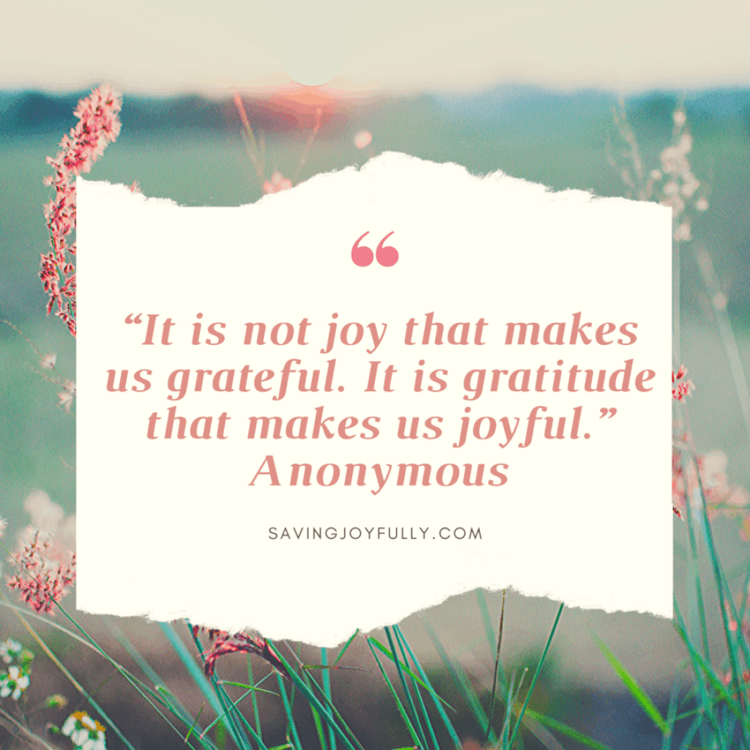
Lain
Robert

Slide 8

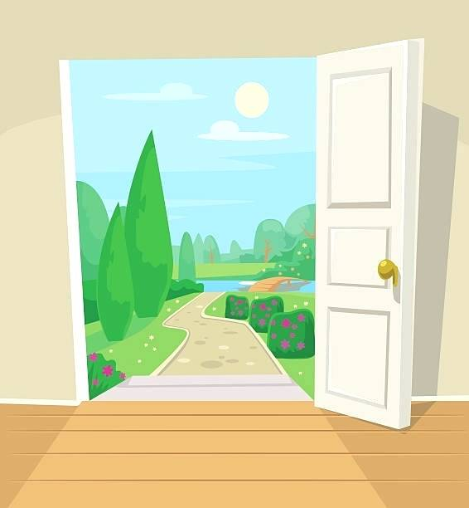
A door- travelling on with ideas of how I can make a difference.
We should be kind to everyone.
Gabriel
We should be thankful and show Joy when people give us things or do special things for us .
Robert
Lain

Slide 9
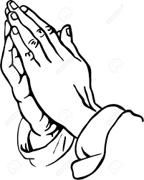
Let us pray…
Sasha & Taliyah

Slide 10
Say this as class altogether
Our Father in heaven,
hallowed be your name,
your kingdom come,
your will be done,
on earth as in heaven.
Give us today our daily bread.
Forgive us our sins
as we forgive those who sin against us.
Lead us not into temptation
but deliver us from evil.
For the kingdom, the power,
and the glory are yours
now and for ever.
Amen.

Slide 11
The Grace
May the grace of the Lord Jesus Christ, and the love of God, and the fellowship of the Holy Spirit be with us all.
Amen
Say this as class altogether

Slide 12


