Slide 1


Welcome to worship
Emily

Slide 2

The Lord is here
His Spirit is with us
Archie

Slide 3
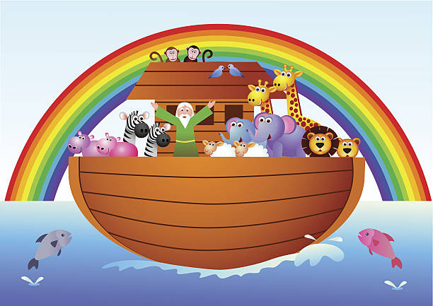

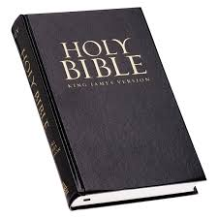
A window– looking at the world in new ways. Learning about situations.
Ruby

Slide 4

Christian value for this half term is…
Ruby

Slide 5
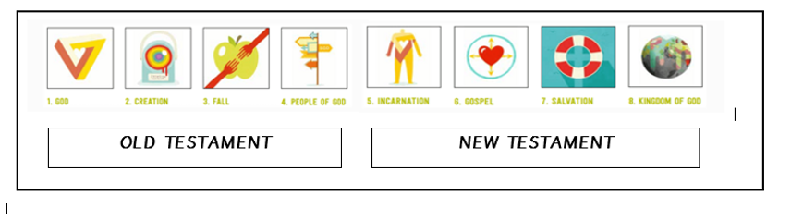
A window– looking at the world in new ways. Learning about situations.
Genesis
Archie

Slide 6
Let’s learn about the story…

Slide 7

A mirror– looking inside me– how do I feel about it? What does it mean for me?
What can we learn from The Bible story?
What Christian values did Noah show?
How does this story link to a value of ‘Hope’?
Ruby and Ophelia

Slide 8

A window– looking at the world in new ways. Learning about situations.
Remember lockdown?
Emily

Slide 9
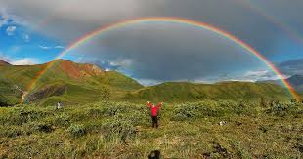

A door- travelling on with ideas of how I can make a difference.
God sent the rainbow as a promise that he will always look after us and our world.
It gives us hope when its raining that sunshine is on its way!
Gladys

Slide 10

Let us pray… you need to write a prayer!
Archie

Slide 11

Ruby and Archie

Slide 12
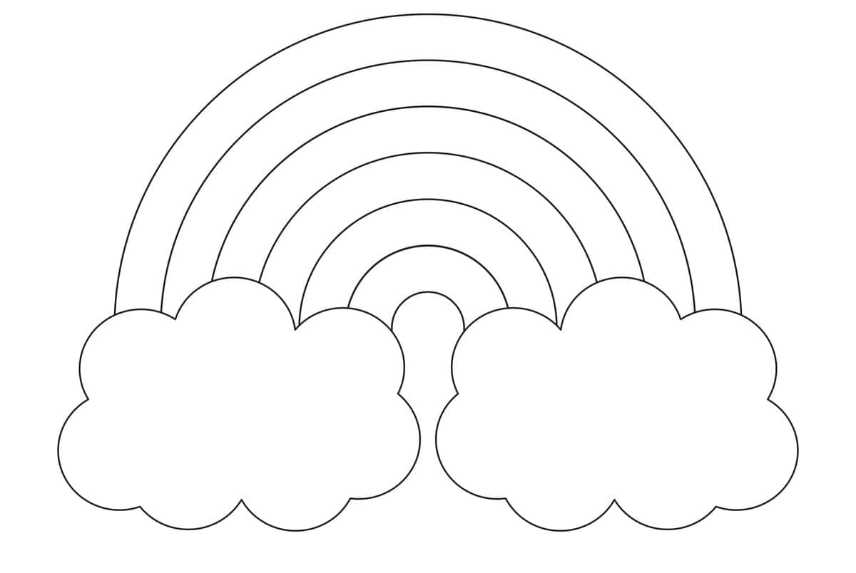
Reflection book
https://www.youtube.com/watch?v=_dQZ2Sb1GPI

Slide 13


Slide 15


Slide 16
Say this as class altogether
Our Father in heaven,
hallowed be your name,
your kingdom come,
your will be done,
on earth as in heaven.
Give us today our daily bread.
Forgive us our sins
as we forgive those who sin against us.
Lead us not into temptation
but deliver us from evil.
For the kingdom, the power,
and the glory are yours
now and for ever.
Amen.

Slide 17
The Grace
May the grace of the Lord Jesus Christ, and the love of God, and the fellowship of the Holy Spirit be with us all.
Amen
Say this as class altogether

Slide 18


Slide 19
Laugh and
point at Archie

Slide 20
‘Rain’ drum lightly
on your knees

Slide 21
Monkey

Slide 22
Horse

Slide 23
Lion

Slide 24
Mouse

Slide 25
Sheep

Slide 26
Dog

