Slide 1

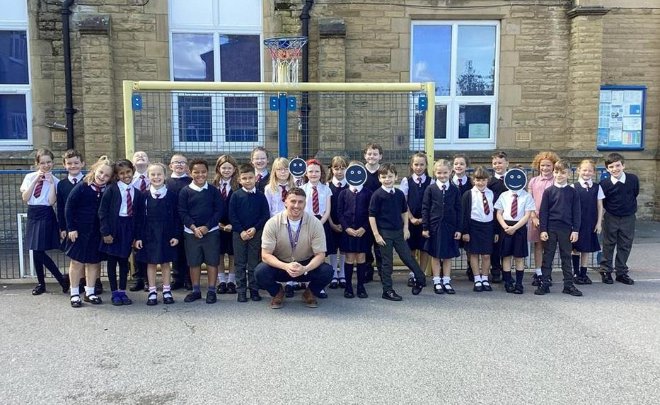

Welcome to
Year 3!

Slide 2


Slide 3

We have codes of conduct for governors, staff and parents and carers and expect all members of our school community to abide by these.
We strive to create a safe, courteous space and we do not tolerate any communication whether in person or email that is not in line with our school values.
Our School Vision:

Slide 4
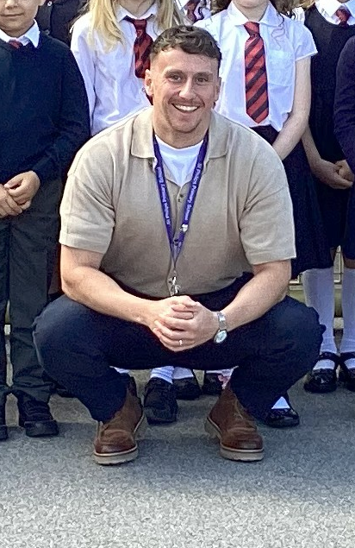
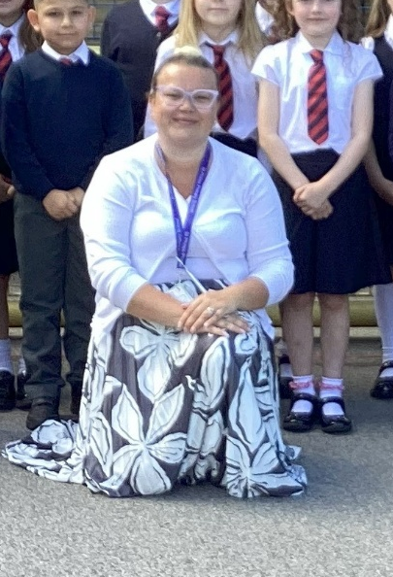
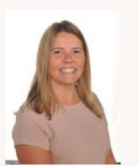
Who will be teaching you?
Mr Scott (me)
Monday - Friday
PPA Wednesday afternoon.
Miss Samuel
Every Wednesday afternoon.
French, Music, PSHE.
Mrs Atkins and Mrs Croxford
Teaching Assistants.
Monday - Friday

Slide 5

School website and how to contact us
We will be updating our school website and class page frequently over the year. Please keep up to date of any announcements. https://www.stphilipssouthport.com/
Contact details are on the homepage so if you are needing to get in contact with school:
head@sps.sefton.school
admin@sps.sefton.school
ScottJ@sps-primary.uk
Mrs Edward says please be respectful of teachers work life balance. Emails should be proportionate and at sensible times. Parent WhatsApp groups that have been set up are not official school communication and have caused difficulty in the past. Parents should be aware of the impact that using these platforms for anything other than basic information sharing can cause. You should be respectful of all members of the school community and should not name children or members of staff in a way that could cause hurt or harm.
Mrs Edward is usually on the path at the start and end of each day if you need a quick word.

Slide 6

Medical
Any medication updates – please let us know of any changes
If your child needs any prescribed medication, a medical form needs to be filled in at the office before we are able to administer it.
For more serious health concerns please book an appointment with Mrs Klaassen who will work in collaboration with and your medical team.
Thank you!

Slide 7


Housekeeping!
Please name all clothing.
PE is on Monday and Friday (afternoon) - no earrings!
Please make sure your child has a water bottle each day.
Healthy snacks can be brought in for Junior morning break time – fruit, vegetable sticks, cereal bars (no sweets or nuts please).

Slide 8
Uniform
Option 1 WINTER UNIFORM
GREY TROUSERS (NO OTHER COLOUR)
WHITE SHIRT with buttons and collar
NAVY LONG SLEEVED JUMPER
SCHOOL TIE
DARK COLOURED SCHOOL SHOES – not trainers
DARK SOCKS
Option 2 WINTER UNIFORM
NAVY SKIRT OR PINAFORE DRESS
WHITE BLOUSE with buttons and collar
NAVY LONG SLEEVED CARDIGAN
SCHOOL TIE
NAVY TIGHTS / NAVY OR WHITE SOCKS
DARK COLOURED SCHOOL SHOES – not trainers
Long hair must be tied back, hair accessories should be minimal and school colours.
Jewellery or make up are not permitted.

Slide 9
Attendance and punctuality
It is crucial for children to arrive on time to school. Children’s activities start at 8:45 which is Times Table rockstar practice for Year 4. If they are late- they are missing learning time.
If your child is being collected at the end of the day, please arrive on time for 3:25pm.
Please do not allow children on the adventure playground before and after the school day. Our gates need to be locked for the safety of our afterschool club so we require families to leave the playground fairly quickly.
Please note that no term time holidays will be authorised and fines will be in place.

Slide 10


Slide 11
Attendance…
First Response
If your child is absent you must contact the school office by telephone or email before 8.15 and definitely by 8.30 to report your child's absence giving clear details of the reason for absence. Failure to do so means that our First Response kicks in and if we cannot get hold of you and we are unable to make contact with you via your emergency contact details, it might be necessary for a senior leader to come to your house!
This is part of our safeguarding response to ensure everyone is safe and well. As you can imagine, a home visit takes up a lot of time and it is usually the case that families have forgotten to call us.
TERM TIME HOLIDAYS ARE NEVER AUTHORISED. Families may be eligible for a fine from the Local Authority.

Slide 12
Cashless school payments!
https://schoolgateway.co.uk/help/
All payments are made electronically on our payment and booking system.

Slide 13
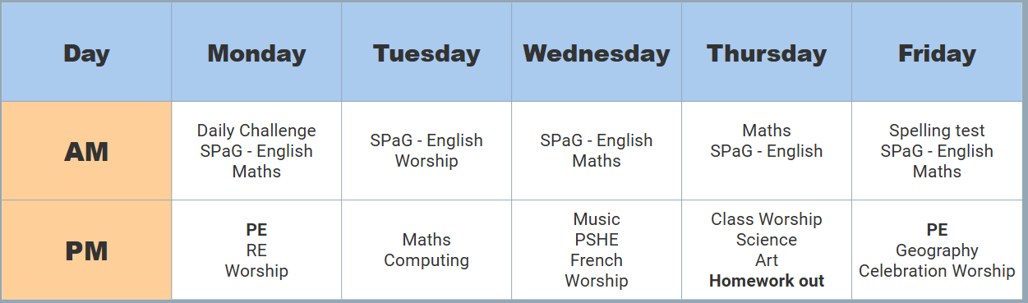
Class Timetable
Homework!
Spellings given out Thursday/ Friday.
Tested following Friday.
  I will make sure the children have a week to practice!

Slide 14
Curriculum
Curriculum map/newsletter is on our website.

Slide 15
White Rose Maths
Place value; partitioning of groups up to 1,000…
Adaptations made and manipulatives (base 10 etc) used where necessary.
Free workbooks!?

Slide 16
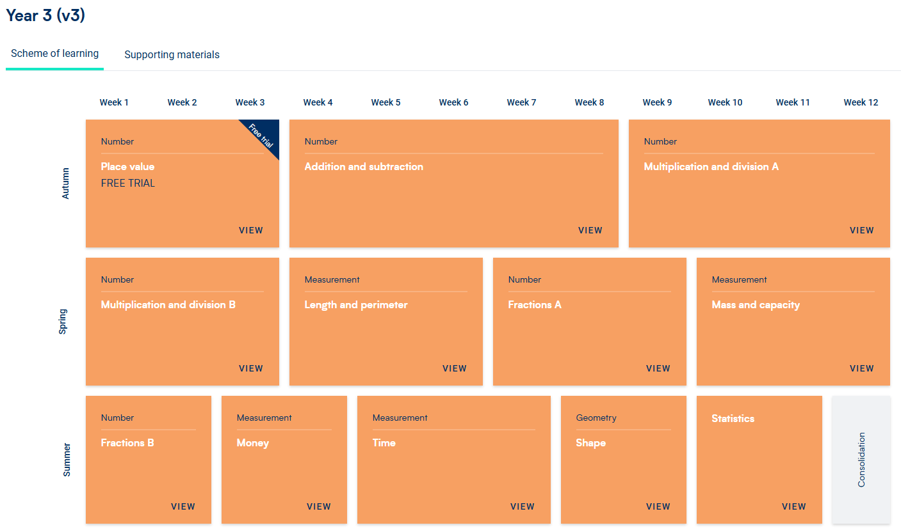
White Rose Maths

Slide 17
Subject ladders
We will have English ladders for you to download on our website. Please read them and refer to them throughout the year as they show the expectations for your child in Year 3.

Slide 18
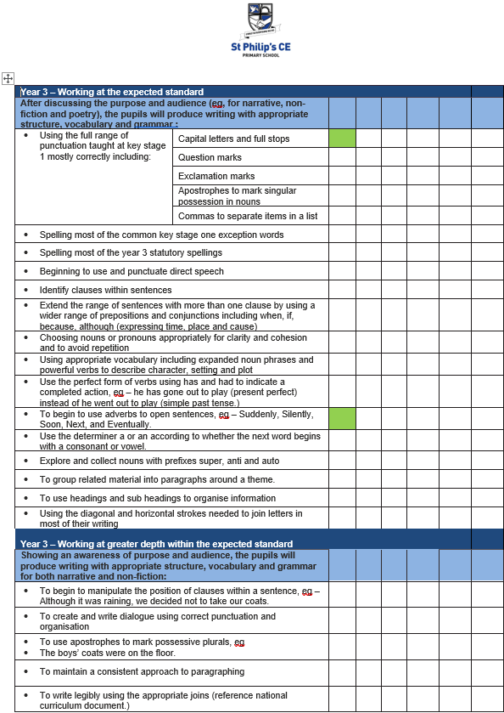

Slide 19
Assessment
Children’s attainment is assessed in relation to year group objectives, this could be…
Below, Working towards, Expected , Greater Depth
At the end of each term we will record your child’s attainment on Insight (our data system) using both teacher and test information. This system allows us to analyse your child’s progress and attainment. We will work closely with you if we feel your child is not making the progress that we would expect.
In February and at the end of the Summer term we will use NFER tests in Years 2- 5 to track progress in Maths, Reading and SPAG. We will share your child’s outcomes with you and will give advice around things that you can do at home to help. We will talk to you about the things that we are working on in school.
There will be:
2 parents evenings
An end of year report
An open door policy to discuss any concerns in relation to learning.

Slide 20
Homework
Homework will be given out on a Friday.
Spelling test on a Friday.
Homework to be given in by the following Thursday. Please let us know if any homework is too difficult so we can give a little extra help at school. Homework club is invite only but can be offered to those who are struggling to complete at home (Juniors only)- please speak to the class teacher.
Please help your child to learn their spellings and tables each week.

Slide 21

Spellings
We have a huge emphasis on spellings. Children need to be practising their spellings daily and not for a spelling test.
In Year 3, children need to be able to spell words from the Year 2 and 3 curriculum list . They must show they can spell these words correctly in their writing.
Spelling sheet for this half term has been sent home already and is on the class web page.
We will be using spelling badges to reward spelling test scores- we have a new system in place this year.
IDL- we may also use IDL to support your child's spelling- you will be given a password to access this at home.

Slide 22


Slide 23

Times tables
As you will be aware, we have the Bronze, Silver and Gold badges in school.
Children should practise their times tables. Even if they think they know them- by Year 5 they must be quick to recall them.
There are also various sites to use:
https://www.youtube.com/watch?v=4BLZKOjNKfk

Slide 24
Reading at home:
Reading Journals
Children will be expected to write their own reading comments in their Reading log book each day.

Slide 25
ST PHILIP’S CE PRIMARY SUPPORT TRIANGLE
SENDCO - Mrs Klaassen
SEN Support
Targeted Support
Enhanced Quality First,
Quality First – Universal Offer for all
High Needs Funding
EHCP’s
Specialist

Slide 26



Behaviour and
Good To Be Green
High expectations
Manners
Greetings
Can do attitudes
Ready, Respectful, Responsible

Slide 27
Behaviour and
Good To Be Green
Half termly- ‘Good to be Green’ certificates
Red cards- letter home to parents on a Friday
Yellow cards- miss some of break time.

Slide 28
St Philip’s Standards
Be Ready
Be Respectful
Be Responsible

Slide 29

Fantastic Walking
Walking properly makes you feel great.
We are going to be doing fantastic walking, All THE TIME!
Head up
Arms by your sides
Slow pace.

Slide 30
School Trips…
Interfaith week!
Liverpool World Museum trip!
Formby beach!
To be confirmed…
We require payment of a voluntary parental contribution for all school trips. Sadly due to budget constraints if we do not receive enough payments the trip may not go ahead. Mrs Edward is always available to discuss any concerns in relation to payment of anything requested. We will never leave a child out.

Slide 31

Volunteers are very welcome!
Safer Recruitment Checks will be completed.

Slide 32

Parent’s meeting:
Weds 22nd October
2pm onwards

Slide 33

Please check your filters.
Be aware of the issues around Whatsapp. School expects parents to manage and monitor children's use and we will not investigate upset linked to home use of whatsapp or other platforms that parents should be monitoring.
Mobile phones are not allowed in school. Phones for children who are walking home in Y5 and Y6 are handed in each day and kept in the school office. The phone is returned at the end of the day.

Slide 34

Check website for information:
http://www.stphilipssouthport.com/
and Twitter!

Slide 35

Any questions?

