Slide 1

ELS Phonics and Reading Workshop
Miss Houghton

Slide 2

What is phonics?
Method of teaching reading
Focuses on graphemes ( letters ) and phonemes ( sounds)
We need to learn our sounds before we can read
First sounds – s, a, t, p , I , n
All our phonics sounds need practicing daily
Phonics is a huge part of our learning in reception.

Slide 3
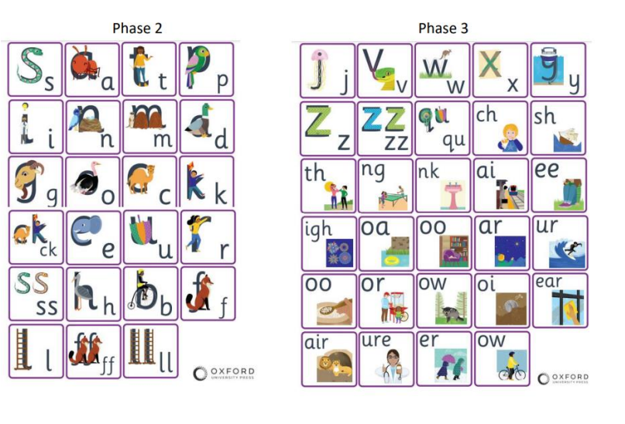
ELS Phonics
https://home.oxfordowl.co.uk/reading/reading-schemes-oxford-levels/essential-letters-and-sounds/

Slide 4

Pronunciation of sounds can be tricky
There are some super videos, explaining how to pronounce the sounds.
https://youtu.be/nBFnAcXHOUQ
https://youtu.be/gDInVjBUGC0
https://youtu.be/8BwWD2ZlvBY

Slide 5
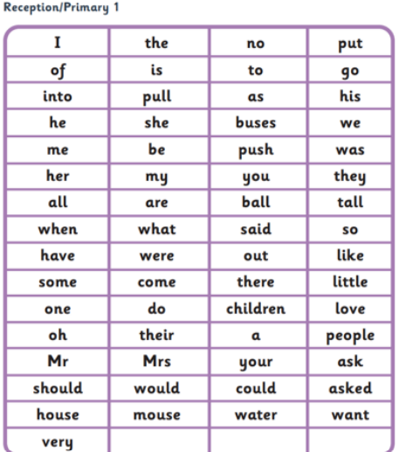
Harder to read and spell words.
Harder to read and spell words, also known as high frequency words are a selection of words your child needs to know by the end of Reception.
These words CANNOT be segmented and blended.
Infront of you is booklet with all the words your child will learn, please practice these at home.

Slide 6
What can you do at home to support your child with phonics?
Practice the sounds daily
Have the letter chart up somewhere, on the fridge or where your child will spend lots of time
If your out and about, what sounds can you see?
Make it fun!

Slide 7

Once your child knows the sounds, they can start to read.
We use 'robot arms' and ' blending hands' to practice our segmenting and blending.
Segmenting is breaking a word up by looking at each sound.
Blending is putting all the sounds together to make a word.
Please encourage the use of both 'robot arms' and 'blending hands' when reading.

Slide 8
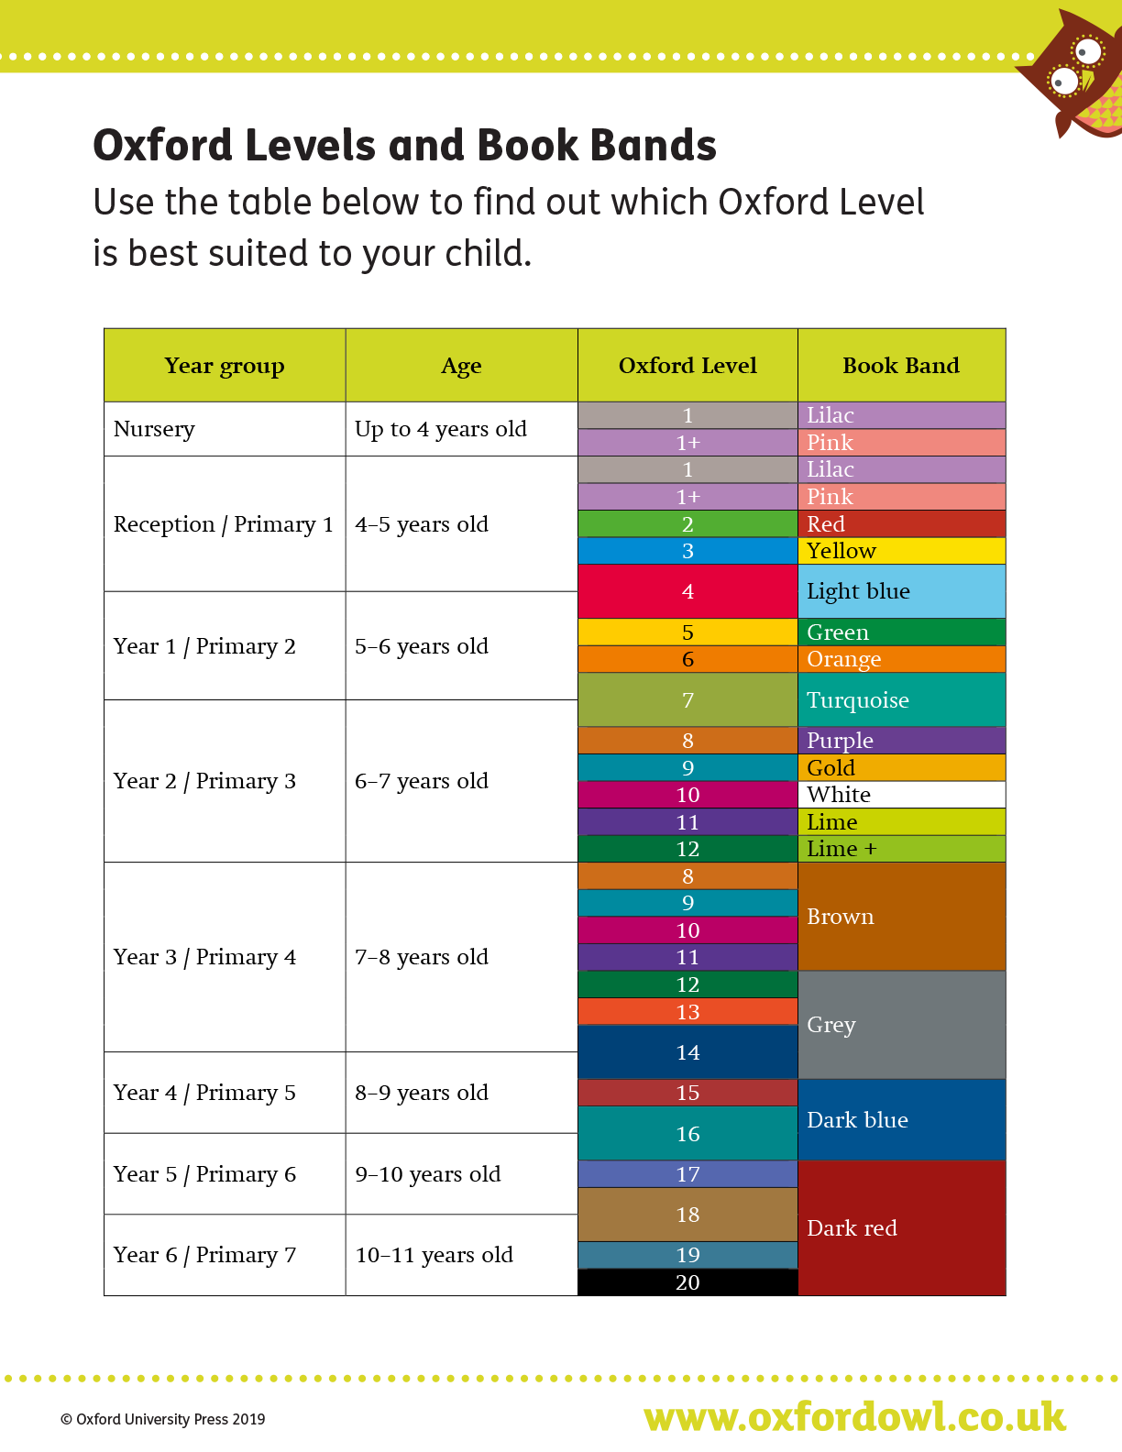
Reading at St Philips
Your child has a library book, please do look at this with them every week. We DO NOT expect your child to read this book. This is an opportunity for communication and to explore the vocabulary.
Children love books !
Bed time stories are so important for your child.
Add some animation to story time

Slide 9
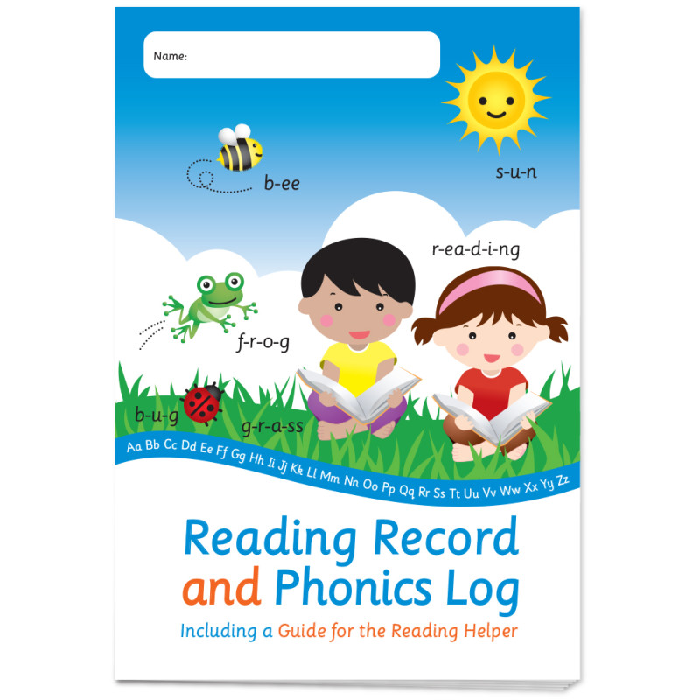
Reading records and reading scheme books
Your child will come home with a reading record , please fill this out correctly. See the example in front of you.
We will hear your child read once a week on their reading day.
Please ensure your child's book is in their bag on the correct day.
We only give reading scheme books out when your child is reading and they know the sounds s, a ,t ,p.
They may be given a reading scheme picture book initially. Please use this as an opportunity for lots of talk and pointing to the pictures.

Slide 10
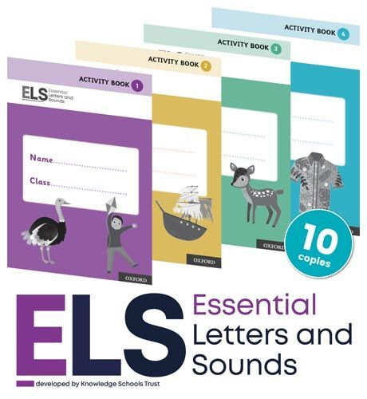
Phonics and Writing
Phonics , reading and writing all come hand in hand with one another.
If your child knows their sounds, they are going to be able to segment a word which means they can apply this to their early writing.
Writing is also an important skill we begin to learn in reception, so it is crucial they have the fundentmals in place first.

Slide 11
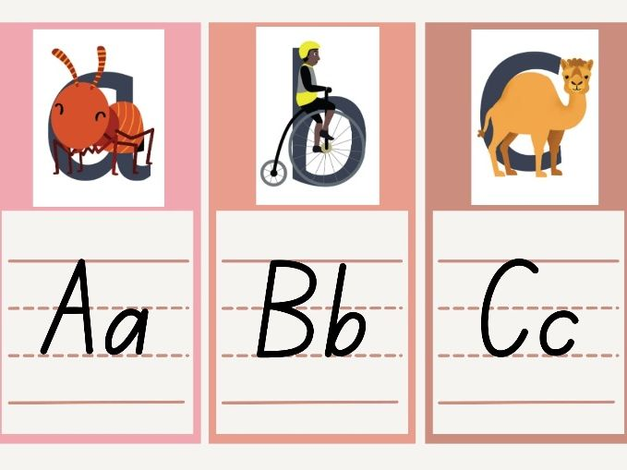
Writing – ELS phonics
As part of our daily phonics sessions, we also practice writing the sounds. This helps us to develop our formation.
https://youtu.be/UtgbeltdOWs

Slide 12

To take away from this session
Ensure your child knows the phonics sounds we learn weekly, these will always be in our homework books.
Practice 'robot arms' and ' blending hands' daily, this will support your child to read and write
Use the free booklets to support your child at home.
Stick the letter chart up on your fridge or somewhere your child can see it.
Practice our weekly harder to read and spell words, these will be on homework.
Make reading fun by adding animation.
Use the vidoes on this PowerPoint or on the website to help.

Slide 13

Thank you
Any questions?
Houghtonp@sps.sefton.school
Please email me if you need further support

