Slide 1


Welcome to Year 1!

Slide 2


Slide 3

We have codes of conduct for Governors, staff and parents and expect all members of our school community to abide by these.
Our School Vision:

Slide 4
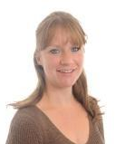
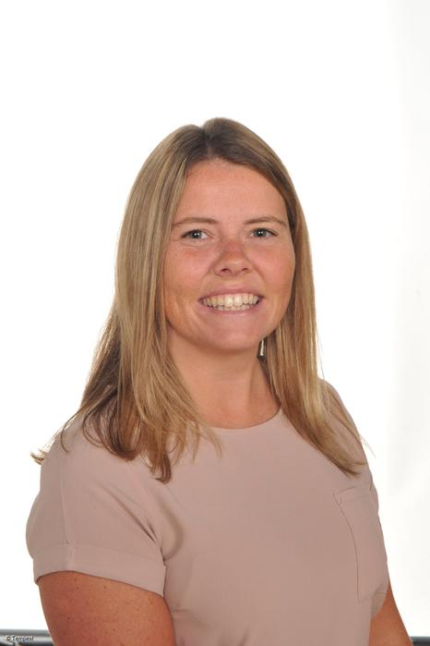
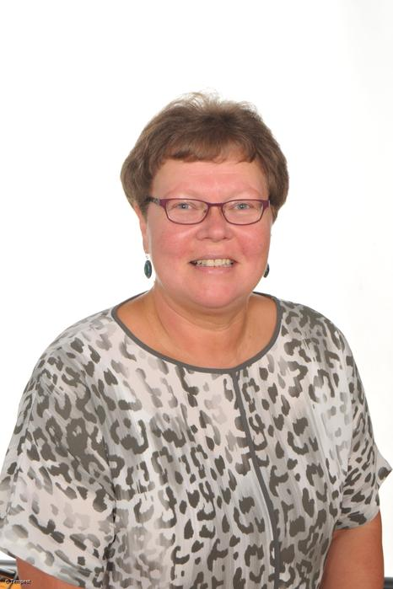
Year 1 staff
Mrs Parsons – Tues, Wed and Thurs
Miss Samuel – Mon and Fri
Mrs Wareing – Teaching assistant
Mrs Edward – Teaching assistant

Slide 5
School website and how to contact us
We will be using and updating our school website and class page frequently over the year. Please keep up to date of any announcements. https://www.stphilipssouthport.com/
Contact details are on the homepage so if you are needing to get in contact with school-
head@sps.sefton.school
admin@sps.sefton.school
parsonsh@sps.sefton.school
samuels@sps.sefton.school
Mrs Edward says please be respectful of teachers work life balance. Emails should be proportionate and at sensible times.
Parent WhatsApp use should be respectful of all members of the school community.
Staff are not able to have lengthy conversations at the start of the school day and any more than a brief chat at the end of the day needs to be a planned appointment.
Mrs Edward is usually on the path at the start and end of each day if you need a quick word.

Slide 6

Medical
Any medication updates – please let us know of any changes
If your child needs any prescribed medication, a medical form needs to be filled in at the office before we are able to administer it.
Thank you

Slide 7


Housekeeping!
Please name all clothing
PE is on Tuesday and Thursday- no earrings
Please make sure your child has a water bottle each day.
Please bring in an apron/old oversized shirt for children to keep in school and use during art lessons.
Please see the office if you would like to pay for milk.
Infants receive a piece of fruit each day.

Slide 8
Uniform
BOYS WINTER UNIFORM
GREY TROUSERS (NO OTHER COLOUR)
WHITE SHIRT
NAVY LONG SLEEVED JUMPER
SCHOOL TIE
DARK COLOURED SCHOOL SHOES – not trainers
DARK SOCKS
GIRLS WINTER UNIFORM
NAVY SKIRT OR PINAFORE DRESS
WHITE BLOUSE
NAVY LONG SLEEVED CARDIGAN
SCHOOL TIE
NAVY TIGHTS / NAVY OR WHITE SOCKS
DARK COLOURED SCHOOL SHOES – not trainers
Long hair must be tied back, hair accessories should be minimal and school colours.
Jewellery is not permitted.

Slide 9
Attendance and punctuality
It is crucial for children to arrive on time to school. Children’s activities start at 8:45 which is a simple writing activity. If they are late- they are missing learning time.
If your child is being collected at the end of the day, please arrive on time for 3:25pm.
Please do not allow children on the adventure playground before and after the school day.
Please note that no term time holidays will be authorised and fines will be in place.

Slide 10


Slide 11
Attendance…
First Response
If your child is absent you must contact the school office by telephone or email to report your child's absence giving clear details of the reason for absence. Failure to do so means that our First Response kicks in and if we cannot get hold of you and we are unable to make contact with you via your emergency contact details, it might be necessary for a senior leader to come to your house!
This is part of our safeguarding response to ensure everyone is safe and well. As you can imagine, a home visit takes up a lot of time and it is usually the case that families have forgotten to call us.
TERM TIME HOLIDAYS ARE NEVER AUTHORISED. Families may be eligible for a fine from the Local Authority.

Slide 12
Cashless school payments
https://schoolgateway.co.uk/help/
All payments are made electronically on our payment and booking system.

Slide 13
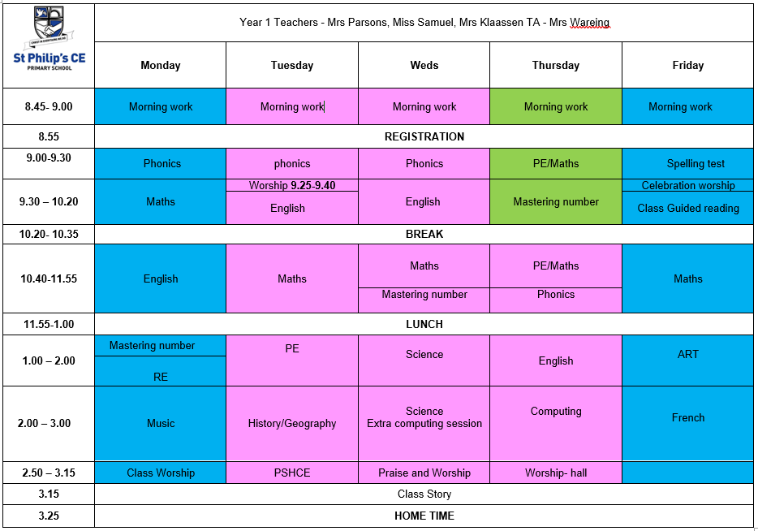
Class Timetable

Slide 14
Curriculum
Curriculum map/newsletter is on our website.

Slide 15
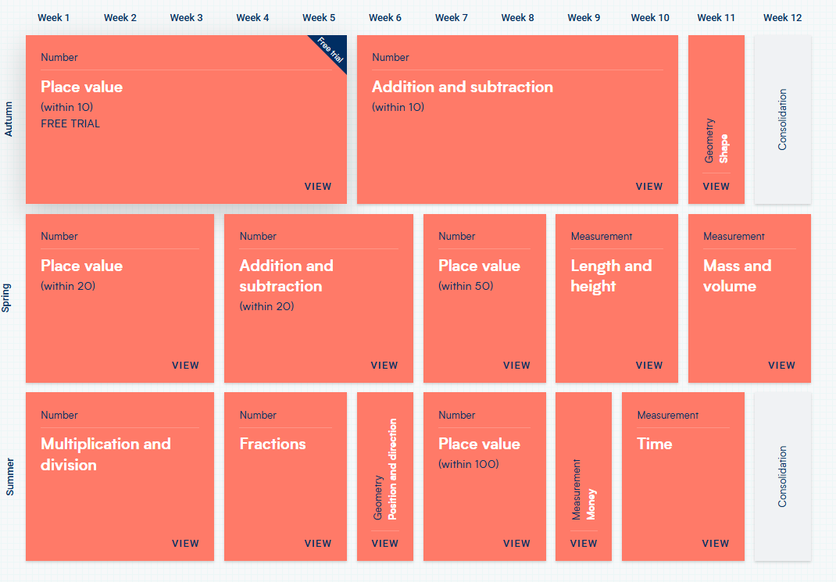
White Rose resources – Maths mastery

Slide 16
Subject ladders
We have English ladders for you to download on our website. Please read them and refer to them throughout the year as they show the expectations for your child in Year 1

Slide 17
Assessment
Children’s attainment is assessed in relation to year group objectives, this could be…
Below, Working towards, Expected , Greater Depth
At the end of each term we will record your child’s attainment on Insight (our data system) using both teacher and test information. This system allows us to analyse your child’s progress and attainment. We will work closely with you if we feel your child is not making the progress that we would expect.
In February and at the end of the Summer term we will use NFER tests in Years 2- 5 to track progress in Maths, Reading and SPAG. We will share your child’s outcomes with you and will give advice around things that you can do at home to help. We will talk to you about the things that we are working on in school.
There will be:
2 parents evenings
An end of year report
An open door policy to discuss any concerns in relation to learning.

Slide 18
Homework
Homework will be given out on a Thursday and Spellings on a Friday.
Spelling test on the following Friday.
Homework to be given in by Wednesday. Please let us know if any homework is too difficult so we can give a little extra help at school.
Please help your child to learn their spellings.
* Please try to read with your child every day.
We would be grateful if you could write in your children’s reading record books every time you read at home.

Slide 19

Spellings
We have a huge emphasis on spellings. Children need to be practising their spellings daily and not for a spelling test.
In Year 2, children need to be able to spell words from the Year 1 and 2 curriculum list. They must show they can spell these words correctly in their writing.
Spellings were sent home last leek and are on the class web page.
We will be using spelling badges to reward spelling test scores.

Slide 20


Slide 21
Reading
Your children will continue reading through the colour bands
Please try and read at home every night.
In school the children will be involved in
Shared reading
1:1 reading with an adult
Reading across the curriculum.
Story time at the end of the day.

Slide 22
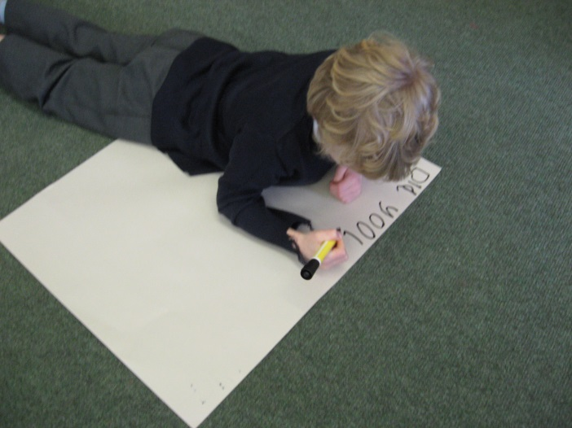
Writing
Shared and Guided writing tasks.
Independent tasks.
Lots of speaking and listening activities to help their writing.

Slide 23

Maths
Practical activities.
Recording in Maths books.
Use of different practical resources eg. Numicon, counters, cubes, base ten
10/15 minutes per day developing number fluency using rekenreks.

Slide 24

Essential Letters and Sounds (ELS) is our chosen DfE validated phonics programme.
Children will experience the joy of language whilst rapidly acquiring the phonics skills they need to become fluent, independent readers and writers.
How do we teach phonics?
We use a simple, consistent approach to teaching phonics
We have mnemonics and rhymes to support learning and recall
We teach phonics every single day from the first days of Reception
Phonics throughout the day to review new sounds and graphemes taught
Lots of opportunities for oral blending - /c/ /oa/ /t/
We teach the ‘code’ for reading, alongside teaching vocabulary

Slide 25


ELS Progression

Slide 26

ELS Progression

Slide 27
ST PHILIP’S CE PRIMARY SUPPORT TRIANGLE
SENDCO - Mrs Klaassen
SEN Support
Targeted Support
Enhanced Quality First
Quality First – Universal Offer for all
High Needs Funding
EHCP’s
Specialist

Slide 28



Behaviour and
Good To Be Green
Very high expectations
Manners
Greetings
Can do attitudes

Slide 29
Behaviour and
Good To Be Green
Half termly- ‘Good to be Green’ certificates
Red cards- letter home to parents on a Friday
Yellow cards- miss some of break time.

Slide 30
St Philip’s Standards
Be Ready
Be Respectful
Be Responsible
Fantastic Walking

Slide 31

Fantastic Walking
Walking properly makes you feel great.
We are going to be doing fantastic walking, All THE TIME!
Head up
Arms by your sides
Slow pace.

Slide 32

Parent’s meeting:
Weds ^{22nd}
October
2pm onwards

Slide 33

Please check your filters

Slide 34


Slide 35


User friendly guides on all areas of ICT, gaming, social media and top tips for online safety. Check all age recommendations on games and Apps.
To sign up please download the app, chose parent as your role and make use of the advice and support offered plus the online training support.

Slide 36

Volunteers are very welcome!
Safer Recruitment Checks will be completed.

Slide 37

Check website for information:
http://www.stphilipssouthport.com/
and Twitter!

Slide 38

Any questions?

