Slide 1
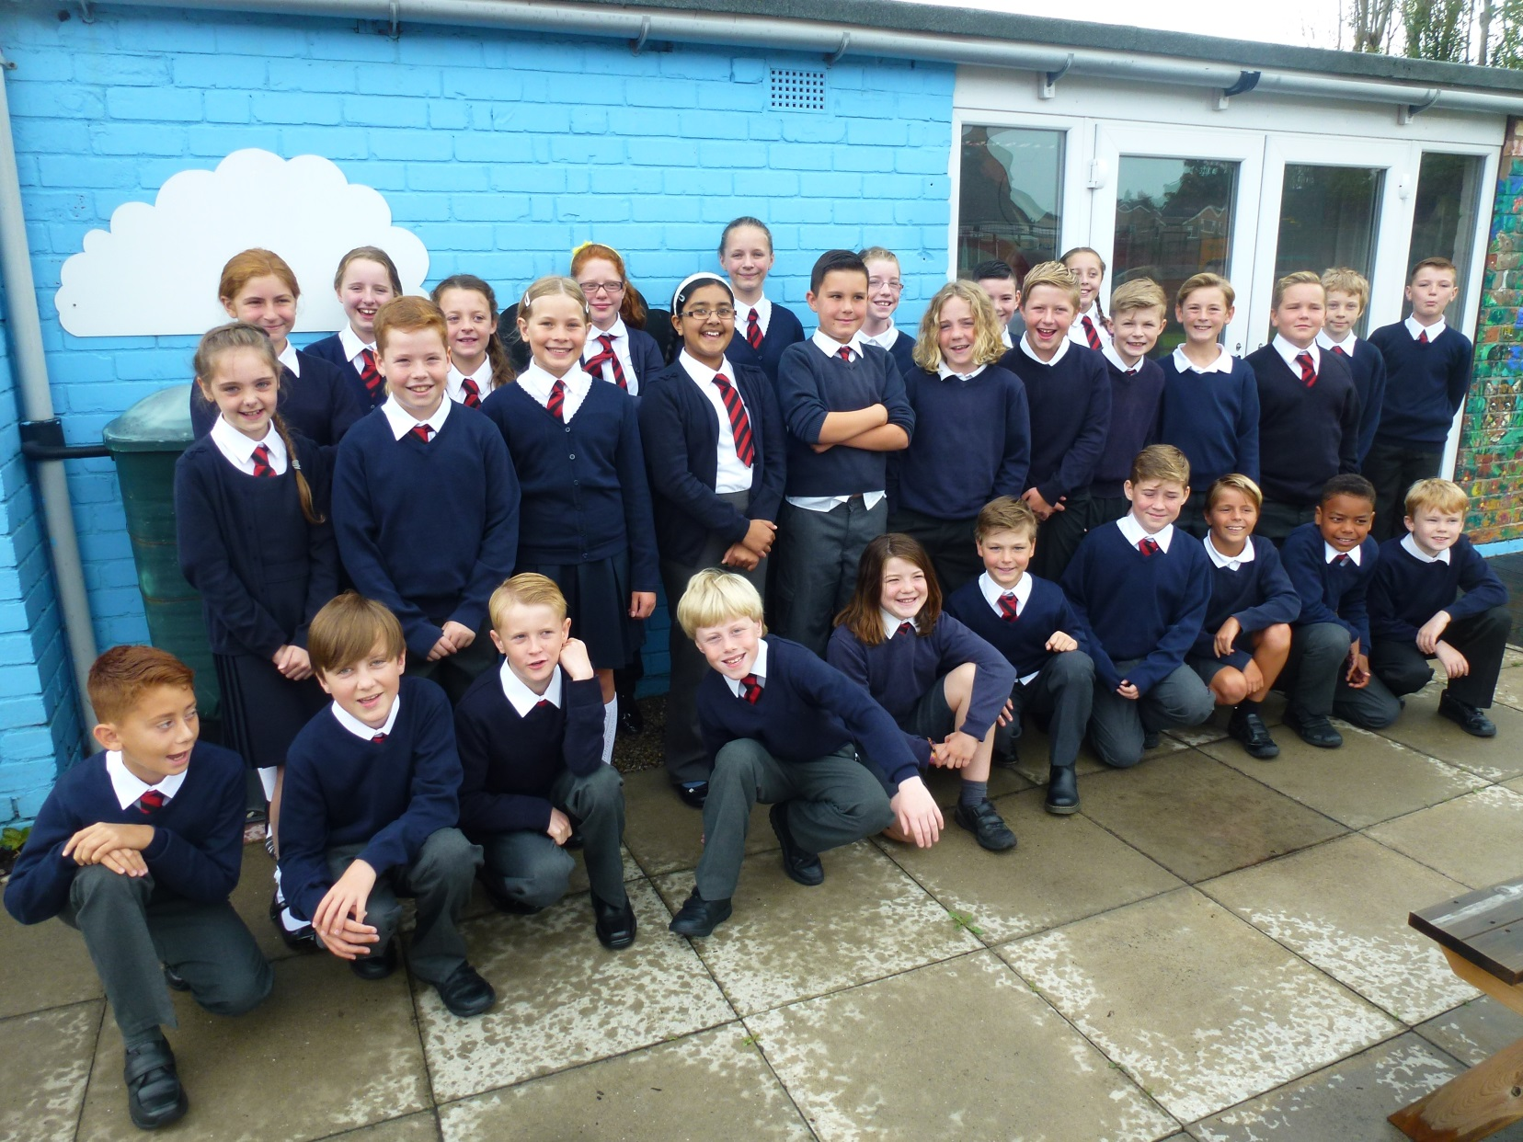
Welcome to year 6

Slide 2
Housekeeping!
Please name all clothing
Any medication updates
PE is Monday and Friday – please have kit in school both days
Thank you

Slide 3
Homework
Homework will be given out on a Tuesday.
Spelling test on Monday.
Homework to be given in by Monday.

Slide 4
Curriculum
Curriculum map/newsletter is on website.

Slide 5
If you would like your children to walk to or from school on their own, please could you send a letter into school giving your permission.
Thanks for your co-operation.

Slide 6
Children’s greatest fear regarding year 6 was
SATS
We’ve tried to reassure them that they’ll be ready for them when they do them.
It’s never as bad as they think it will be – we make them feel special during SATS week.
Some children enjoy the challenge!
Hopefully they’ll be happy with their
results.

Slide 7
Robin Wood is way up there on their list of things they’re looking forward to.
Details and forms to fill in will be sent out shortly.
Date of trip - July 4th – 6th
Payments can be made at the office to Mrs Dean – she is happy for you to pay weekly or monthly so as to spread the cost.

Slide 8
Your children have all, without exception, taken to their year 6 responsibilities extremely well.
They all have jobs around the school which will be changed termly so as to give as many children as possible the opportunity to try out different things.

Slide 9
We are frequently asked by the children when they will get their buddies. There is a huge amount of buddy excitement in the class!!!
The reception children have started full days in school today. Having lunch here is obviously all new to them and so the year 6 children are helping them to learn the routines. This will be of great assistance to the staff and will be a fabulous opportunity for reception and year 6 to get to know each other.

Slide 10
Thank you for coming.
We’re here most evenings if there is anything you’d like to talk about.

