Slide 1
Welcome to year 2

Slide 2
Year 2 staff
Mrs Bond
Mrs Edwards

Slide 3
Routines
Doors open at 8.45am.
Register at 8.55am.
Finish at 3.20pm.
If your child is absent from school please send a letter to the class teacher
It’s really important to be on time (whenever possible) as morning activities start as soon as we arrive at school.

Slide 4

Housekeeping!
Please name all uniform –
Boys’ winter uniform Girls’ winter uniform
Grey trousers Navy skirt or pinafore
White shirt White blouse
Navy long sleeved jumper Navy long sleeved cardigan
School tie School tie
Please make sure your child has a water bottle each day
Tuesdays and Thursdays are PE days. Please make sure kits are in school. PE kit – blue shorts and white t-shirt (eg on website) Children are allowed to wear navy blue tracksuit bottoms for outside PE during the winter.
We are struggling for space to store bags. Please could the children bring school book bags.

Slide 5
Class Timetable
 | 9.00 | 9.15 – 10.20 |  |  | 10.40 – 11.55 |  | 1.00 – 3.20
Mon | P h o n i c s | English |  | B r e a k | Key skills | L u n c h | G R | Science |  |  | W o r s h i p | Science
 |  |  |  |  | Maths
Tues |  | English |  |  | Maths |  | G R | Topic |  |  | W o r s h i p | PE
Wed |  | English |  |  | Maths |  | W o r s h i p | Topic | ICT SPaG / Handwriting Guided Reading
Thurs |  | English |  |  | Maths |  | G R | PE |  | W o r s h i p |  | Music
Fri | S p | Maths key skills | PSHE |  | Comprehension Mrs Afford |  | Art French Golden time Mrs Afford / Mrs Waring

Slide 6

Medical
Any medication updates – please let us know of any changes
Please feel free to check your child’s inhaler before leaving to make sure it’s still in date.
We have been advised that children should use a spacer when taking their inhaler - if possible please send one into school.
If your child needs any prescribed medication, a medical form needs to be filled in at the office before we are able to administer it.
Thank you

Slide 7
Homework
Homework will be given out on a Friday to be returned by Wednesday.
I would be really grateful if you could return homework on time so I have chance to mark it before Friday – Thank you.
Spellings will be tested each Friday.
Weekly spelling will be put on the website.
Please try to read with your child every day.
Please let us know if any homework is too difficult so we can give a little extra help at school.
Thank you

Slide 8
Reading
Your children will continue reading through the colour bands
Please try and read at home every night.
In school the children will be involved in
Shared reading.
Guided reading.
Reading across the curriculum.
Story time at the end of the day.

Slide 9
Curriculum
Curriculum map and autumn newsletter is on the website.
Website
Please keep checking the website dates and news.
We will try to keep the website updated with lots of photos of your children at work and play.
Trips
You will also find information about after school clubs on the website.

Slide 10
Assessment
Assessment takes place at the end of each half term.
We track progress using Target Tracker.
The children work to meet all the objectives on the ladders you’ve been given.
Your children are in Year 2 so we are in Band 2
Each band has been split into six sections
Beginning and Beginning Plus ( B and B+)
Working Within and Working within Plus – Up to 70% of the statements are confidently achieved (W and W+)
Secure and Secure Plus (S and S+)
We aim for most children to make 6 bands of progress each year
If you’d like more information, here is a full explanation of the assessment process on the website.
To support our Teacher assessment, at the end of KS1, we use the Teacher assessment framework.
Please make sure you have taken:
English and maths ladders
Writing assessment sheet
Spelling lists

Slide 11

SATS
All Year 2 children sit SATS tests in Maths, Reading and SPAG (spelling, punctuation and grammar) in May.
There is no writing test but writing is teacher assessed.
More information will be given nearer the time but please be reassured that the testing process will be as stress free as possible.

Slide 12
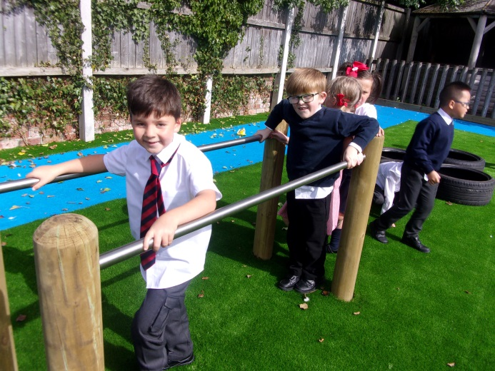
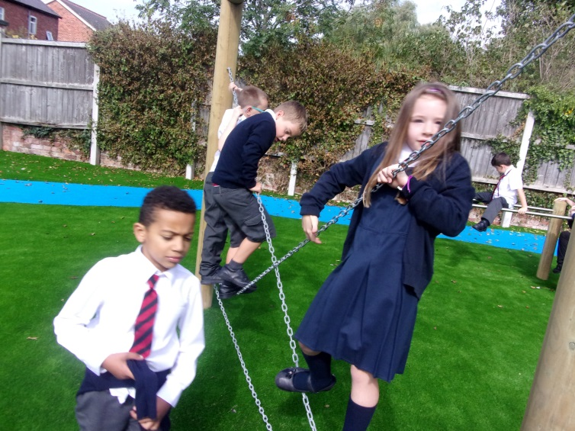
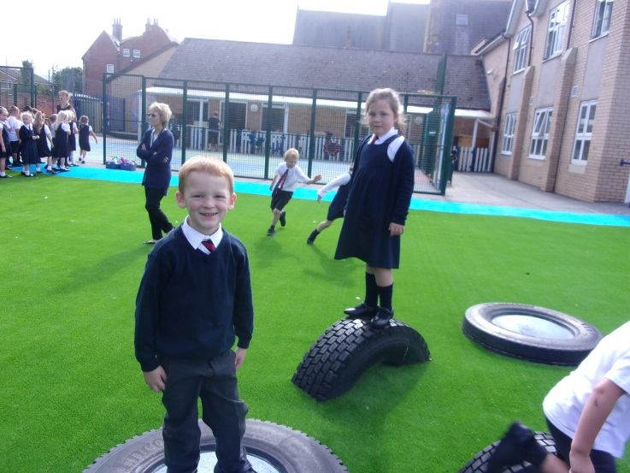
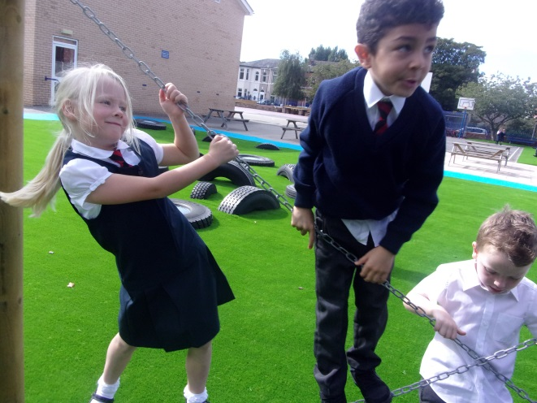
New play area
The children have been loving the new play area.
Please stay off the new play area before and after school as we are trying to keep it special for the children

Slide 13
Thank you for coming.
We’re here most evenings if there is anything you’d like to talk about.
Also - parent’s evening this term is on Monday October 15th.

