Slide 1



Slide 2
School website
We will be using and updating our school website and class page frequently over the year. Please keep up to date of any announcements.
Contact details are on the homepage so if you are needing to get in contact with school- this can now be done through using our website instead of calling the office.

Slide 3

Medical
Any medication updates – please let us know of any changes
Please feel free to check your child’s inhaler before leaving to make sure it’s still in date.
We have been advised that children use a spacer when taking their inhaler - if possible please send one into school.
If your child needs any prescribed medication, a medical form needs to be filled in at the office before we are able to administer it.
Thank you

Slide 4


Housekeeping!
Please name all clothing
PE is on Friday afternoons– please have kit in school.
Children must have pumps for indoor PE and trainers for outdoor PE. Navy joggers are to be worn for outdoor sports.
Please make sure your child has a water bottle each day
Healthy snacks can be brought in for morning break time – fruit, vegetable sticks, cereal bars (no sweets or nuts please).

Slide 5
Uniform
BOYS WINTER UNIFORM
GREY TROUSERS (NO OTHER COLOUR)
WHITE SHIRT
NAVY LONG SLEEVED JUMPER
SCHOOL TIE
DARK COLOURED SCHOOL SHOES.
DARK SOCKS
GIRLS WINTER UNIFORM
NAVY SKIRT OR PINAFORE DRESS
WHITE BLOUSE
NAVY LONG SLEEVED CARDIGAN
SCHOOL TIE
NAVY TIGHTS / NAVY OR WHITE SOCKS
DARK COLOURED SCHOOL SHOES.
Find the full uniform
list on our website

Slide 6
Attendance and punctuality
School starts at 8:50am. It is therefore crucial for children to arrive on time to school. Children’s activities start at 8:50 which is either spellings and grammar or Maths key skills. If they are late- they are missing learning time.
If your child is being collected at the end of the day, please arrive on time for 3:20pm.
Please do not allow children on the new adventure playground before and after the school day.
Please note that no term time holidays will be authorised and fines will be in place.

Slide 7
Homework
Homework will be given out on a Friday.
Spelling test on the following Friday.
Homework to be given in by Wednesday. Please let us know if any homework is too difficult so we can give a little extra help at school.
Please help your child to learn their spellings and tables each week.

Slide 8

Spellings
We are having a huge emphasis on spellings this year. Children need to be practising their spellings daily and not for a spelling test.
In Year 6, children need to be able to spell words from the Year 3 and 4 curriculum list as well as the Year 5 and 6. They must show they can spell these words correctly in their writing.
Please take home the spelling sheet with both word lists on and ensure your child refers to it throughout each week.

Slide 9
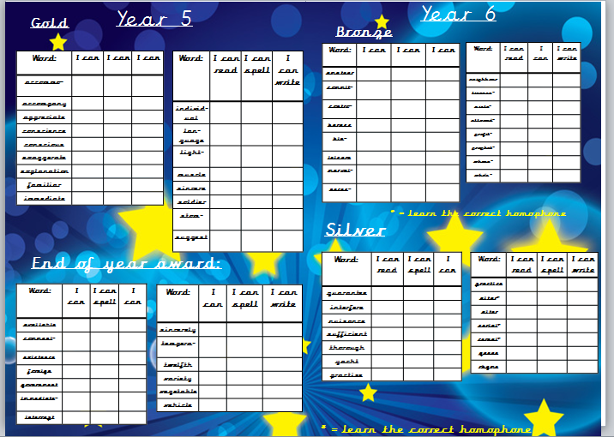

Slide 10


Slide 11
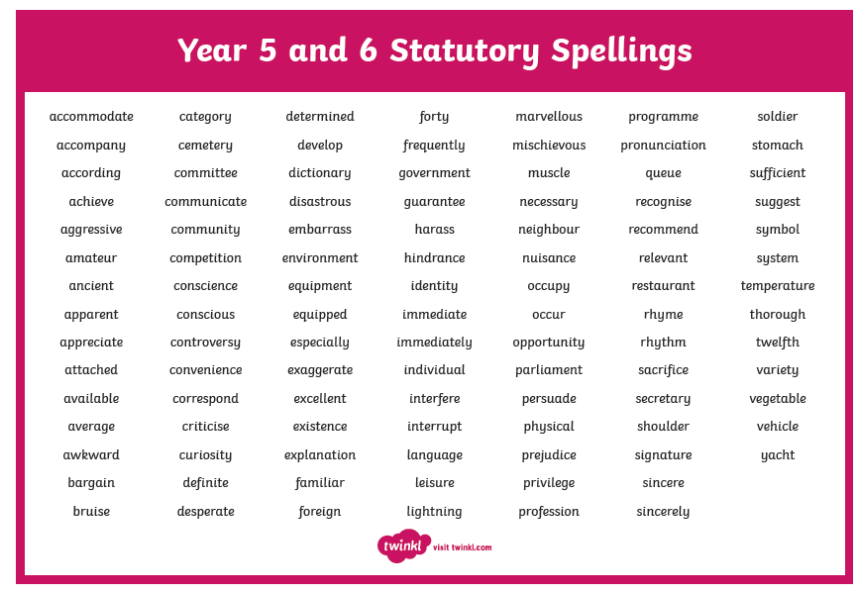

Slide 12

Times tables
As you will be aware, we have the Bronze, Silver and Gold badges in school.
Children must practise their times tables daily. Even if they think they know them- by Year 6 they must be quick to recall them.
Children will be given two resources to take home and practise. There are also various sites to use:
https://www.youtube.com/watch?v=4BLZKOjNKfk

Slide 13
Reading at home:
Children will be expected to write their own reading comments in their purple book each day.
Children will have a reading activity to complete each week.
Spellings should be practised in their homework book that covers 2 pages.

Slide 14
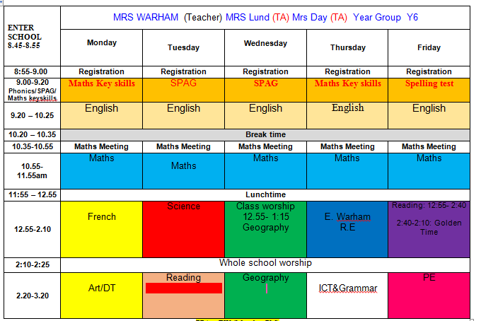
Class Timetable
Reading
PE
R.E
Golden time

Slide 15
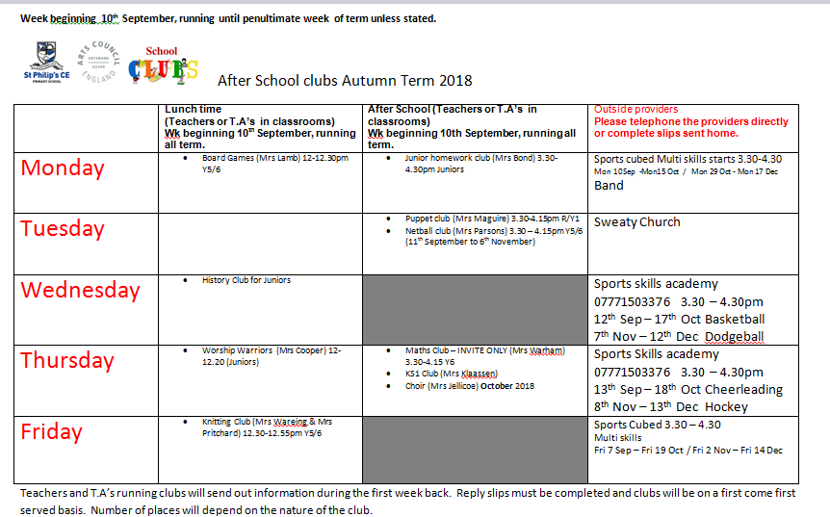
After School Clubs
Refer to our school website

Slide 16
Curriculum
Curriculum map/newsletter is on website.
Please make sure you have taken:
English and maths ladders
Writing assessment sheet
Spelling lists

Slide 17



Behaviour and
Good To Be Green
Very high expectations
Manners
Greetings
Can do attitudes

Slide 18
Fri 7th Sep- Movie, snacks, slippers, cushions
Fri 14th Sep- Extended Break and snack
Fri 21st Sep- Chocolate krispie cakes
Fri 28th Sep-Technology
Fri 5th Oct- Sit next to who you want
Fri 12th Oct- Chocolate dipped fruit and marshmallows
Fri 19th Oct- Movie and snacks
Good to be green rewards

Slide 19

Walking home
If you would like your children to walk home from school on their own, please could you sign the permission slip provided. This is for the safety of your children as they will be let out at the end of the day by a number of different teachers.
Thanks for your co-operation.

Slide 20
Buddies
Please note the buddy assembly will be
Wednesday 3rd October at 2.30.

Slide 21
Responsibilities
Children have jobs around the school which will be changed termly so as to give as many children as possible the opportunity to try out different things.

Slide 22


Residential
The Year 6 residential is way up there on their list of things they’re looking forward to.
Date of trip:
Wednesday 12th – Friday 14th June 2019
This year we’re going to a PGL
Activity centre.
Winmarleigh Hall Adventure Centre, Preston.
We have created a payment plan so as to spread the cost. This can be paid either at the office or through Parent Pay.
See letter for details.
WE HAVE MANAGED TO GET A DISCOUNT OF £20 PER CHILD.
THE ORIGINAL PRICE WAS £229, NOW £209!

Slide 23
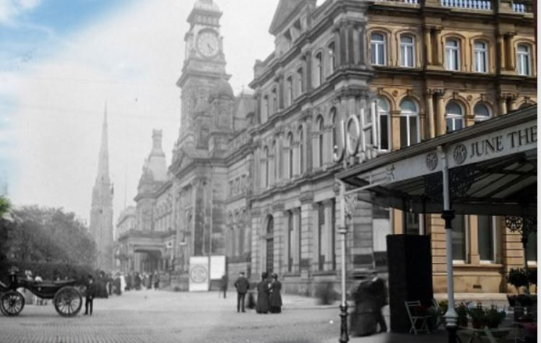
Up coming trip to the Atkinson
We are just waiting for confirmation from the Atkinson about a trip before half term to visit the new exhibition about local history…watch out for the letter…voluntary contribution £3

Slide 24
Permissions letter
Please sign the letter tonight regarding PG certificate material, local trips that don’t involve voluntary contributions and photo permission for education related websites beyond school.

Slide 25
Children’s greatest fear regarding year 6 was:
SATS
We’ve tried to reassure them that they’ll be ready for them when they do them.
It’s never as bad as they think it will be – we make them feel special during SATS week.
Some children enjoy the challenge!
Hopefully they’ll be happy with their
results.
SATS week: Monday 13th May – Thursday 16th May 2019

Slide 26

Parent’s evening:
Monday 15th October
2:00pm – 7:00pm.

Slide 27
Subject ladders
We have English and Maths ladders for you to download on our website. Please read them and refer to them throughout the year as they show the expectations for your child in Year 6.

Slide 28

Assessment

Slide 29


Slide 30

Year 6- band 6

Slide 31


Slide 32
Thank you for coming.
We’re here most evenings if there is anything you’d like to talk about.
Check website for information:
http://www.stphilipssouthport.com/

