Slide 1
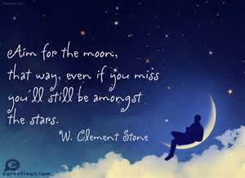
Year 6- you will shine!

Slide 2



Slide 3


Slide 4


Slide 5


Slide 6
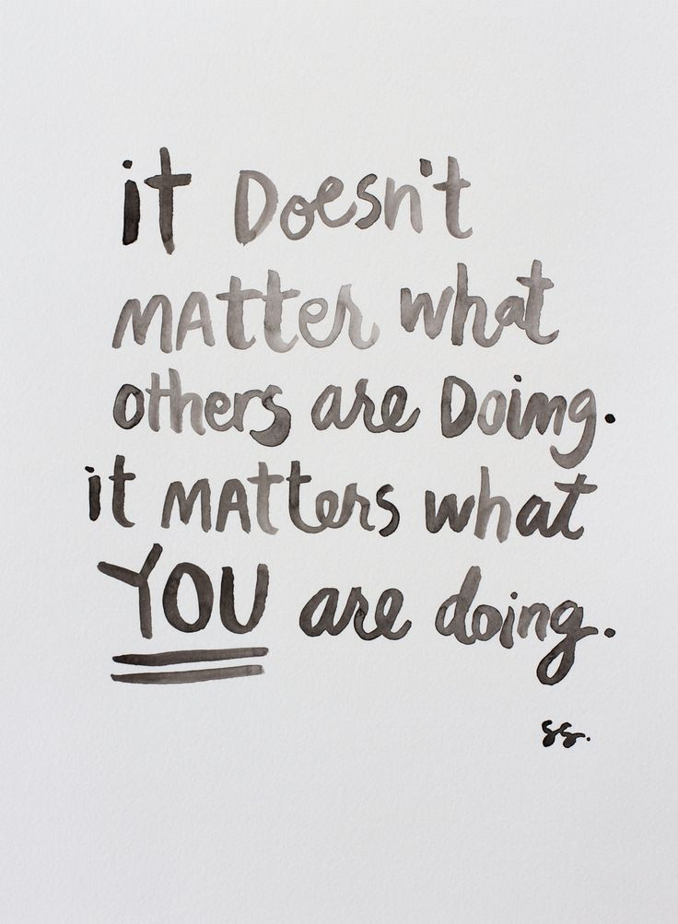

Slide 7

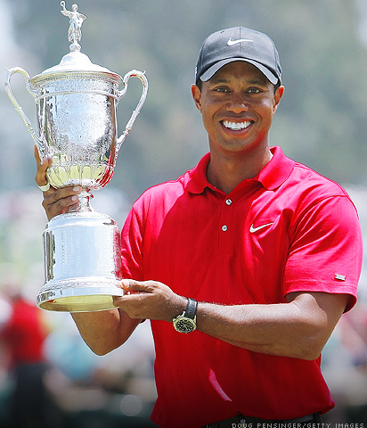

Slide 8


Slide 9


Slide 10



Slide 11


Slide 12



Slide 13


Slide 14


Slide 15

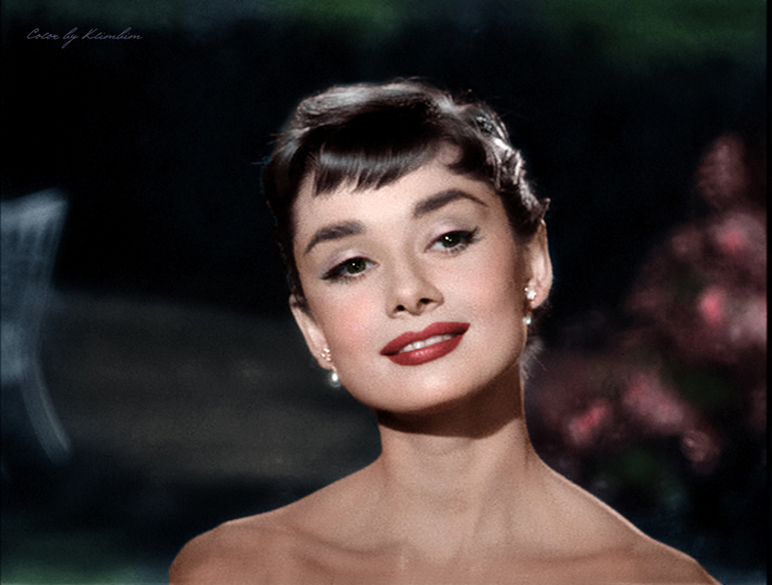

Slide 16


Slide 17
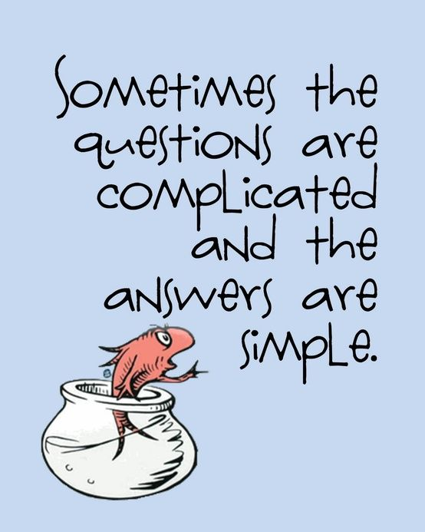

Slide 18


Slide 19


Slide 20


Slide 21
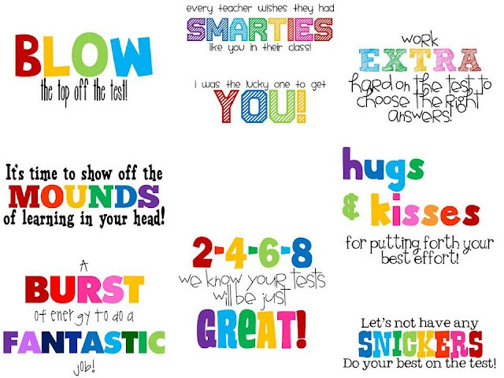

Slide 22


Slide 23
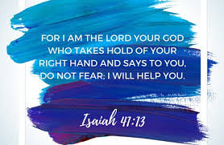

Slide 24

Good Luck Year 6,
we know you are amazing!
from all of your teachers X X X

