Slide 1

WEDNESDAY 12th – Friday 14th June

Slide 2
A Taste of what we’ll be doing… http://www.pgl.co.uk/en-gb/adventure-holidays/parents/videos-for-parents

Slide 3
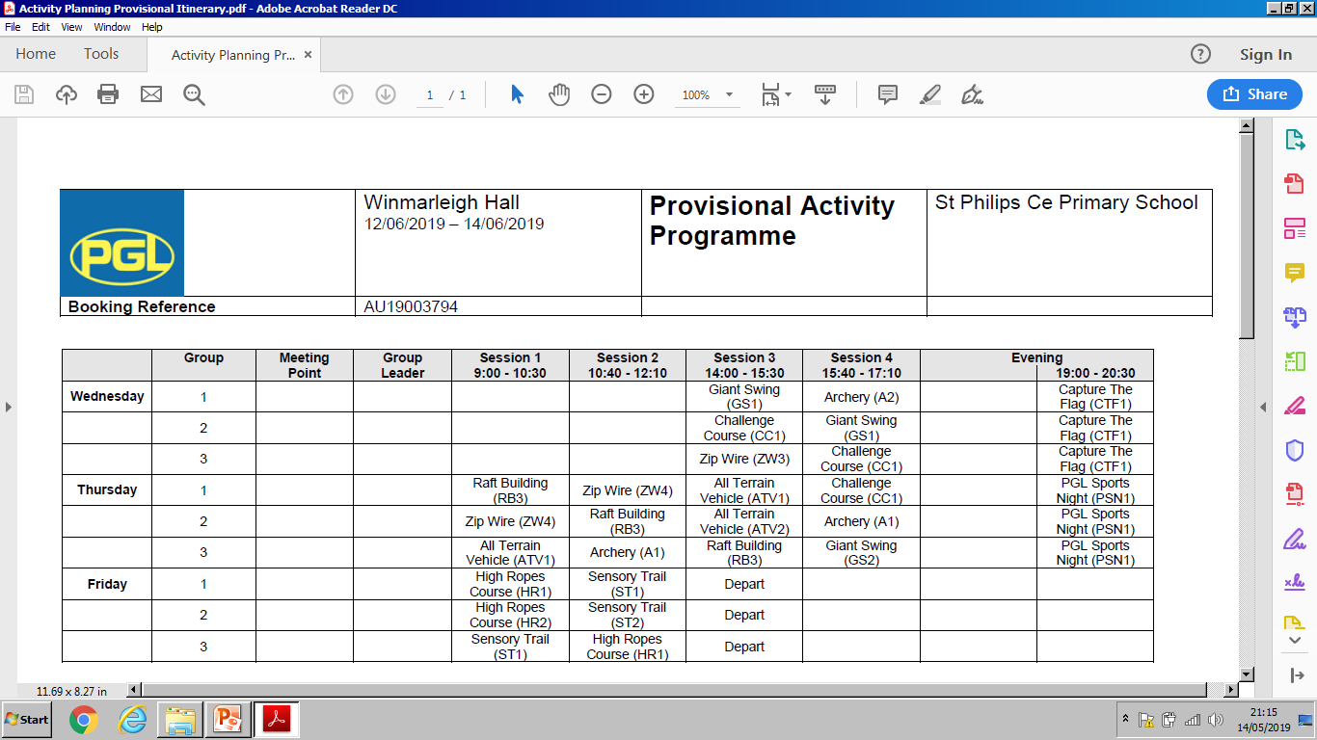
WEDNESDAY 12TH – FRIDAY 14TH JUNE
Below is a sample of how days are organised and the type of activities we might do

Slide 4
On the day we arrive, children will be going into their activities before checking into their rooms. Children will need to come to school dressed for their physical activity.

Slide 5
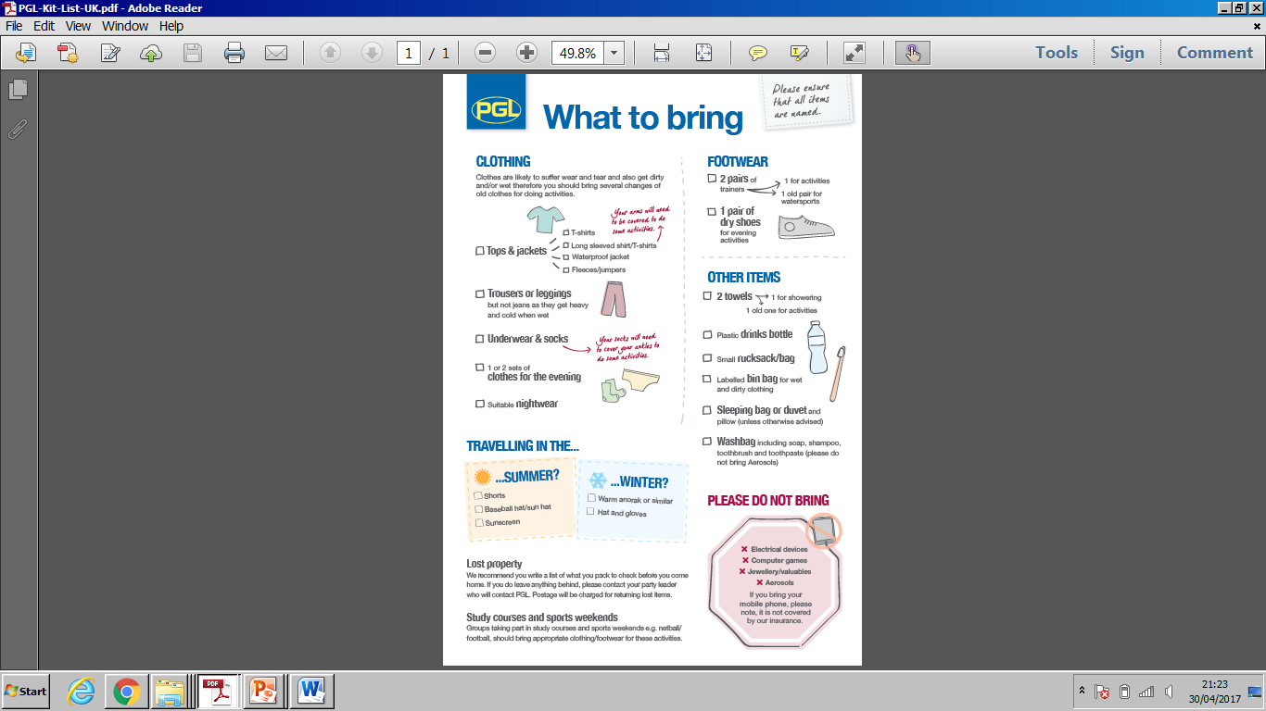

Slide 6
Please take particular note
No mobile phones, computer games and electronic devices
No valuable jewellery
No aerosols
Remember to bring bedding
Please name all clothes
Please bring suitable and adequate clothing and footwear.

Slide 7
Pocket Money
Children are welcome to bring some money to spend in the shop – please keep it to a maximum of £10.
Please put money into a named envelope and hand it in on the morning of departure and we’ll look after it.

Slide 8
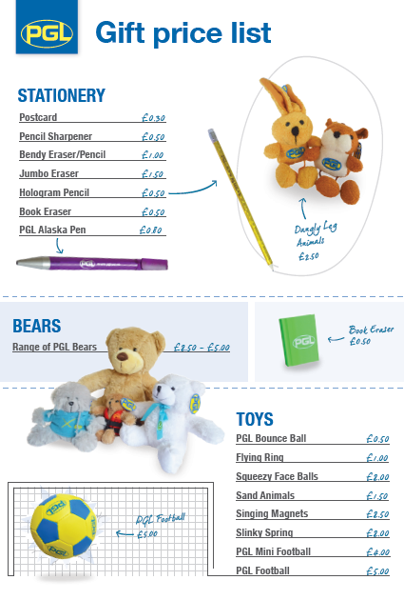
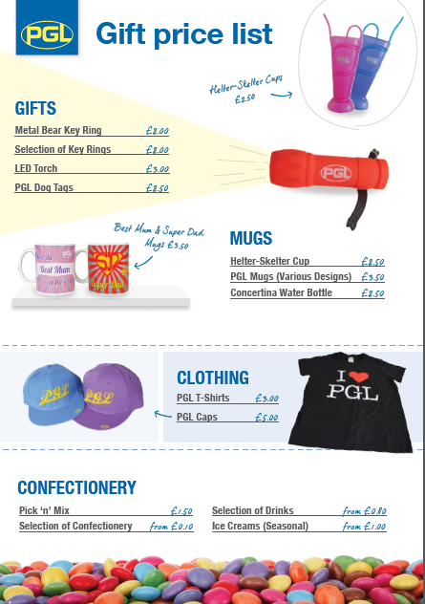
Shop prices

Slide 9
Sleeping arrangements
Most children will be sleeping in four-bedded/ 8 bedded rooms
We have staff bedrooms along the same corridor so will
be right there if there are any problems during the night.

Slide 10
Medication and contact numbers
You will be given a form to fill in this evening to inform us of any medication your child may require throughout their stay.
Please either complete before you leave or send it back as soon as possible.
Any medication must clearly named and handed to us on the morning of departure.
In the event of your child suffering from any minor aches and pains eg headaches, we require a signature from you to allow us to administer pain killers.

Slide 11
Day of departure
On Wednesday the 12th June
Please come to school at the normal time and children will be registered as usual.
Bags will be left in the school hall
Bedding should be in a named bag and left in hall.
Named medication to be handed to teachers
Pocket money will be collected for safe keeping
Children need a packed lunch

Slide 12
Friday 14th
We leave the centre near Preston at about 2.00pm
We hope to be back at school for 3.20 (we will inform school if there are any delays)
Children will need collecting as they will have a lot to carry.

Slide 13
Please see any one of us if you have any concerns:
Mrs Edward
Mrs Warham
Mrs Day

Slide 14
Due to poor Wifi signal, we will not be able to upload photographs on the website but we will be communicating with the office staff, who can update the website for us.

