Slide 1
Welcome to Year 6

Slide 2
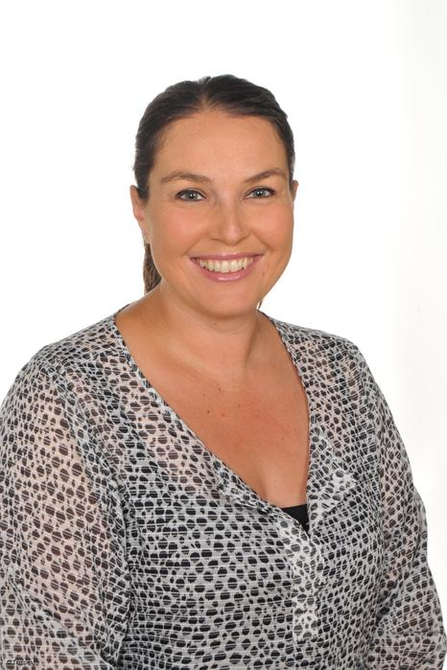
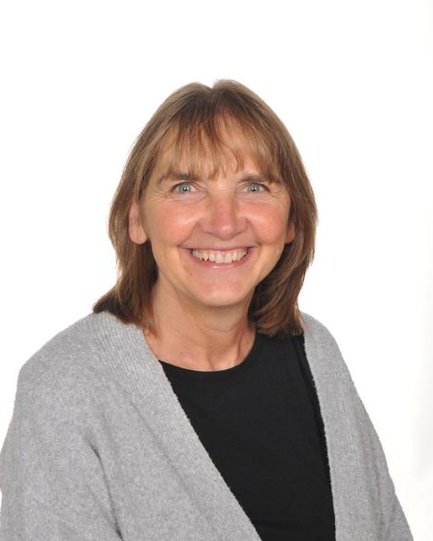
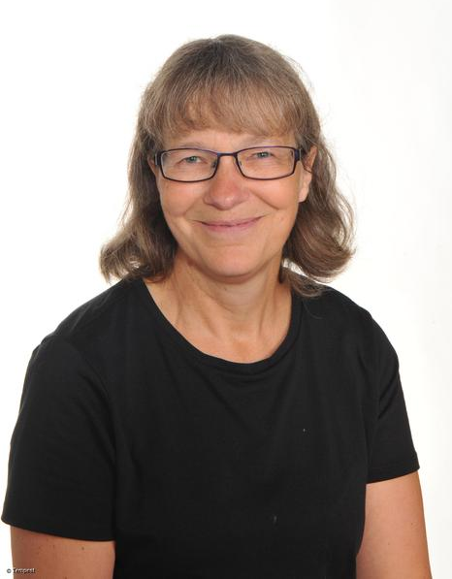
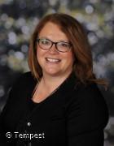
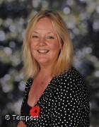
Year 6 staff
Teachers
Mrs Lamb Mrs Bond Ms Lund
(Mond and Tues) (Thurs and Fri) (Wed pm)
Wednesday am – Mrs Lamb/Mrs Bond
Support staff - Mrs Day, Mrs Westby and Miss Hardaker

Slide 3

We have codes of conduct for governors, staff and parents and carers and expect all members of our school community to abide by these.
We strive to create a safe, courteous space and we do not tolerate any communication whether in person or email that is not in line with our school values.
Our School Vision:

Slide 4


Our Christian Vision…
Happiness, love and security abound
Everyone is special
Every achievement is celebrated
Relationships and teamwork matter
A beacon of light in the community
Christ in Everything we Do!

Slide 5

School website and how to contact us
We will be updating our school website and class page frequently over the year. Please keep up to date of any announcements. https://www.stphilipssouthport.com/
Contact details are on the homepage so if you are needing to get in contact with school- head@sps.sefton.school
admin@sps.sefton.school
lambn@sps.sefton.school
bondd@sps.sefton.school
Mrs Edward says please be respectful of teachers work life balance. Emails should be proportionate and at sensible times. Parent Whatsapp groups that have been set up are not official school communication and have caused difficulty in the past. Parents should be aware of the impact that using these platforms for anything other than basic information sharing can cause. You should be respectful of all members of the school community and should not name children or members of staff in a way that could cause hurt or harm.
Mrs Edward is usually on the path at the start and end of each day if you need a quick word.

Slide 6
Routines
Doors open at 8.45, Registration at 8.55
Finish at 3.25pm.
If your child is absent from school please telephone the school as soon as possible
It’s really important to be on time (whenever possible) as morning activities start as soon as we arrive at school.
If your child will be walking home please give written consent to the school.

Slide 7
Attendance…
First Response
If your child is absent you must contact the school office by telephone or email before 8.15 and definitely by 8.30 to report your child's absence giving clear details of the reason for absence. Failure to do so means that our First Response kicks in and if we cannot get hold of you and we are unable to make contact with you via your emergency contact details, it might be necessary for a senior leader to come to your house!
This is part of our safeguarding response to ensure everyone is safe and well. As you can imagine, a home visit takes up a lot of time and it is usually the case that families have forgotten to call us.
TERM TIME HOLIDAYS ARE NEVER AUTHORISED. Families may be eligible for a fine from the Local Authority.

Slide 8

Housekeeping!
Please name all uniform –
Boys’ winter uniform Girls’ winter uniform
Grey trousers Navy skirt or pinafore
White shirt White blouse
Navy long sleeved jumper Navy long sleeved cardigan
School tie School tie
PE will be on Tuesdays and Thursdays so please come to school in your PE kit on those days (including blue jogging bottoms and blue jumpers/hoodies when it’s cold). White or black trainers suitable for sport NOT fashion may be worn. You are not allowed to wear jewellery for PE (including earrings) so please make sure you have removed these before you come to school.
Please make sure your child has a water bottle each day
We are struggling for space to store bags. Please could the children bring school book bags or a small bag.

Slide 9
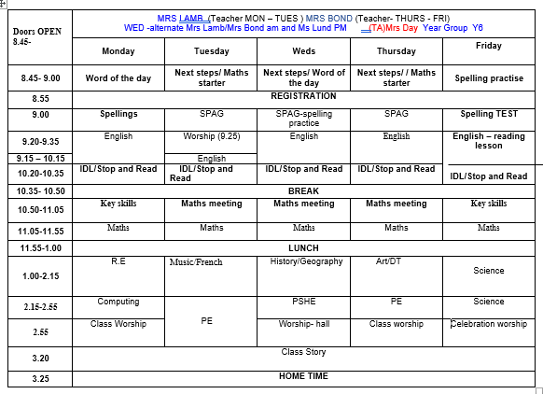
Class Timetable

Slide 10
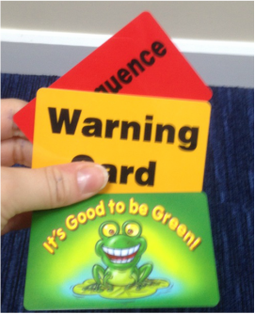

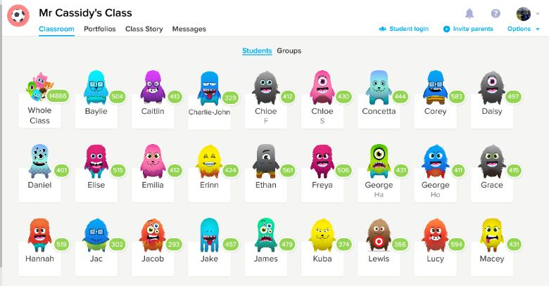
Behaviour!
Behaviour flow chart is on the web site
Children are awarded dojos for following the class rules – there is a prize at the end of the week
If children are not following the class rules a verbal warning is given before a card is issued

Slide 11
Behaviour and
Good To Be Green
Half termly- ‘Good to be Green’ certificates
Red cards- letter home to parents on a Friday
Yellow cards- miss some of break time.

Slide 12
St Philip’s Standards
Be ready
Be Respectful
Be Responsible
Fantastic Walking

Slide 13

Spellings
We have a huge emphasis on spellings. Children need to be practising their spellings daily and not for a spelling test.
In Year 6, children need to be able to spell words from the Year 3, 4 and 5 curriculum list . They must show they can spell these words correctly in their writing.
Spelling sheet for this half term has been sent home already and is on the class web page.
We will be using spelling badges to reward spelling test scores- we have a new system in place this year.
IDL- we may also use IDL to support your child's spelling- you will be given a password to access this at home.

Slide 14

Medical
Any medication updates – please let us know of any changes
Please check that your child’s inhaler is in date.
We have been advised that children should use a spacer when taking their inhaler - if possible please send one into school.
If your child needs any prescribed medication, a medical form needs to be filled in at the office before we are able to administer it.
Thank you

Slide 15
Homework
Homework will be given out on a Wednesday to be returned on Monday.
We would be really grateful if you could return homework on time so we have chance to mark it before Wednesday – Thank you.
Spellings will be tested each Friday.
Weekly spelling will be put on the website.
Please try to read with your child 5 times a week.
Please let us know if any homework is too difficult so we can give a little extra help at school.
Thank you

Slide 16

Reading
Your children will continue reading through the colour bands
Please try and read at home at least 5 times a week.
In school the children will be involved in
‘Stop and read’ daily
Reading across the curriculum.
Reading lesson each Friday
Story time at the end of the day.

Slide 17

Curriculum
Curriculum map and autumn newsletter is on the website.
Website
Please keep checking the website dates and news.
We will try to keep the website updated with lots of photos of your children at work and play.
Trips
You will also find information about after school clubs on the website.

Slide 18
Assessment
Assessment takes place at the end of each term.
We track progress using Insight.
Children are teacher assessed using the following levels:
Below
Working towards
Expected
Exceeding

Slide 19
Assessment
Statutory Assessments take place at the end of KS2 (Year 6).
For your children these will be week commencing 11th May 2026
We will have a meeting about the SATs at a later date.

Slide 20
School Trips…
To be confirmed…
Liverpool Cathedral - Leaver’s service
End of SATs celebration – Kings Gardens
Anderton Centre – residential
(If there is anyone who doesn’t want their child to go on the residential, please can you let the office know so we don’t continue to ask for the deposit – thank you.)
We require payment of a voluntary parental contribution for all school trips. Sadly due to budget constraints if we do not receive enough payments the trip may not go ahead. Mrs Edward is always available to discuss any concerns in relation to payment of anything requested. We will never leave a child out.

Slide 21

Parent’s meeting:
Weds 22nd October
2pm onwards

Slide 22

Please check your filters.
Be aware of the issues around Whatsapp. School expects parents to manage and monitor children's use and we will not investigate upset linked to home use of whatsapp or other platforms that parents should be monitoring.
Mobile phones are not allowed in school. Phones for children who are walking home in Y5 and Y6 are handed in each day and kept in the school office. The phone is returned at the end of the day.

Slide 23

Volunteers are very welcome!
Safer Recruitment Checks will be completed.

Slide 24

Check website for information:
http://www.stphilipssouthport.com/
and Twitter!

Slide 25

Any questions?

