Slide 1

WEDNESDAY 17TH – FRIDAY 19TH MAY

Slide 2
Taste of what we’ll be doing

Slide 3
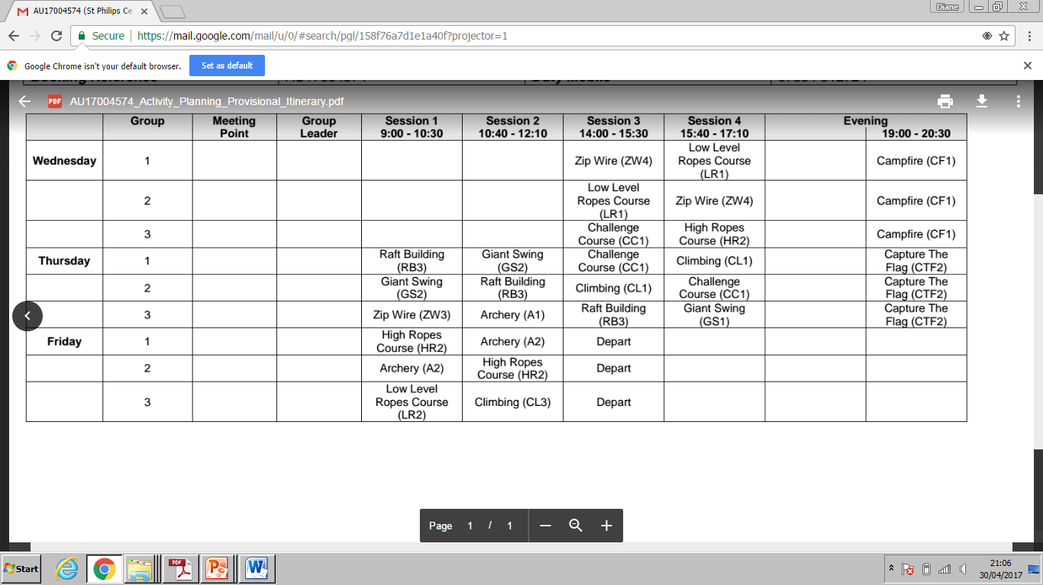
WEDNESDAY 17TH – FRIDAY 19TH MAY

Slide 4
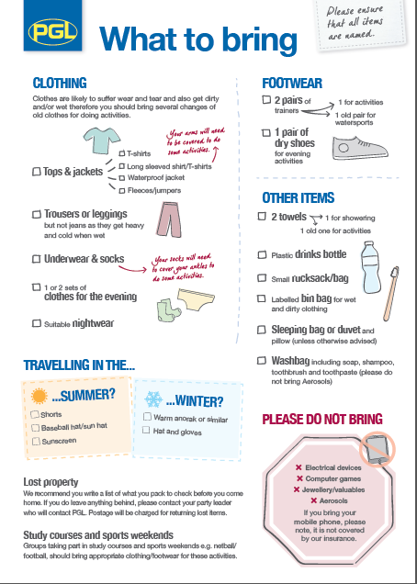

Slide 5
Please take particular note
No mobile phones, computer games and electronic devices
No valuable jewellery
No aerosols
Remember to bring bedding
Please name all clothes
Please bring suitable and adequate clothing and footwear.

Slide 6
Pocket Money
Children are welcome to bring some money to spend in the shop – please keep it to a maximum of £6
Please put money into a named envelope and we’ll look after it.

Slide 7
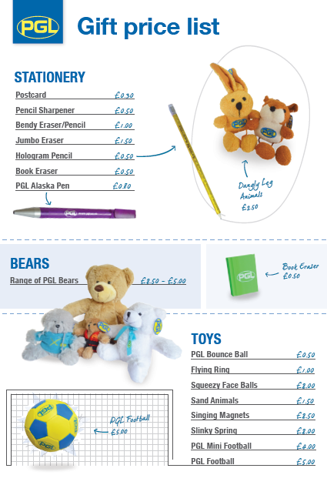
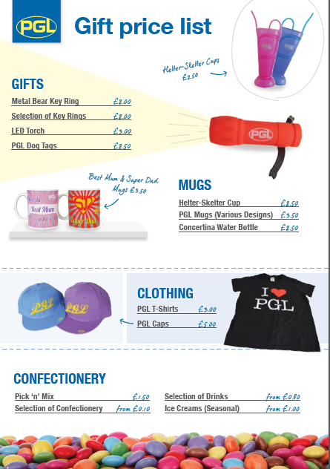
Shop prices

Slide 8
Sleeping arrangements
Most children will be sleeping in four-bedded rooms
We have been allocated 6 four-bedded rooms and 1 six bedded room.
We have staff bedrooms along the same corridor so will
be right there if there are any problems during the night.

Slide 9
Medication and contact numbers
You will be given a form to fill in this evening to inform us of any medication your child may require throughout their stay.
Please either complete before you leave or send it back as soon as possible.
Any medication must clearly named and handed to us on the morning of departure.
In the event of your child suffering from any minor aches and pains eg headaches, we require a signature from you to allow us to administer pain killers.

Slide 10
Day of departure
On Wednesday the 17th
Please come to school at the normal time and children will be registered as usual.
Bags will be left in the school hall
Bedding should be in a named bag and left in hall.
Named medication to be handed to teachers
Pocket money will be collected for safe keeping
Children need a packed lunch

Slide 11
Friday 19th
We leave the centre in Preston at about 2.00pm
We hope to be back at school for 3.20 (we will inform school if there are any delays)
Children will need collecting as they will have a lot to carry.

Slide 12
Please see any one of us if you have any concerns
Mrs Edward
Mrs Bond
Mrs Lund

Slide 13
Look out for photos on the website throughout our stay.

