Slide 1
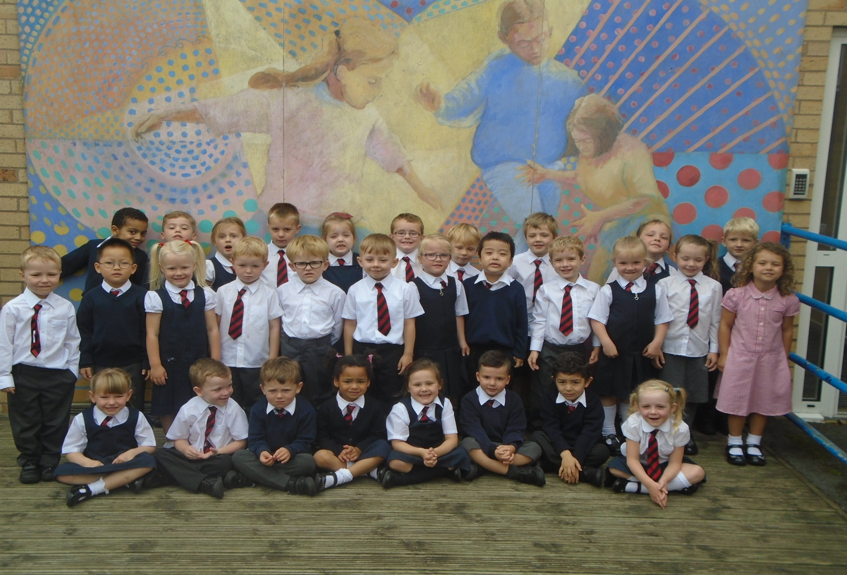
Reception Parents Workshop
Welcome!

Slide 2


Phonics
What is phonics?
All words are made up of sounds. We have 26 letters in our alphabet but the English language is made up of 42 sounds.
c/a/t sh/ee/p ch/i/ck phonemes
We use Jolly Phonics to introduce and teach phonics. Fun, interactive, multi-sensory with each sound introduced through a story, a song and an action.

Slide 3
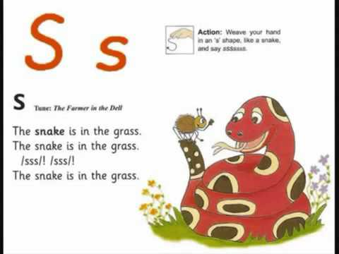
Today’s sound

Slide 4

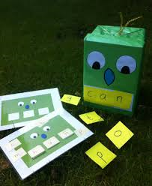
Daily Phonics
First sounds
s a t p i n
Blend
sat pin nip sit pit pat pip sip

Slide 5
Phonics
Young children learn quickly where an activity is involved and therefore a sound a day is introduced. 4 a week & then blending games & tricky words too.
the to my we all
When children know some tricky words and sounds and can blend to make words then we start with reading books. We do not rush into this as we don’t want to put children off reading.

Slide 6

Jolly Phonics App
Children learn to
– Hear the letter sounds
– Recognize the letter sounds
– See letter formation
– Write the letters themselves
– Blend sounds in words for reading
– Identify sounds in words for spelling
http://jollylearning.co.uk/

Slide 7

Reading
Range of reading books
Reading records – please comment
Initially books are changed weekly on a set day
Library books
Guided group reading and whole class reading
Reading tips
Little and often
Point to words as reading
Talk about pictures
Look at initial sound of word
Sound out & blend
Spot tricky words
Good reading environment with no distractions
Ask open questions like What? Why? Where? Which? How do you know?

Slide 8
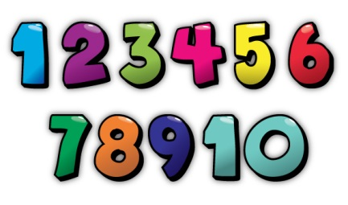

Maths
NUMBER
Strong focus on number and developing the children’s understanding of the patterns that underpin early number.
Numicon

Slide 9


Maths
Counting groups of objects accurately
Last number is the quantity.
Seen & unseen objects to count
Rote counting in order
Starting at 0 and 1 but other numbers too!
3 to 19 or 9 to 21
Equally important is counting backwards
20,19,18,17
Counting in 2’s, 5’s, 10’s
Crossing the tens 29 then 30 not 20 10
Emphasising teens

Slide 10


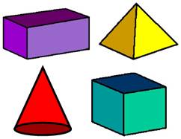
Maths
Problem solving
Daily practical activities
Encourage ‘have a go’ and ‘I can’ attitude
Shape, space & measure
Patterns – describing, making, recognising
2d & 3d shapes
Measurements
Language

Slide 11

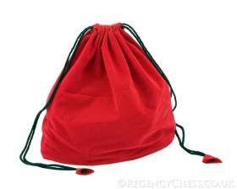

Other
Writing, pencil grip & robot talking
Learning journeys, WOW certificates, child and parents comments
Homework books – fortnightly, topical
Named PE kits –Tuesday& Thursday
Lunches, water bottles, milk & fruit
Information, newsletters, website, text messages & twitter

Slide 12
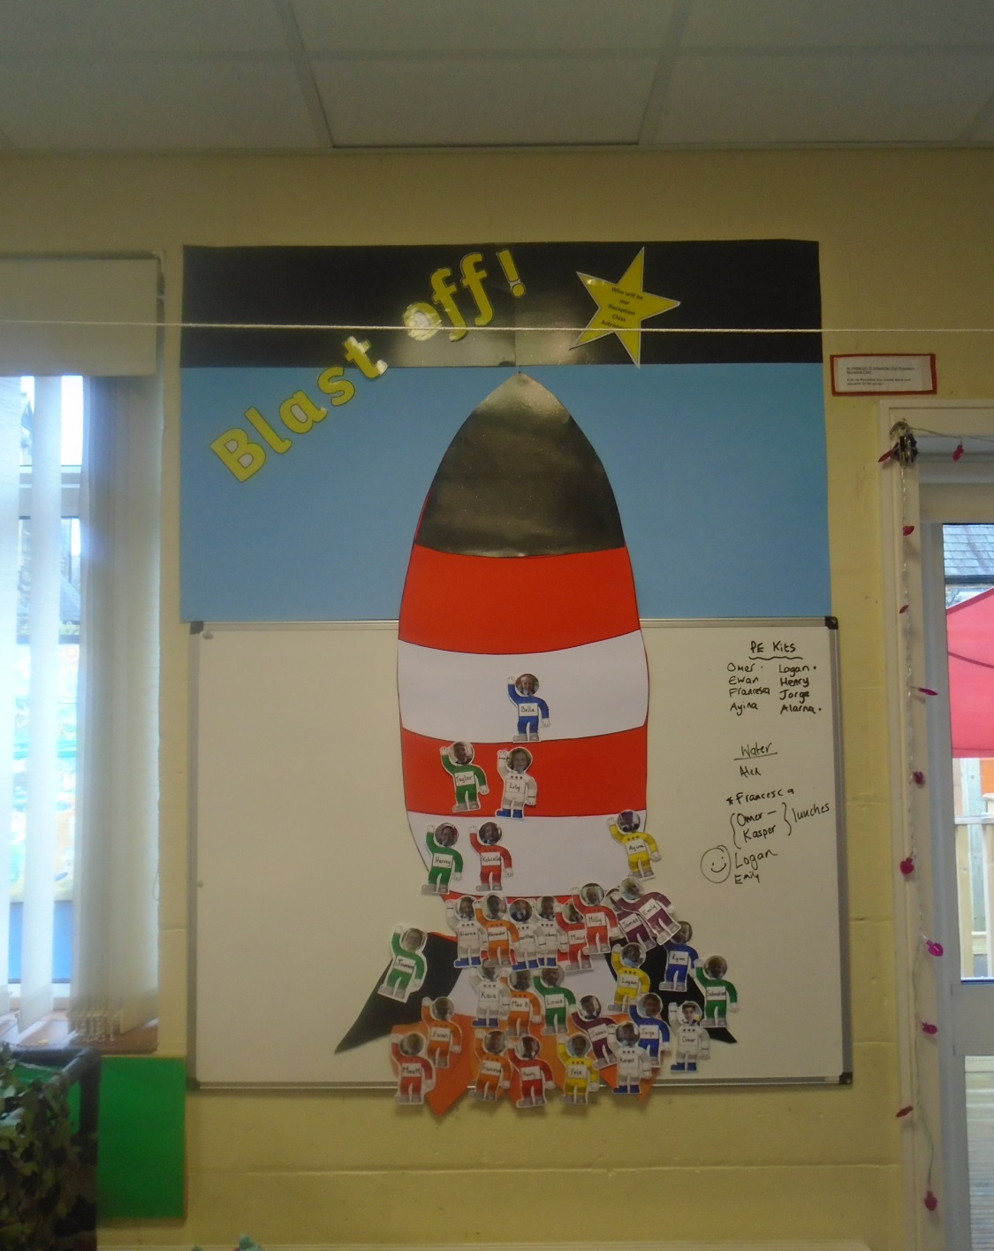
Blast off Behaviour

Slide 13


Stay and play
Stay and Play time where you can stay with your child and share their learning journeys
Letter will be sent home with dates

Slide 14

Reminders!
Harvest festival – Tuesday 11/10/16 (2.30pm)
Buddy Assembly –Wednesday 12/10/16 (2.30pm)
Christmas Performance 15/12/16
Parent teacher meetings just before half term
A letter with relevant dates will follow

Slide 15


Thank you!
Information sheet
Questionnaire to complete

