Slide 1
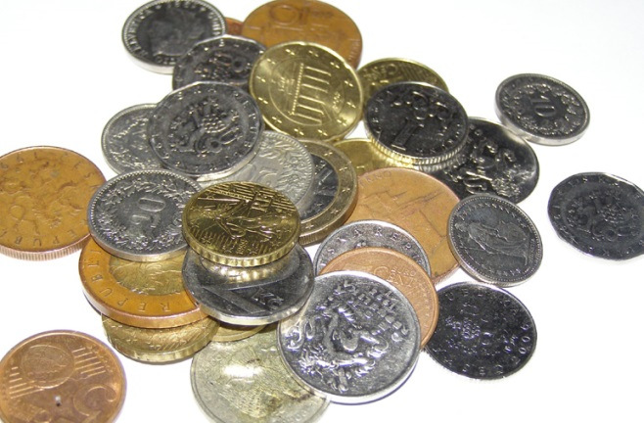
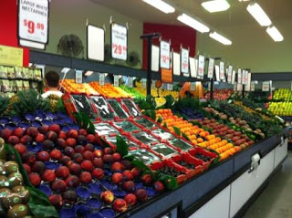
Reception’s Shopping Trip
October 2016
How many pieces of fruit can we buy with our money?
What numbers can we spot around us?

Slide 2
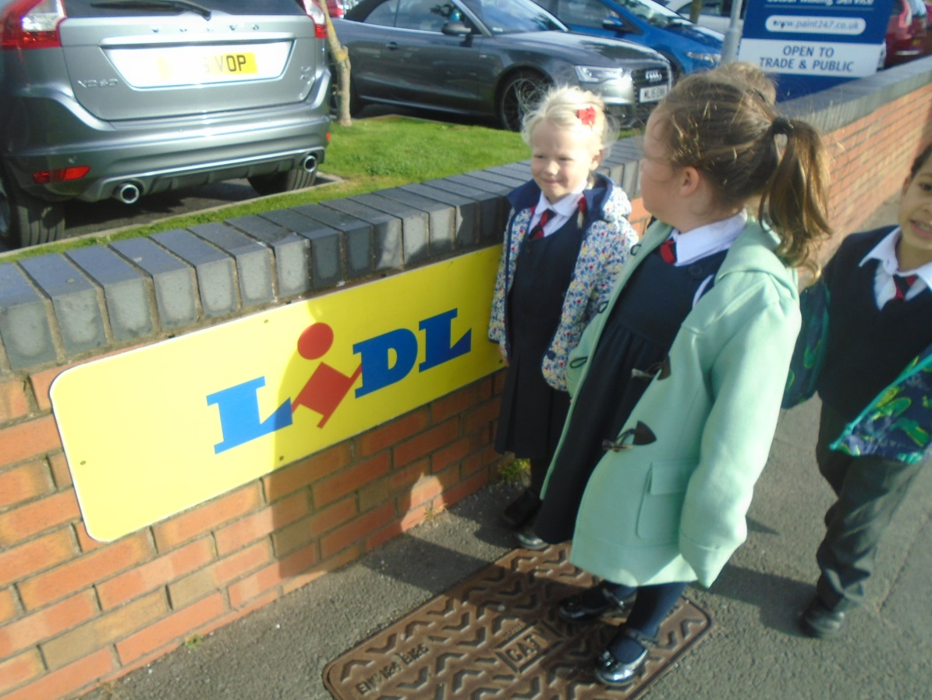
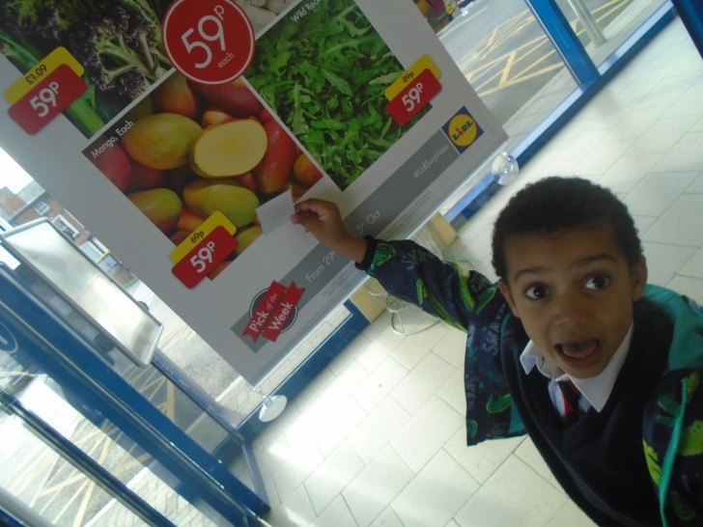
Numbers Everywhere!
“Look I can see numbers on the car!”
We spotted:
Car number plates
House numbers
Prices of items in the shop

Slide 3
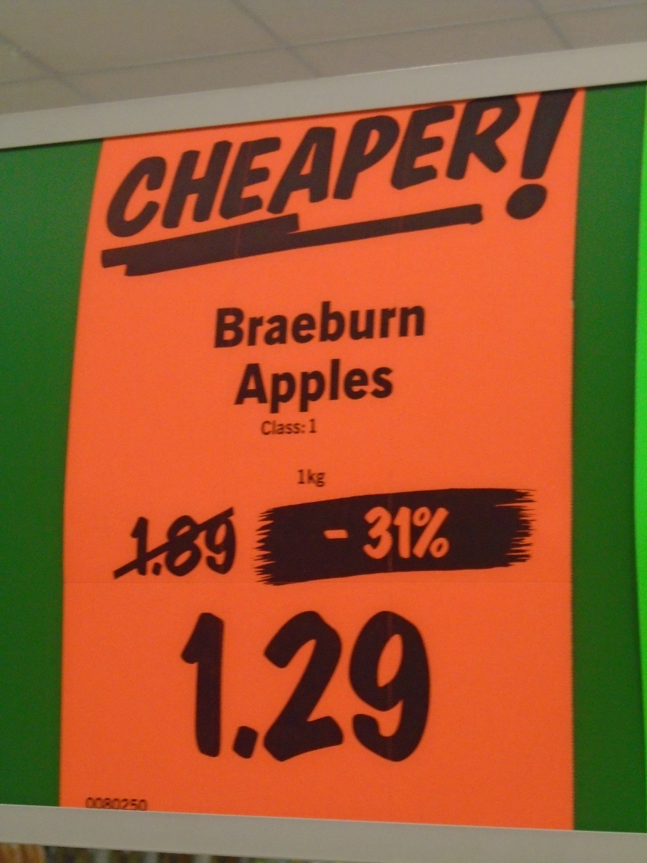
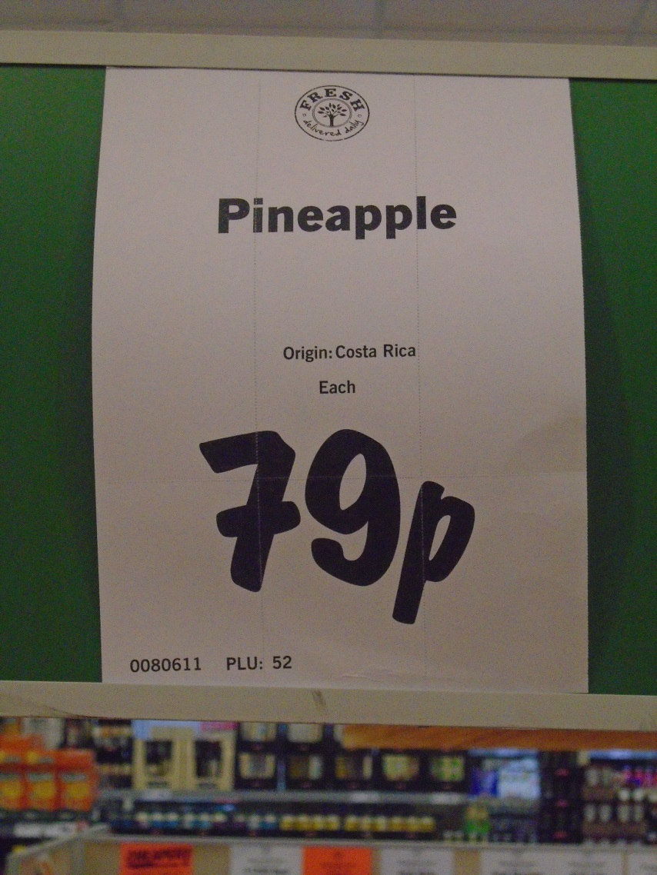
How much?

Slide 4
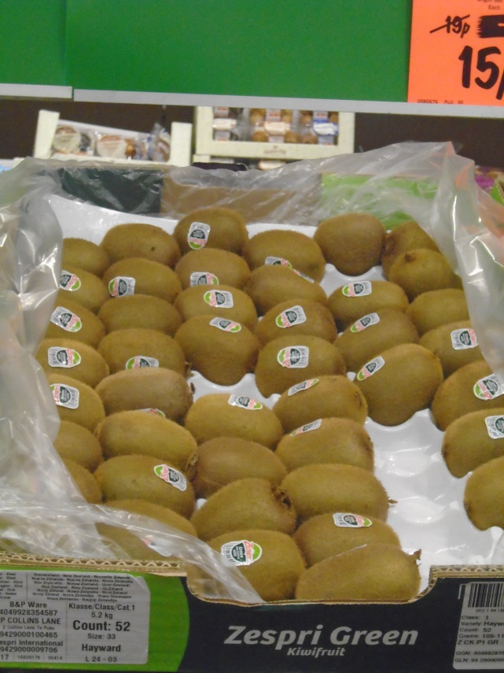
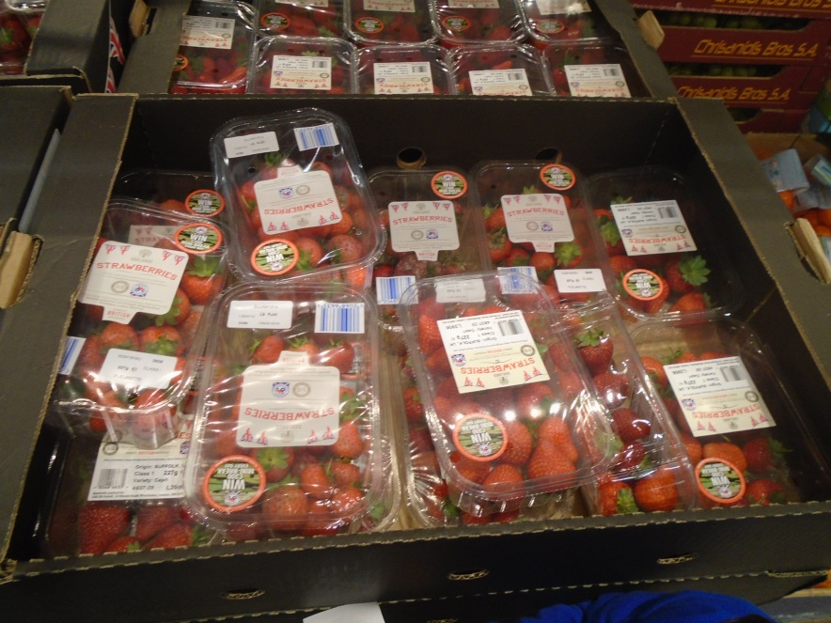
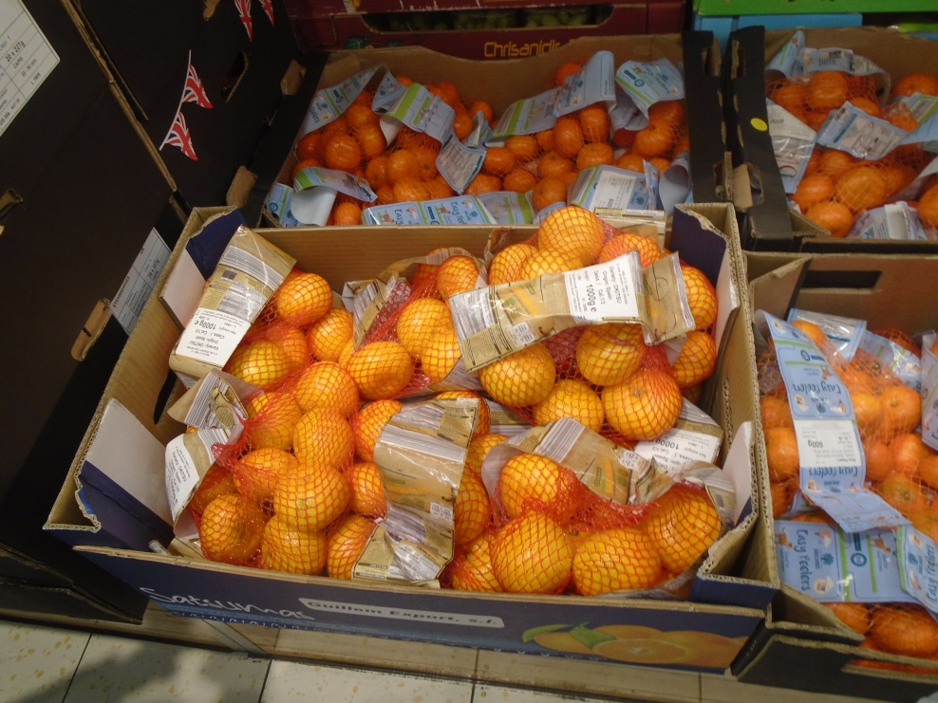
How many different types of fruit?

Slide 5
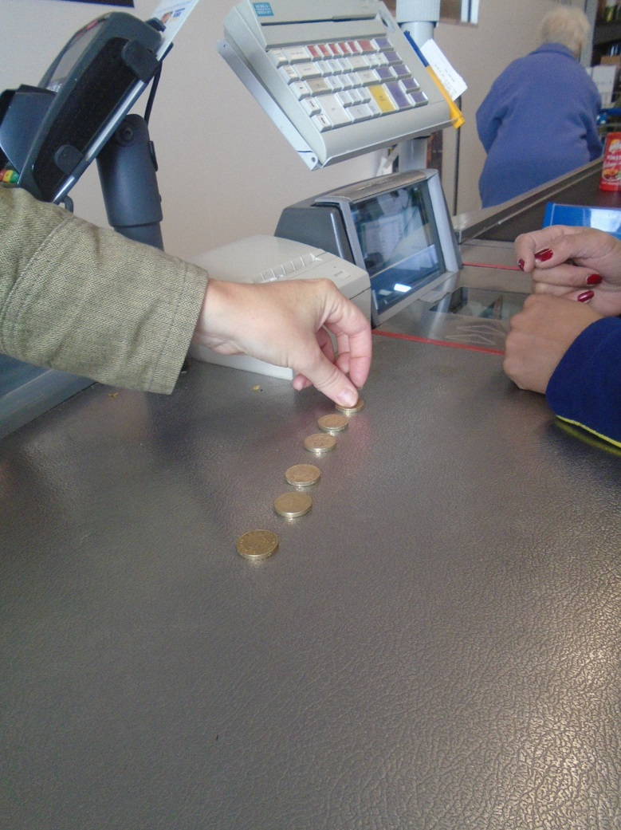
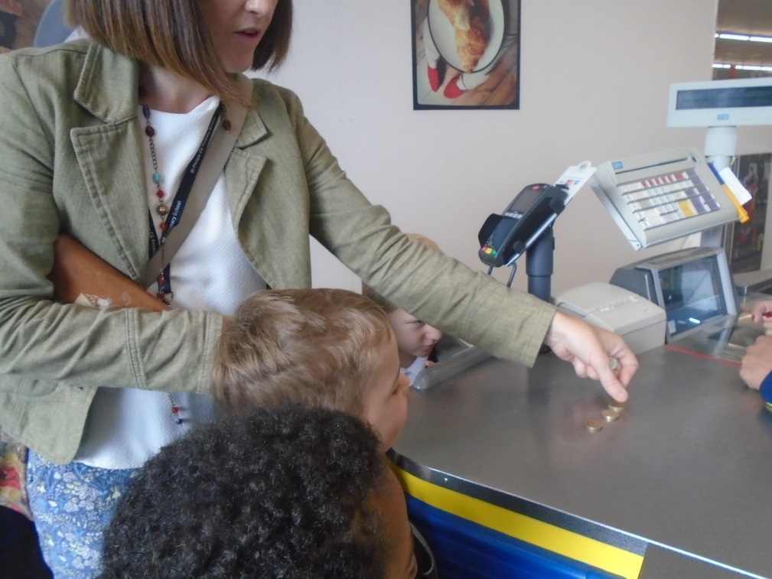
How many coins did we pay with?

Slide 6
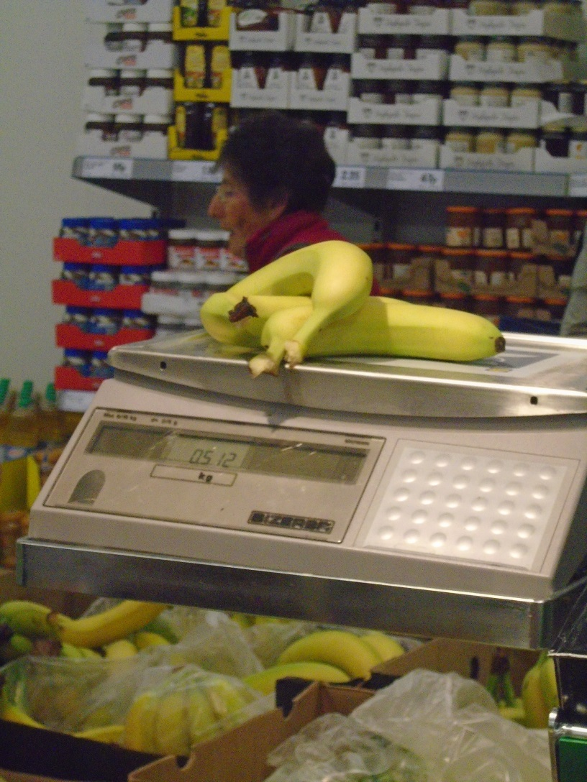
Lots of maths vocabulary too!
How much do 3 bananas weigh?
How heavy are they?
What was our favourite fruit?
How many children liked watermelon?
What fruit is a sphere shape?

Slide 7
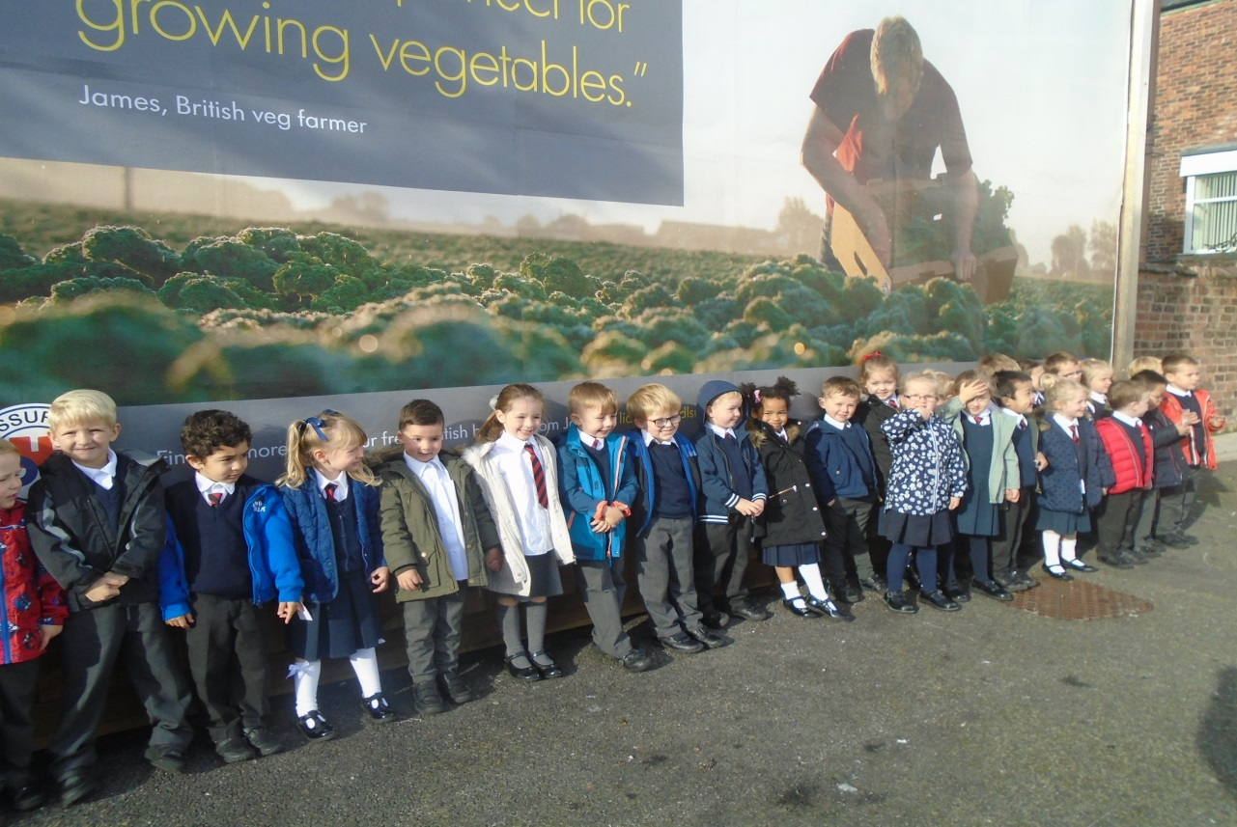
We loved our trip and loved tasting all the fruit we bought. We also did LOADS of maths too!

