Slide 1
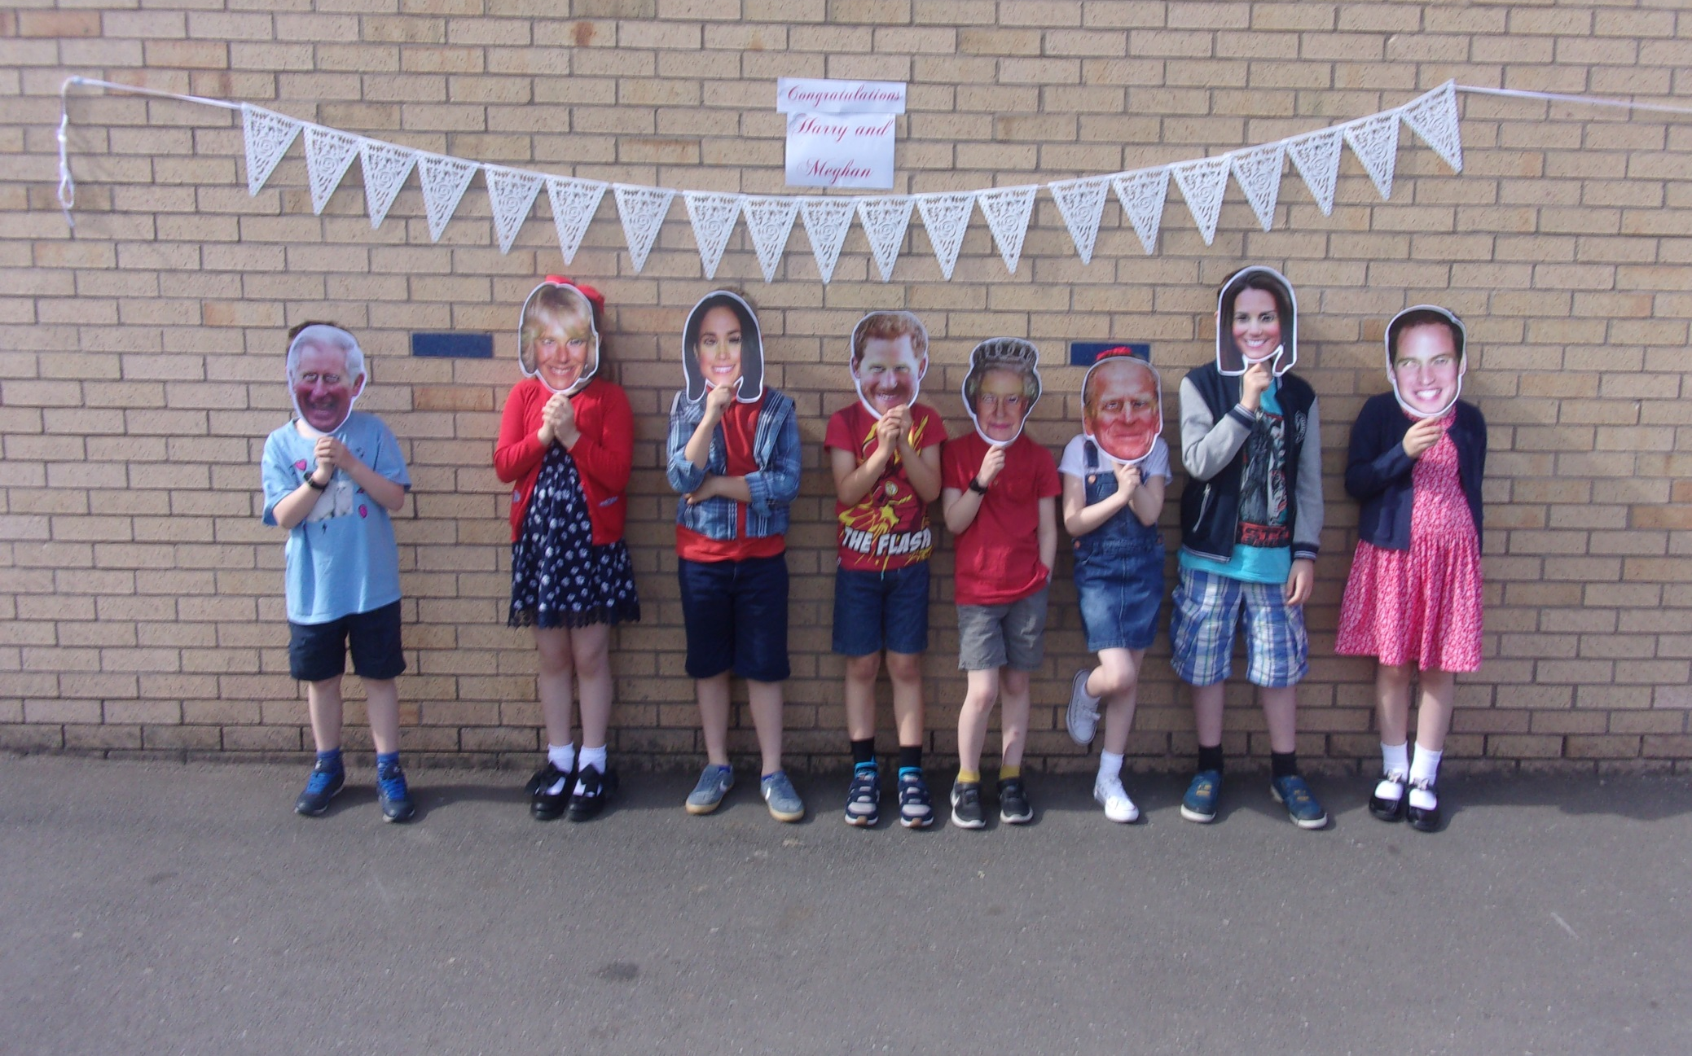
Left to right: Lucas BD, Mia, Ignacy, Gabriel, Adam, Faith, Lucas and Heidi.

Slide 2
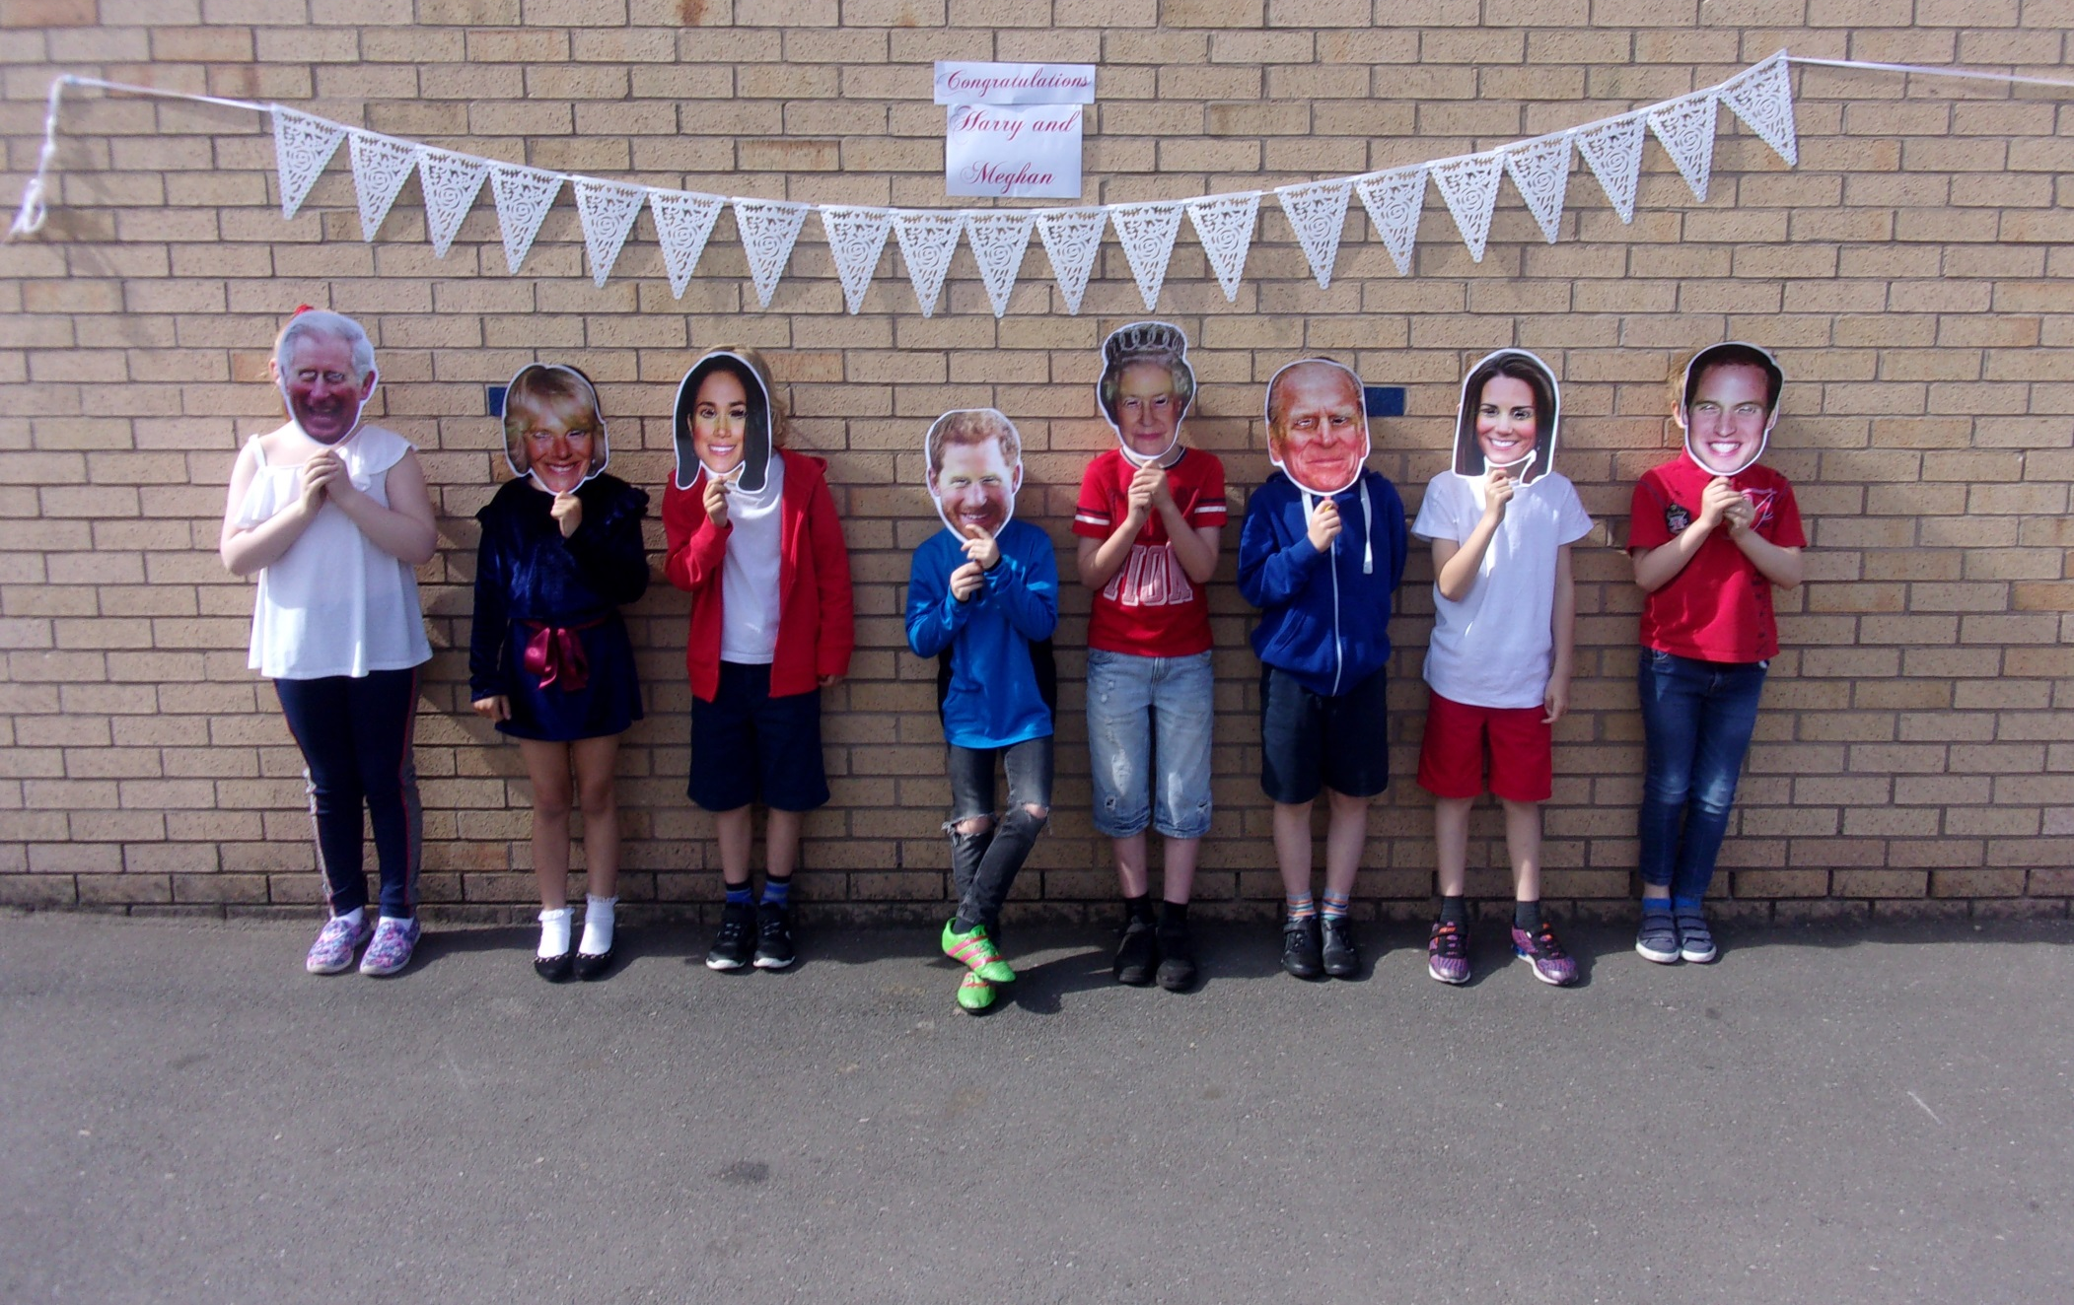
Left to right: Lois, Elamara, Luka, Jamie, Daniel, Joel, Mason and George.

Slide 3
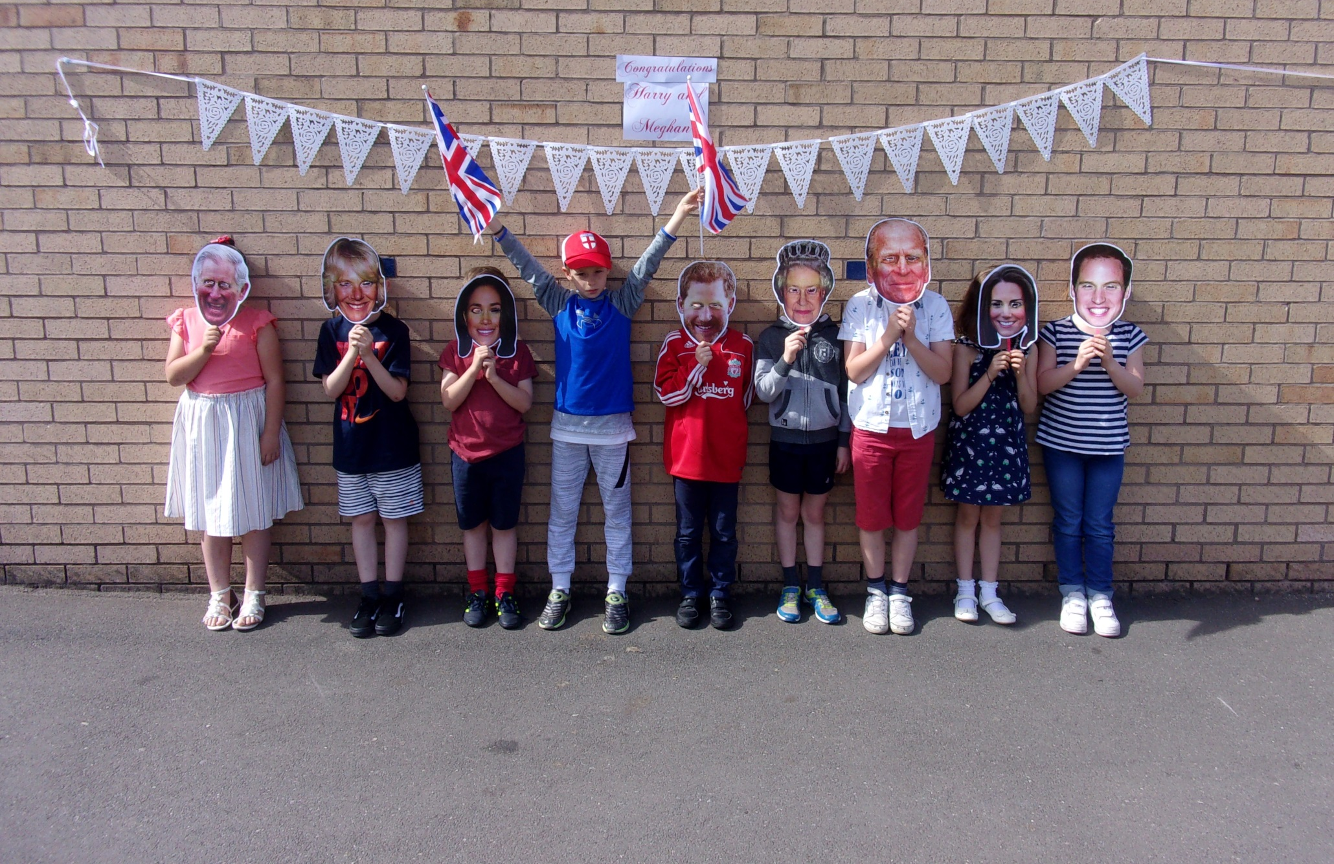
Left to right: Daisy F, Archie, Isaac, Kai, Ethan, Ben, Oliver, Daisy G and Jasmine.

Slide 4
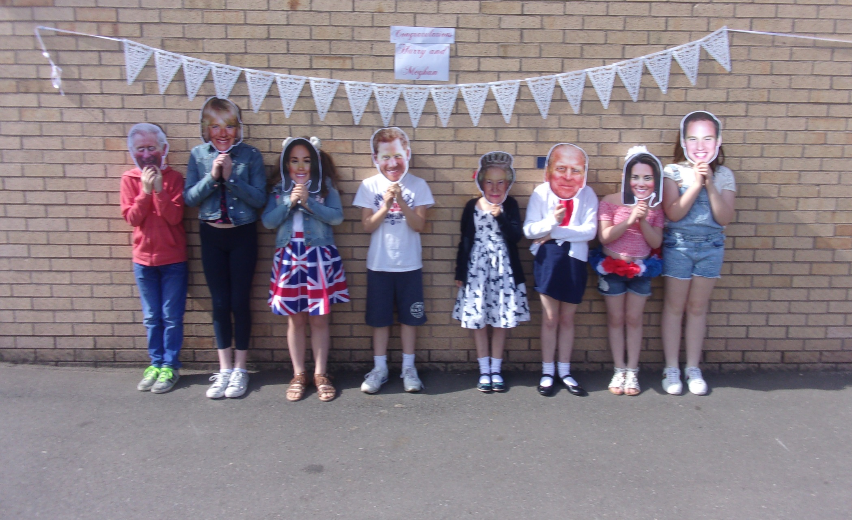
Left to right: Aston, Harriet, Florrie, Henry, Gaja, Megan, Kiera and Lily.

Slide 5
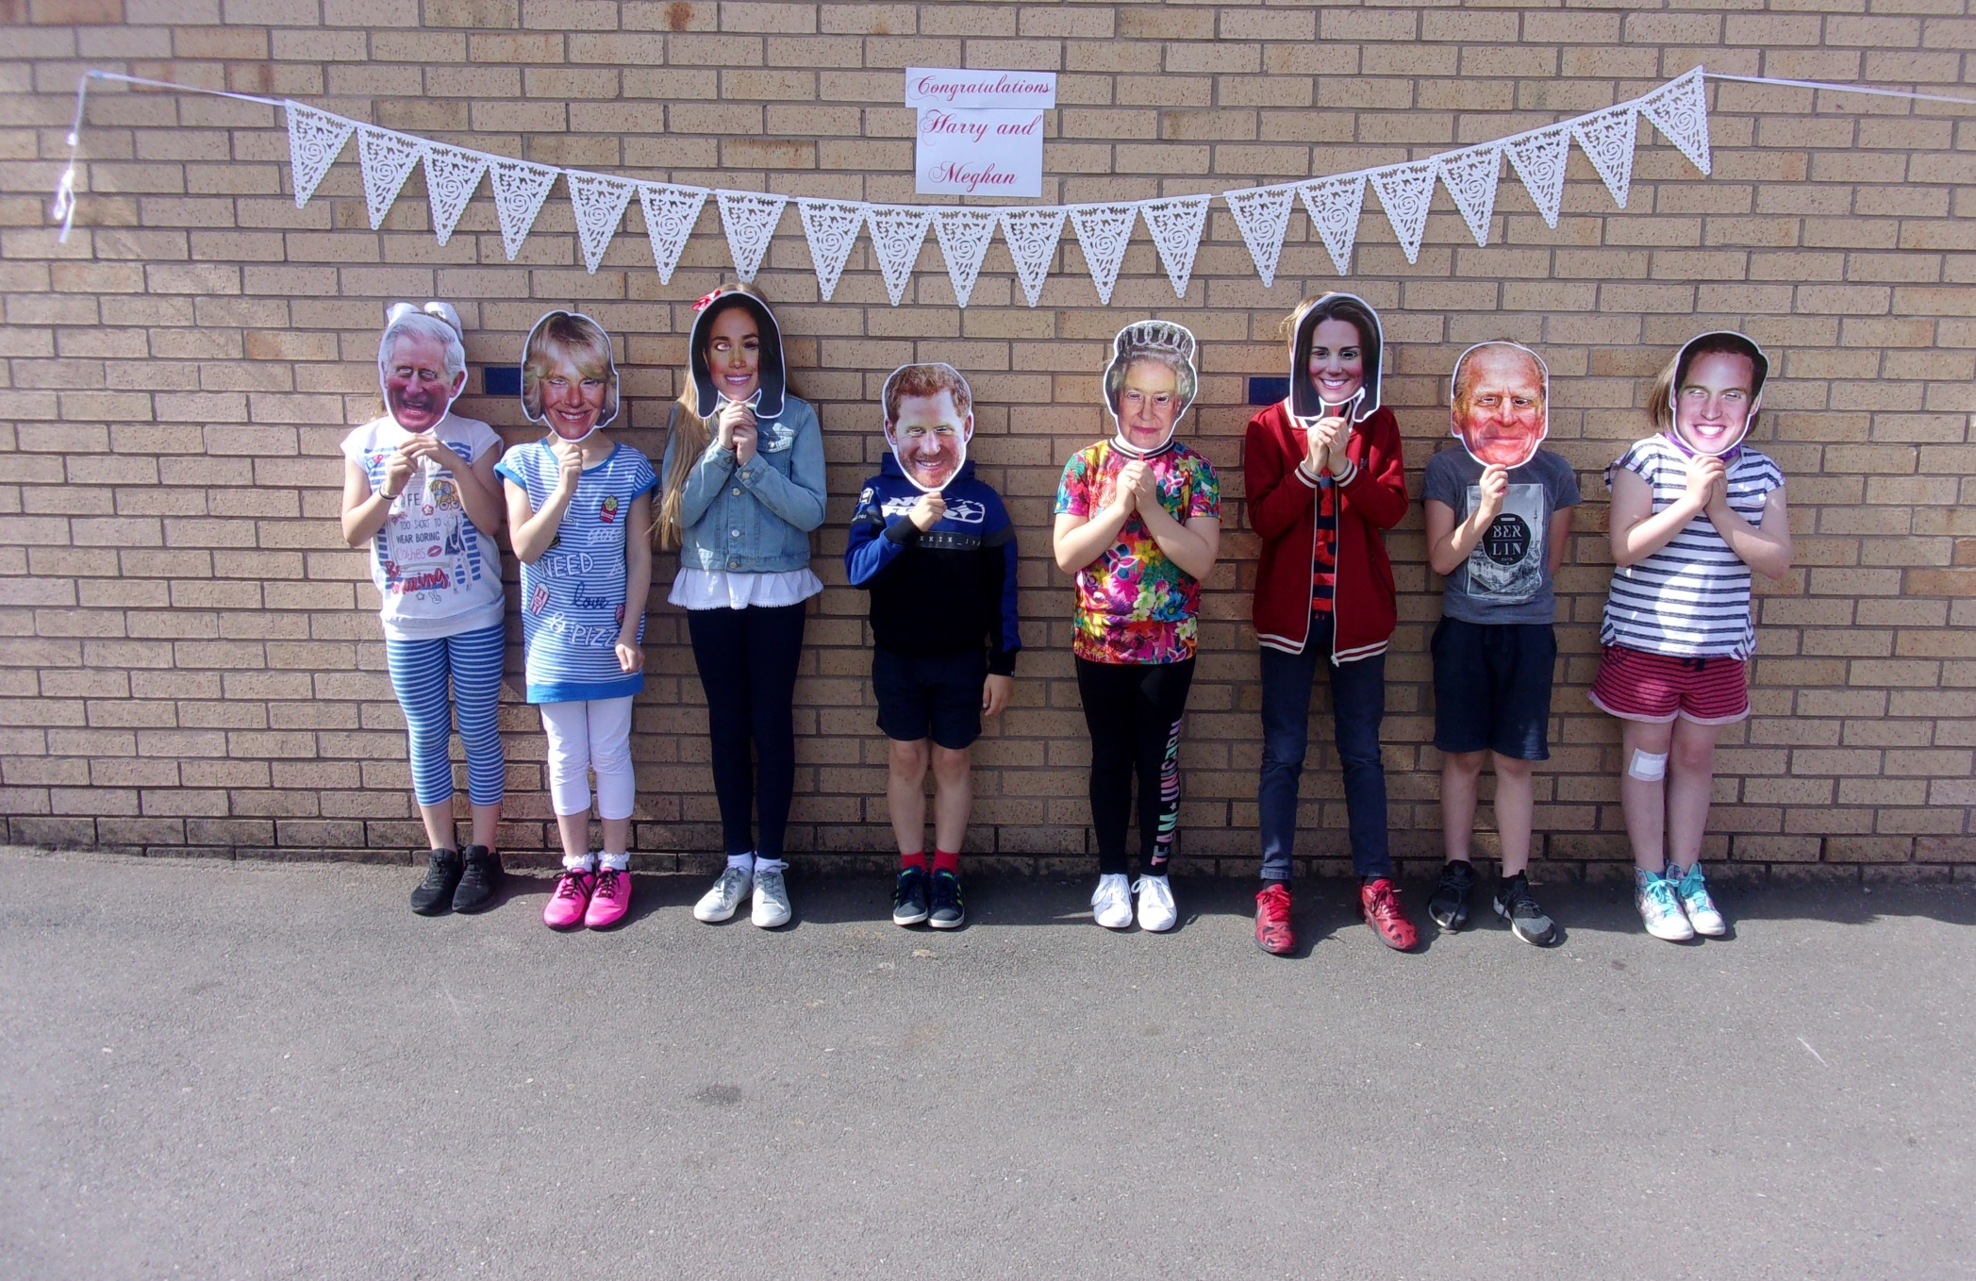
Left to right: Maddi, Maj, Emme, Josh, Mia, Sam, Lucas and Abigail.

Slide 6
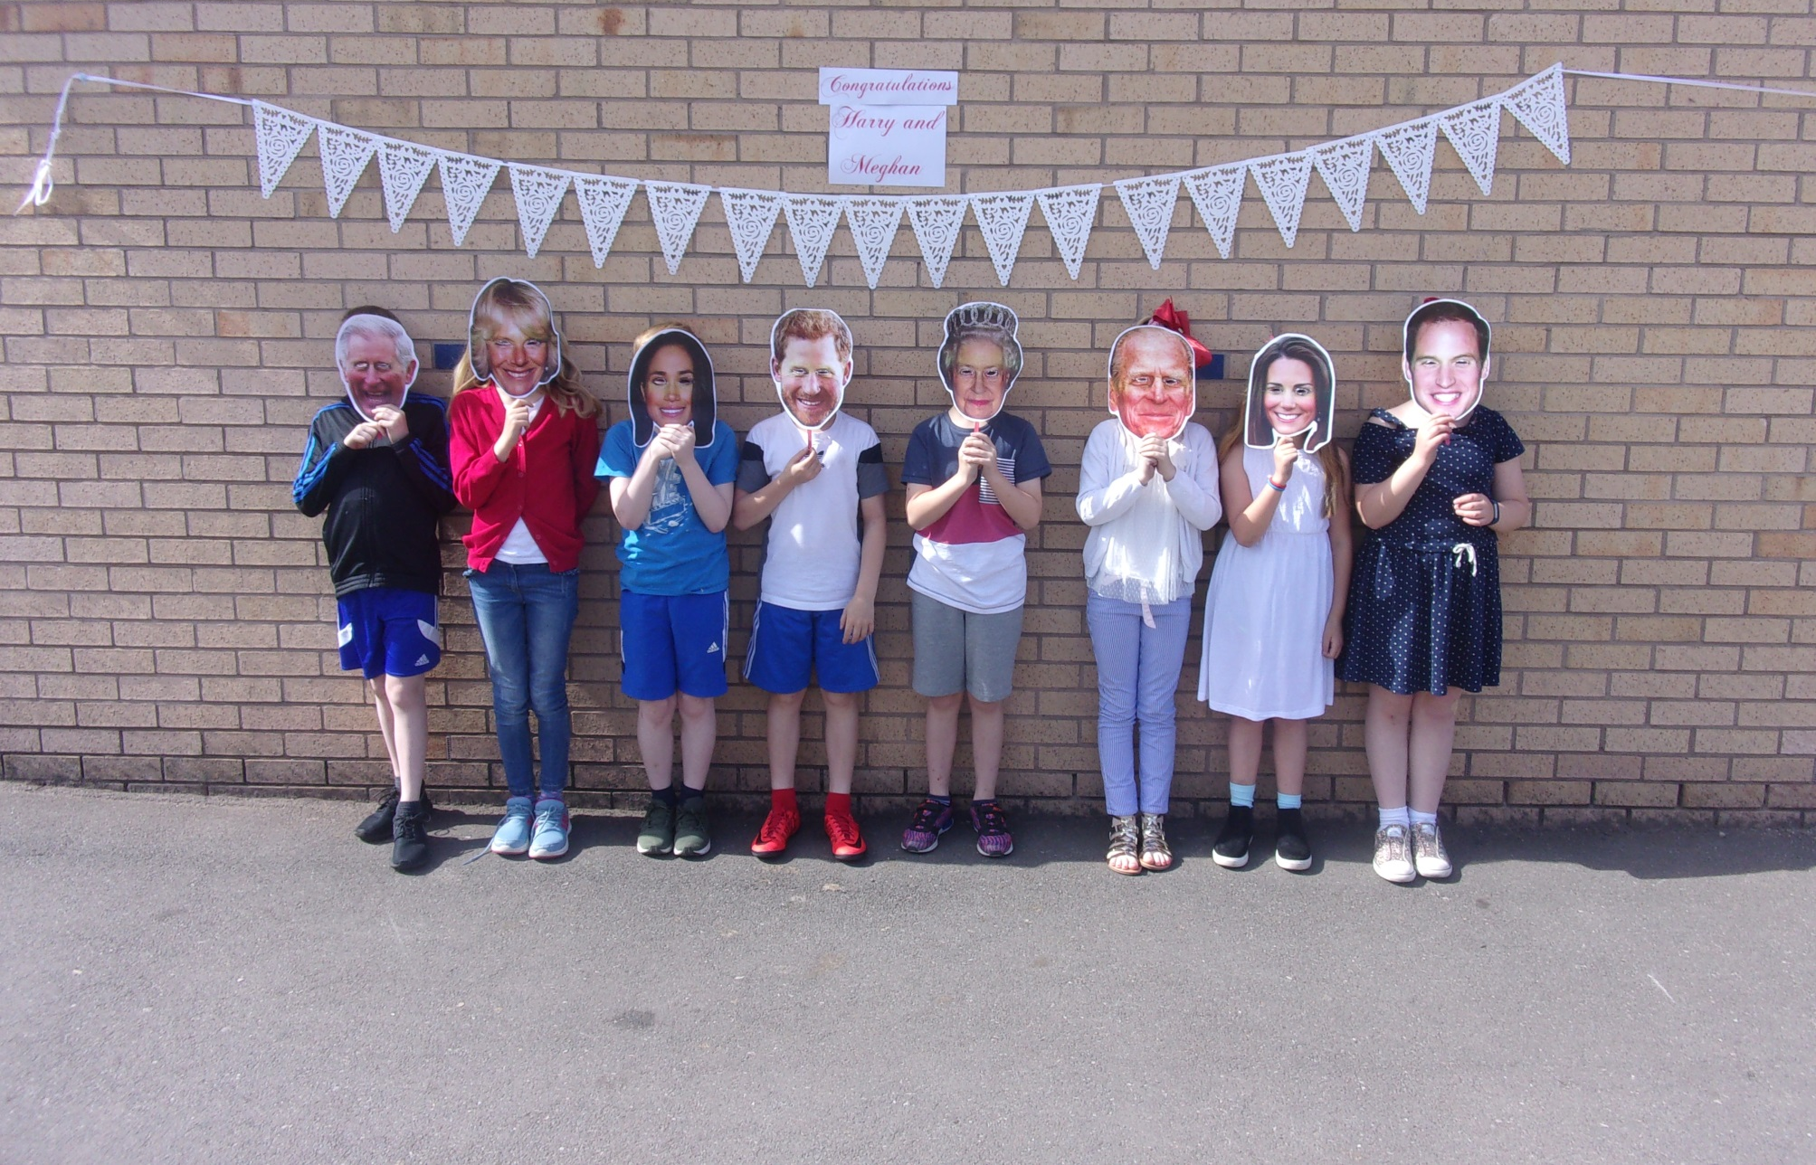
Left to right: Oscar, Lena, Connor, Theo, Aaron, Tia, Jasmine and Grace.

Slide 7
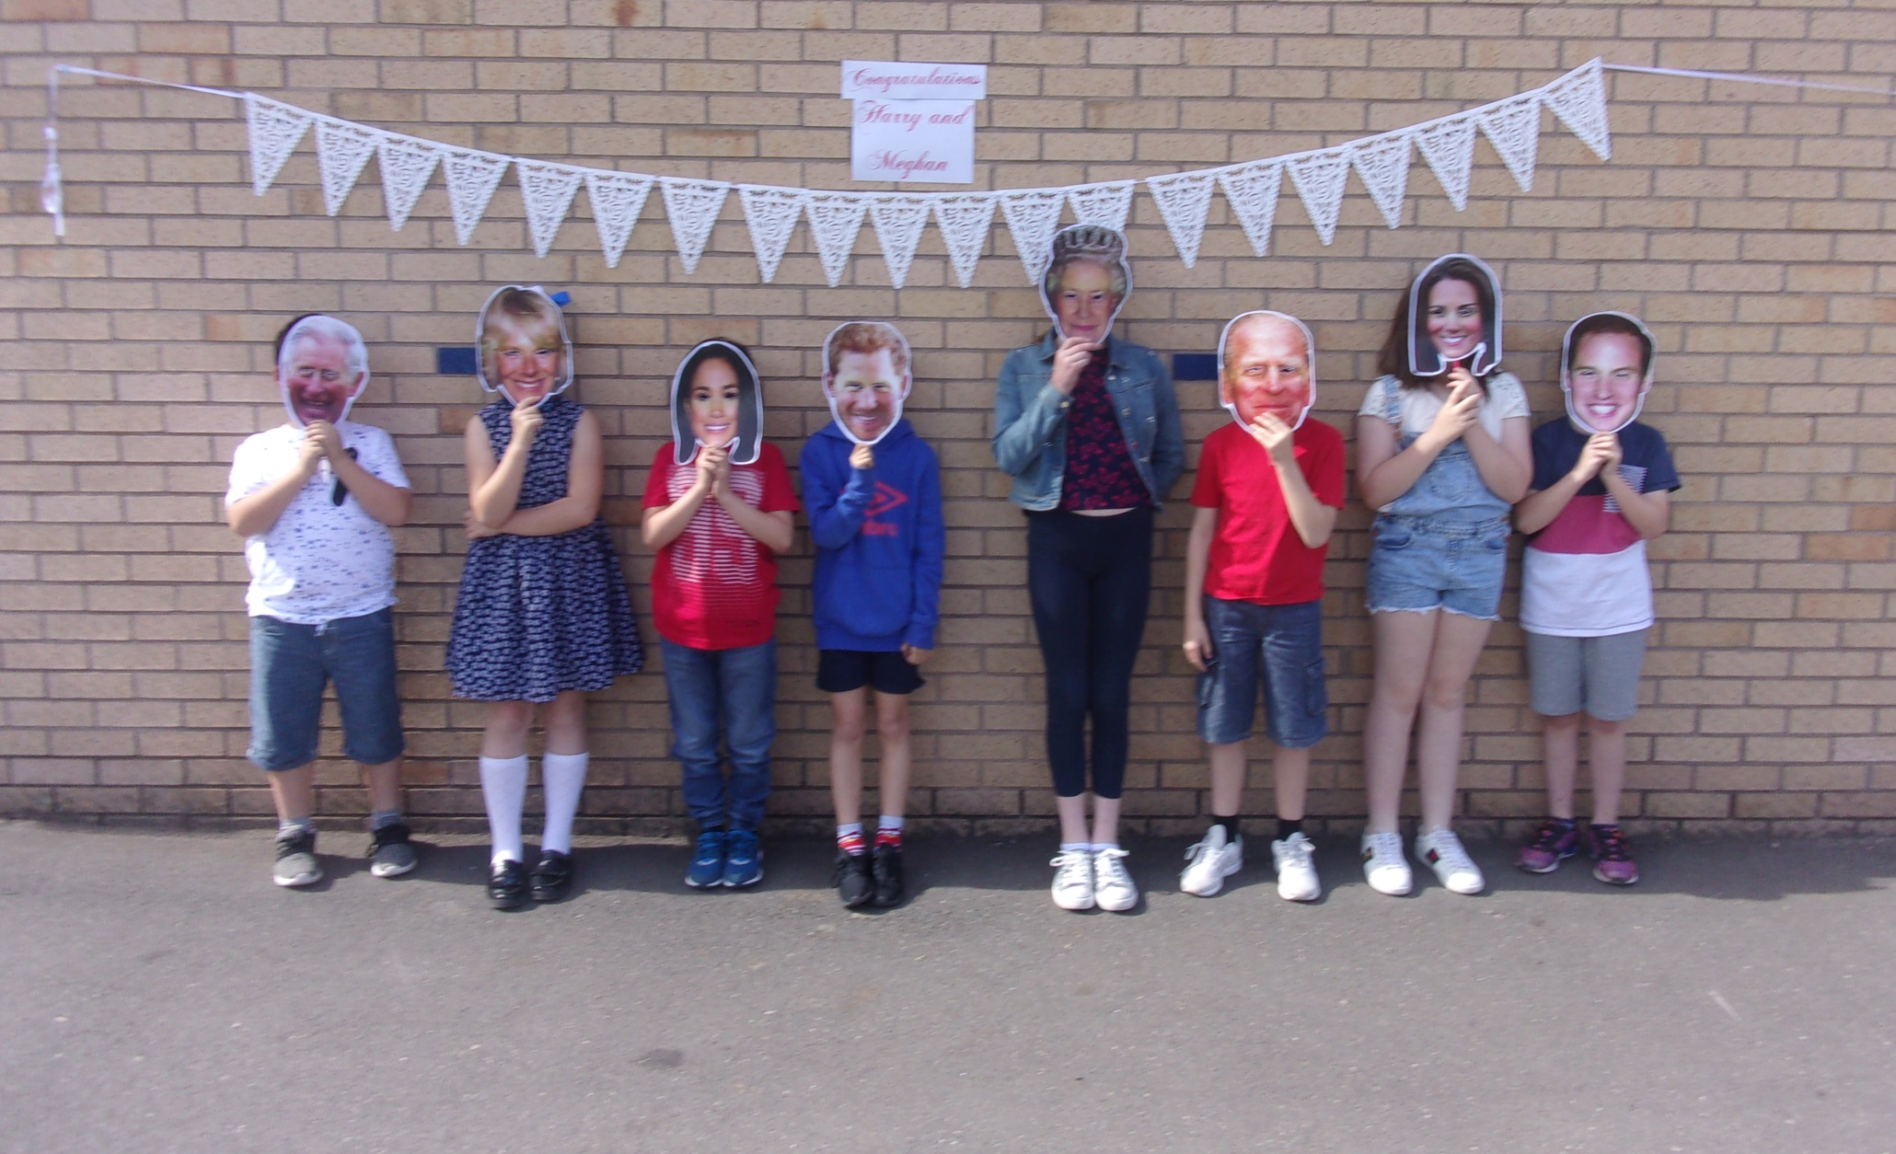
Left to right: Harvey, Diana, Adam, Joseph, Harriet, Layton, Lily and Aaron.

