Slide 1
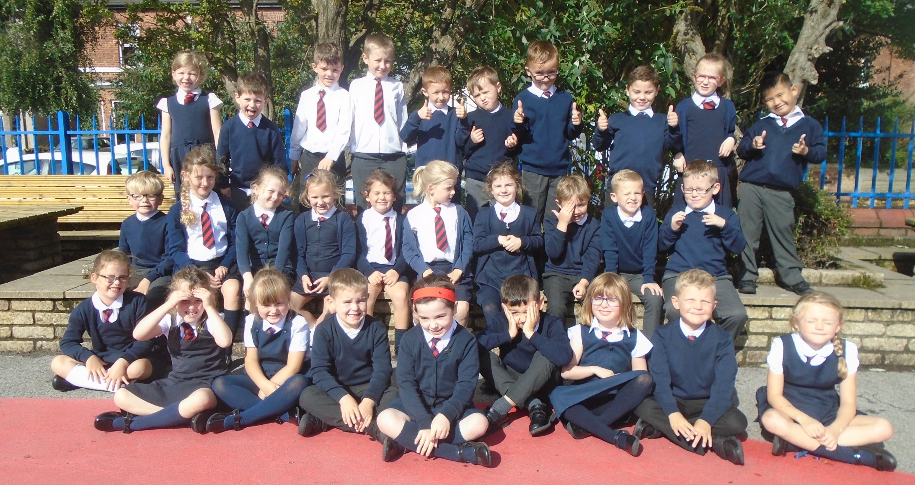
Welcome to year 2

Slide 2
Year 2 staff
Mrs Bond
Mrs Edwards
Mrs Rothwell
Mrs Bianchi

Slide 3
Routines
Doors open at 8.45am.
Register at 8.55am.
Finish at 3.20pm.
Thank you so much to everyone for being so punctual - we start phonics at 9 so it’s really important to be on time so everyone is ready to get started.

Slide 4

Housekeeping!
Please name all uniform –
Boys’ winter uniform Girls’ winter uniform
Grey trousers Navy skirt or pinafore
White shirt White blouse
Navy long sleeved jumper Navy long sleeved cardigan
School tie School tie
Please make sure your child has a water bottle each day
Tuesdays and Fridays are PE days. Please make sure kits are in school.
Children are allowed to wear navy blue tracksuit bottoms for outside PE during the winter.

Slide 5
Class Timetable
 | 9.00 - 9.20 | 9.20 – 10.15 |  |  | 10.55 – 11.55 |  | 1.00 - 3.20
Monday | P h o n i c s | English | Worshi p |  | Maths | L u n C h | A | Science
Tuesday |  | English |  | B r e a k | Maths |  | A | PE Mrs Antell | PSHE Mrs Edwards Mrs Waring
Wednesday |  | English |  |  | Maths |  | A | Topic History/Geography |  | Music
Thursday |  | English |  |  | Maths |  | A | ICT Suite/ Ipads Handwriting | RE
Friday | S p e l l i n g s | Maths – Reasoning Comprehension Guided Reading |  |  | PE Mrs Antell |  | A | Art French Golden time Mrs Afford

Slide 6

Medical
Any medication updates – please let us know of any changes
Please feel free to check your child’s inhaler before leaving to make sure it’s still in date.
We have been advised that children should use a spacer when taking their inhaler - if possible please send one into school.
If your child needs any prescribed medication, a medical form needs to be filled in at the office before we are able to administer it.
Thank you

Slide 7
Homework
Homework will be given out on a Friday to be returned by Wednesday.
Spellings will be tested each Friday.
Please try to read with your child every day and help them to learn their spellings.
Please let us know if any homework is too difficult so we can give a little extra help at school.
Thank you

Slide 8
Reading
Books are banded into colours.
Please try and read at home every night.
Shared reading.
Guided reading.
Reading across the curriculum.
Reading is fun!!!!!

Slide 9
Curriculum
Curriculum map is on the website.
Website
Please keep checking the website dates and news.
We will try to keep the website updated with lots of photos of your children at work and play.
You will also find information about after school clubs on the website.

Slide 10
Assessment
Assessment takes place at the end of each half term.
We track progress using Target Tracker.
The children work to meet all the objectives on the ladders you’ve been given.
Your children are in Year 2 so we are in Band 2
Each band has been split into six sections
Beginning and Beginning Plus ( B and B+)
Working Within and Working within Plus – Up to 70% of the statements are confidently achieved (W and W+)
Secure and Secure Plus (S and S+)
We aim for most children to make 6 bands of progress each year
If you’d like more information, here is a full explanation of the assessment process on the website.
To support our Teacher assessment, at the end of KS1, we use the Teacher assessment framework.
Please make sure you have taken:
English and maths ladders
Writing assessment sheet
Spelling lists

Slide 11

SATS
All Year 2 children sit SATS tests in Maths, Reading and SPAG (spelling, punctuation and grammar) in May.
There is no writing test but writing is teacher assessed.
More information will be given nearer the time but please be reassured that the testing process will be as stress free as possible.

Slide 12
Thank you for coming.
We’re here most evenings if there is anything you’d like to talk about.
Also - parent’s evening

