Slide 1



Slide 2
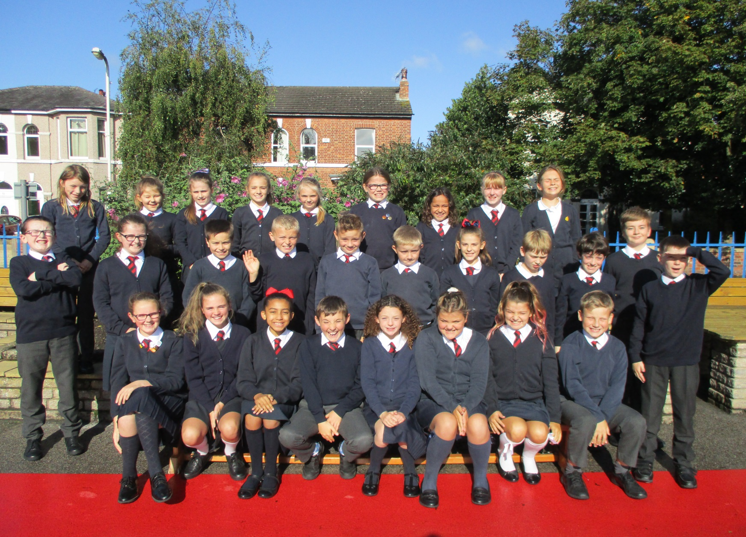

Slide 3

Medical
Any medication updates – please let us know of any changes
Please feel free to check your child’s inhaler before leaving to make sure it’s still in date.
We have been advised that children use a spacer when taking their inhaler - if possible please send one into school.
If your child needs any prescribed medication, a medical form needs to be filled in at the office before we are able to administer it.
Thank you

Slide 4


Housekeeping!
Please name all clothing
PE is on Thursday afternoons– please have kit in school.
Children must have pumps for indoor PE and trainers for outdoor PE. Navy joggers are to be worn for outdoor sports.
Please make sure your child has a water bottle each day
Healthy snacks can be brought in for morning break time – fruit, vegetable sticks, cereal bars (no sweets or nuts please).

Slide 5
Uniform
BOYS WINTER UNIFORM
GREY TROUSERS (NO OTHER COLOUR)
WHITE SHIRT
NAVY LONG SLEEVED JUMPER
SCHOOL TIE
DARK COLOURED SCHOOL SHOES.
DARK SOCKS
GIRLS WINTER UNIFORM
NAVY SKIRT OR PINAFORE DRESS
WHITE BLOUSE
NAVY LONG SLEEVED CARDIGAN
SCHOOL TIE
NAVY TIGHTS / NAVY OR WHITE SOCKS
DARK COLOURED SCHOOL SHOES.
Find the full uniform
list on our website

Slide 6
Homework
Homework will be given out on a Friday.
Spelling test on the following Friday.
Homework to be given in by Wednesday. Please let us know if any homework is too difficult so we can give a little extra help at school.
Please help your child to learn their spellings and tables each week.

Slide 7
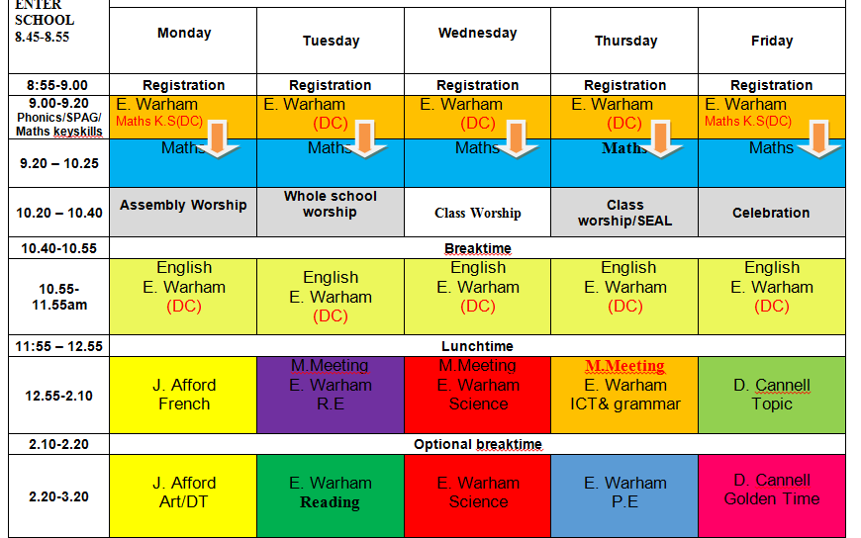
Class Timetable

Slide 8
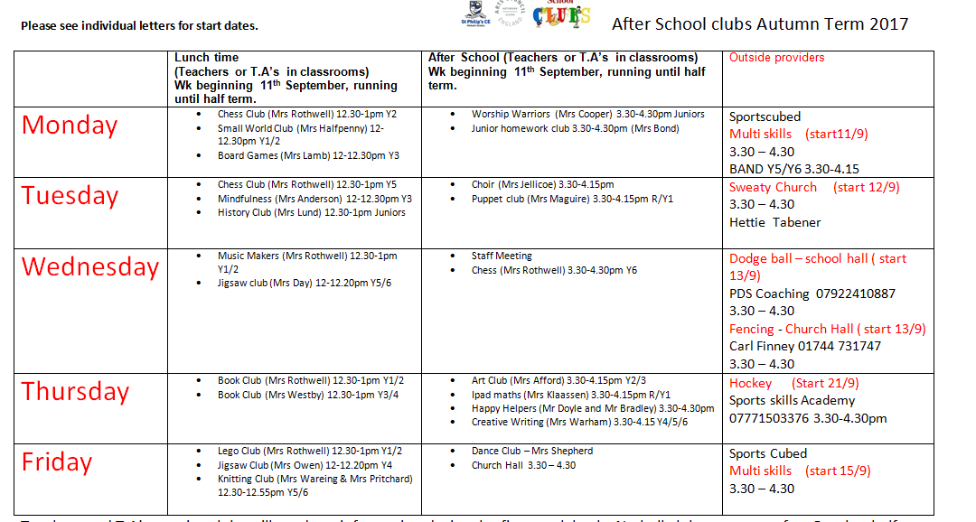
After School Clubs
Refer to our school website

Slide 9
Curriculum
Curriculum map/newsletter is on website.
Please make sure you have taken:
English and maths ladders
Writing assessment sheet
Spelling lists

Slide 10


Behaviour and
Good To Be Green

Slide 11

Walking home
If you would like your children to walk home from school on their own, please could you sign the permission slip provided. This is for the safety of your children as they will be let out at the end of the day by a number of different teachers.
Thanks for your co-operation.

Slide 12
Buddies
I expect your children have already told you all about their buddies.
They met up for the first time last Friday.
It was lovely to see how caring and nurturing the Year 6 children were with the reception children. They all seemed to get on well and I’m sure the relationships will flourish throughout the year.
We now have a rota so they can play with the buddies one lunch time per week.
Please note the buddy assembly will be
Wednesday 11th October at 2.30.

Slide 13
Responsibilities
Your children have all, without exception, taken to their year 6 responsibilities extremely well.
They all have jobs around the school which will be changed termly so as to give as many children as possible the opportunity to try out different things.

Slide 14


Residential
The Year 6 residential is way up there on their list of things they’re looking forward to.
Date of trip:
June 2018
This year we’re going to a PGL
Activity center.
Winmarleigh Hall Adventure Centre, Preston.
We have created a payment plan so as to spread the cost. This can be paid either at the office or through Parent Pay.
See letter for details.
WE HAVE MANAGED TO GET A DISCOUNT OF £20 PER CHILD.
THE ORIGIONAL PRICE WAS £229, NOW £209!

Slide 15
Children’s greatest fear regarding year 6 was:
SATS
We’ve tried to reassure them that they’ll be ready for them when they do them.
It’s never as bad as they think it will be – we make them feel special during SATS week.
Some children enjoy the challenge!
Hopefully they’ll be happy with their
results.
SATS week: Monday 14th May-Thursday 17th May

Slide 16

Parent’s evening:
Wednesday 1st November: 3:30-6:00
Thursday 2nd November: 5:00-8:00.

Slide 17

Spellings
We are having a huge emphasis on spellings this year. Children need to be practising their spellings daily and not for a spelling test.
In Year 6, children need to be able to spell words from the Year 3 and 4 curriculum list as well as the Year 5 and 6. They must show they can spell these words correctly in their writing.
Please take home the spelling sheet with both word lists on and ensure your child refers to it throughout each week.

Slide 18

Times tables
As you will be aware, we have the Bronze, Silver and Gold badges in school.
Children must practise their times tables daily. Even if they think they know them- by Year 6 they must be quick to recall them.
Children will be given two resources to take home and practise. There are also various sites to use:
https://www.youtube.com/watch?v=4BLZKOjNKfk

Slide 19
Subject ladders
We have English, Maths ladders for you to take away with you. Please read them and refer to them throughout the year as they show the expectations for your child in Year 6.

Slide 20

Assessment

Slide 21


Slide 22


Slide 23
Thank you for coming.
We’re here most evenings if there is anything you’d like to talk about.
Check website for information:
http://www.stphilipssouthport.com/

Slide 24


Slide 25


