Slide 1
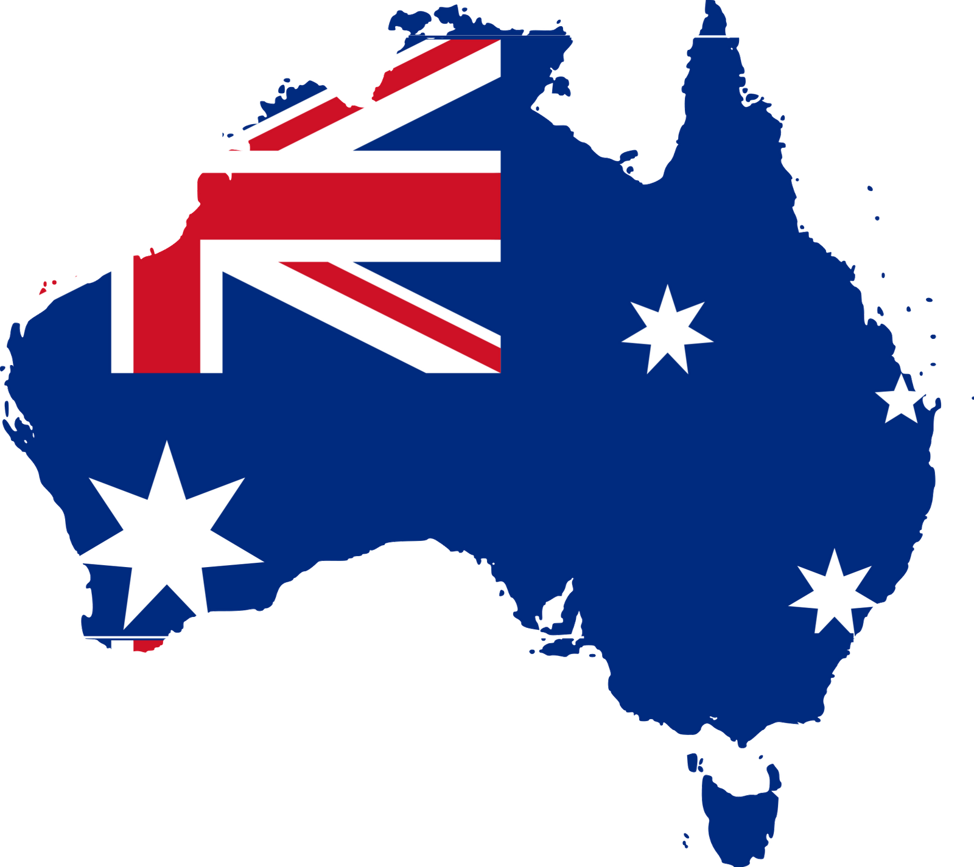
History and life of Australia
By Charlie Year 6

Slide 2
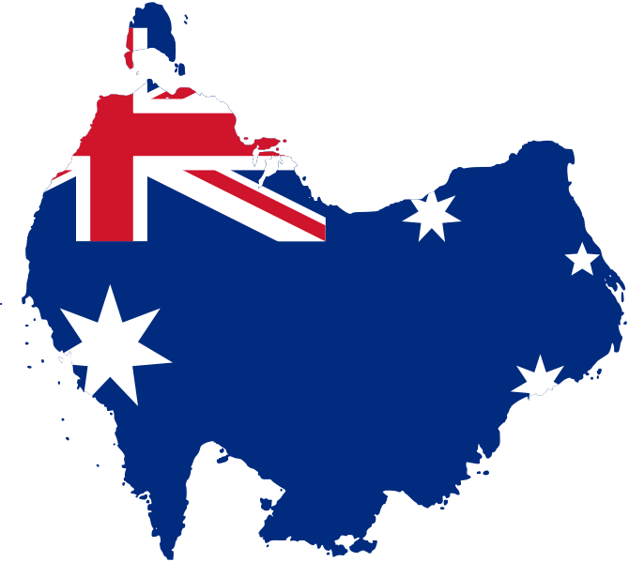
HOW MANY PEOPLE LIVE THERE
Back in the 1700s only 7 million people lived Australia (London has 7 million people living in it )
Now it has a population of 24.26 million people living there.

Slide 3

Who were the first people to live there?
The first people to live there were called the aboriginal people and Torres strait islanders .They came by boat from the islands of Indonesia . They lived in all parts of Australia

Slide 4
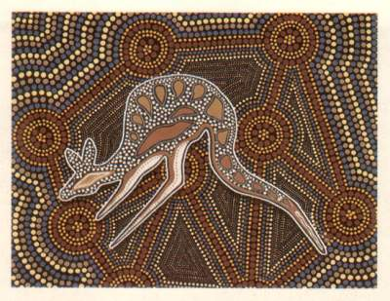
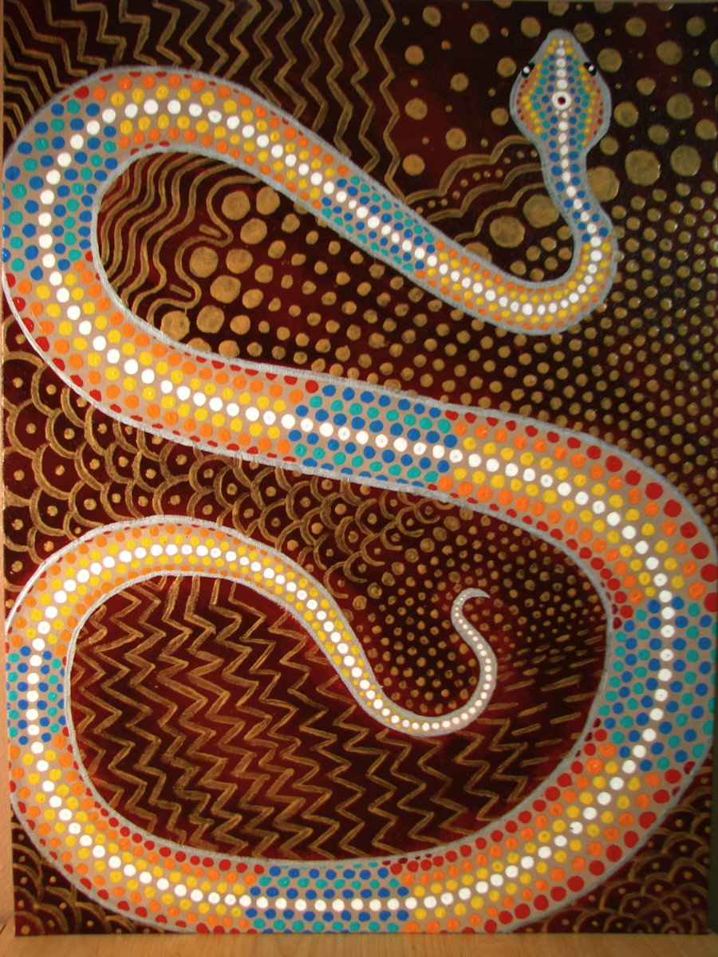
Aboriginal art
This is some aboriginal art , this is what they would paint.

Slide 5
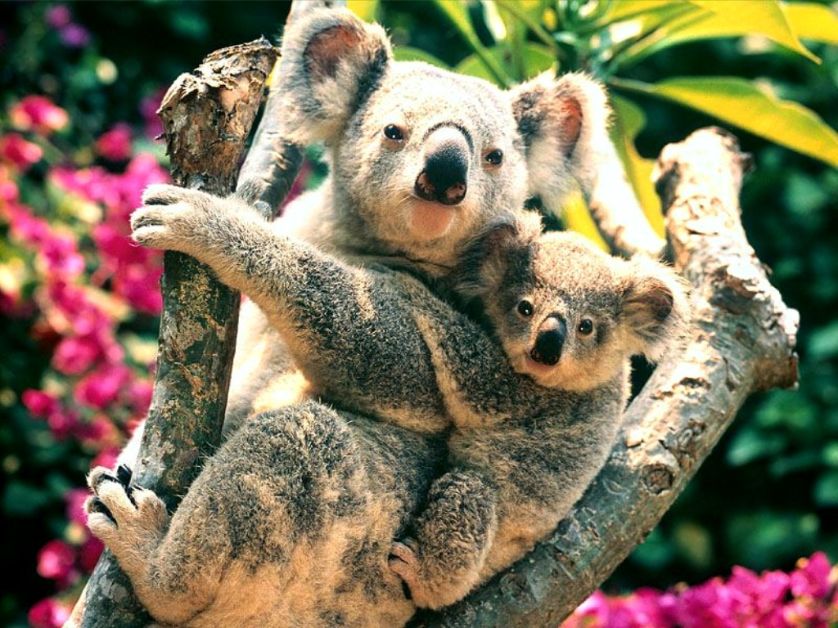
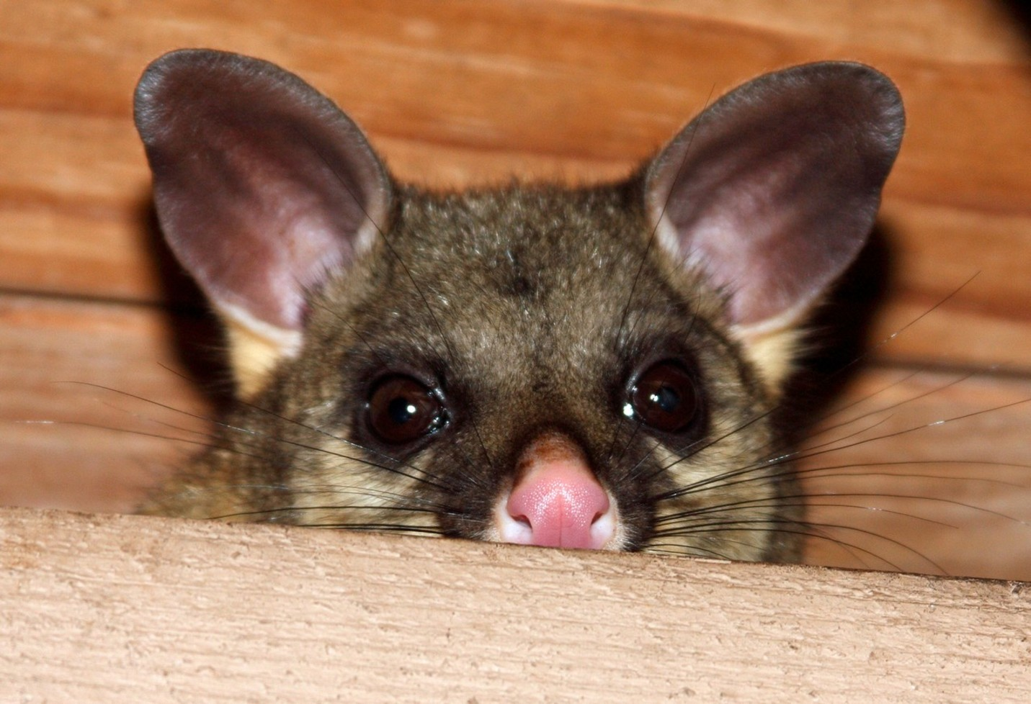
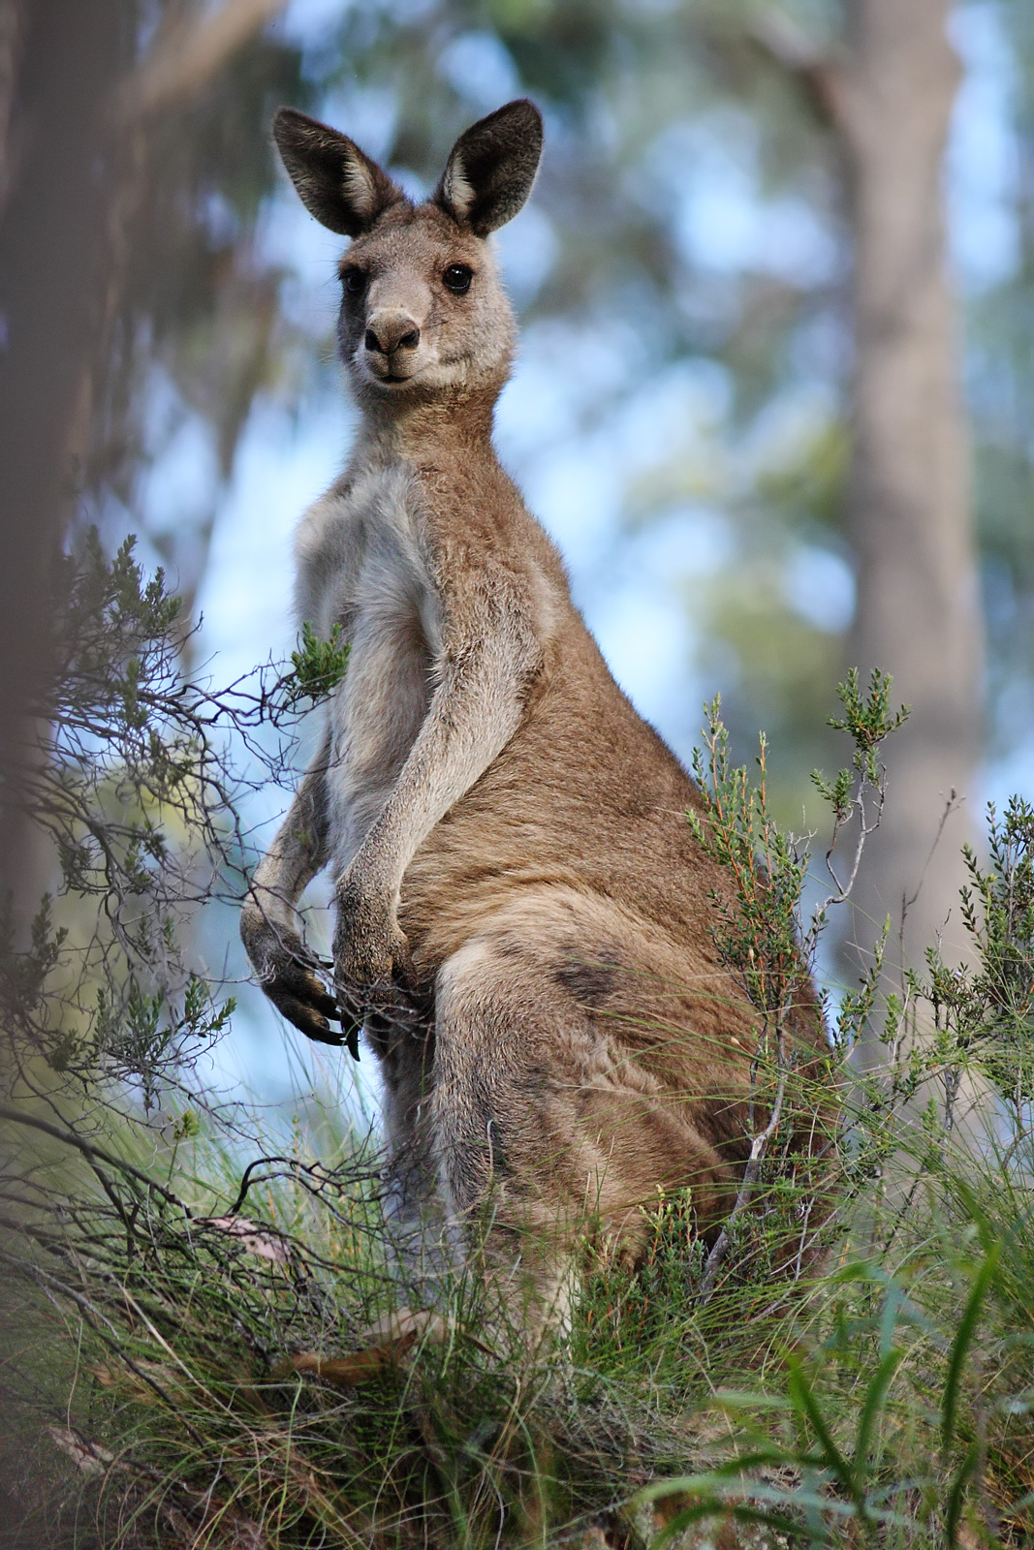
Animals in Australia
Names
Pictures
Koalas
Kangaroos
Possums

Slide 6
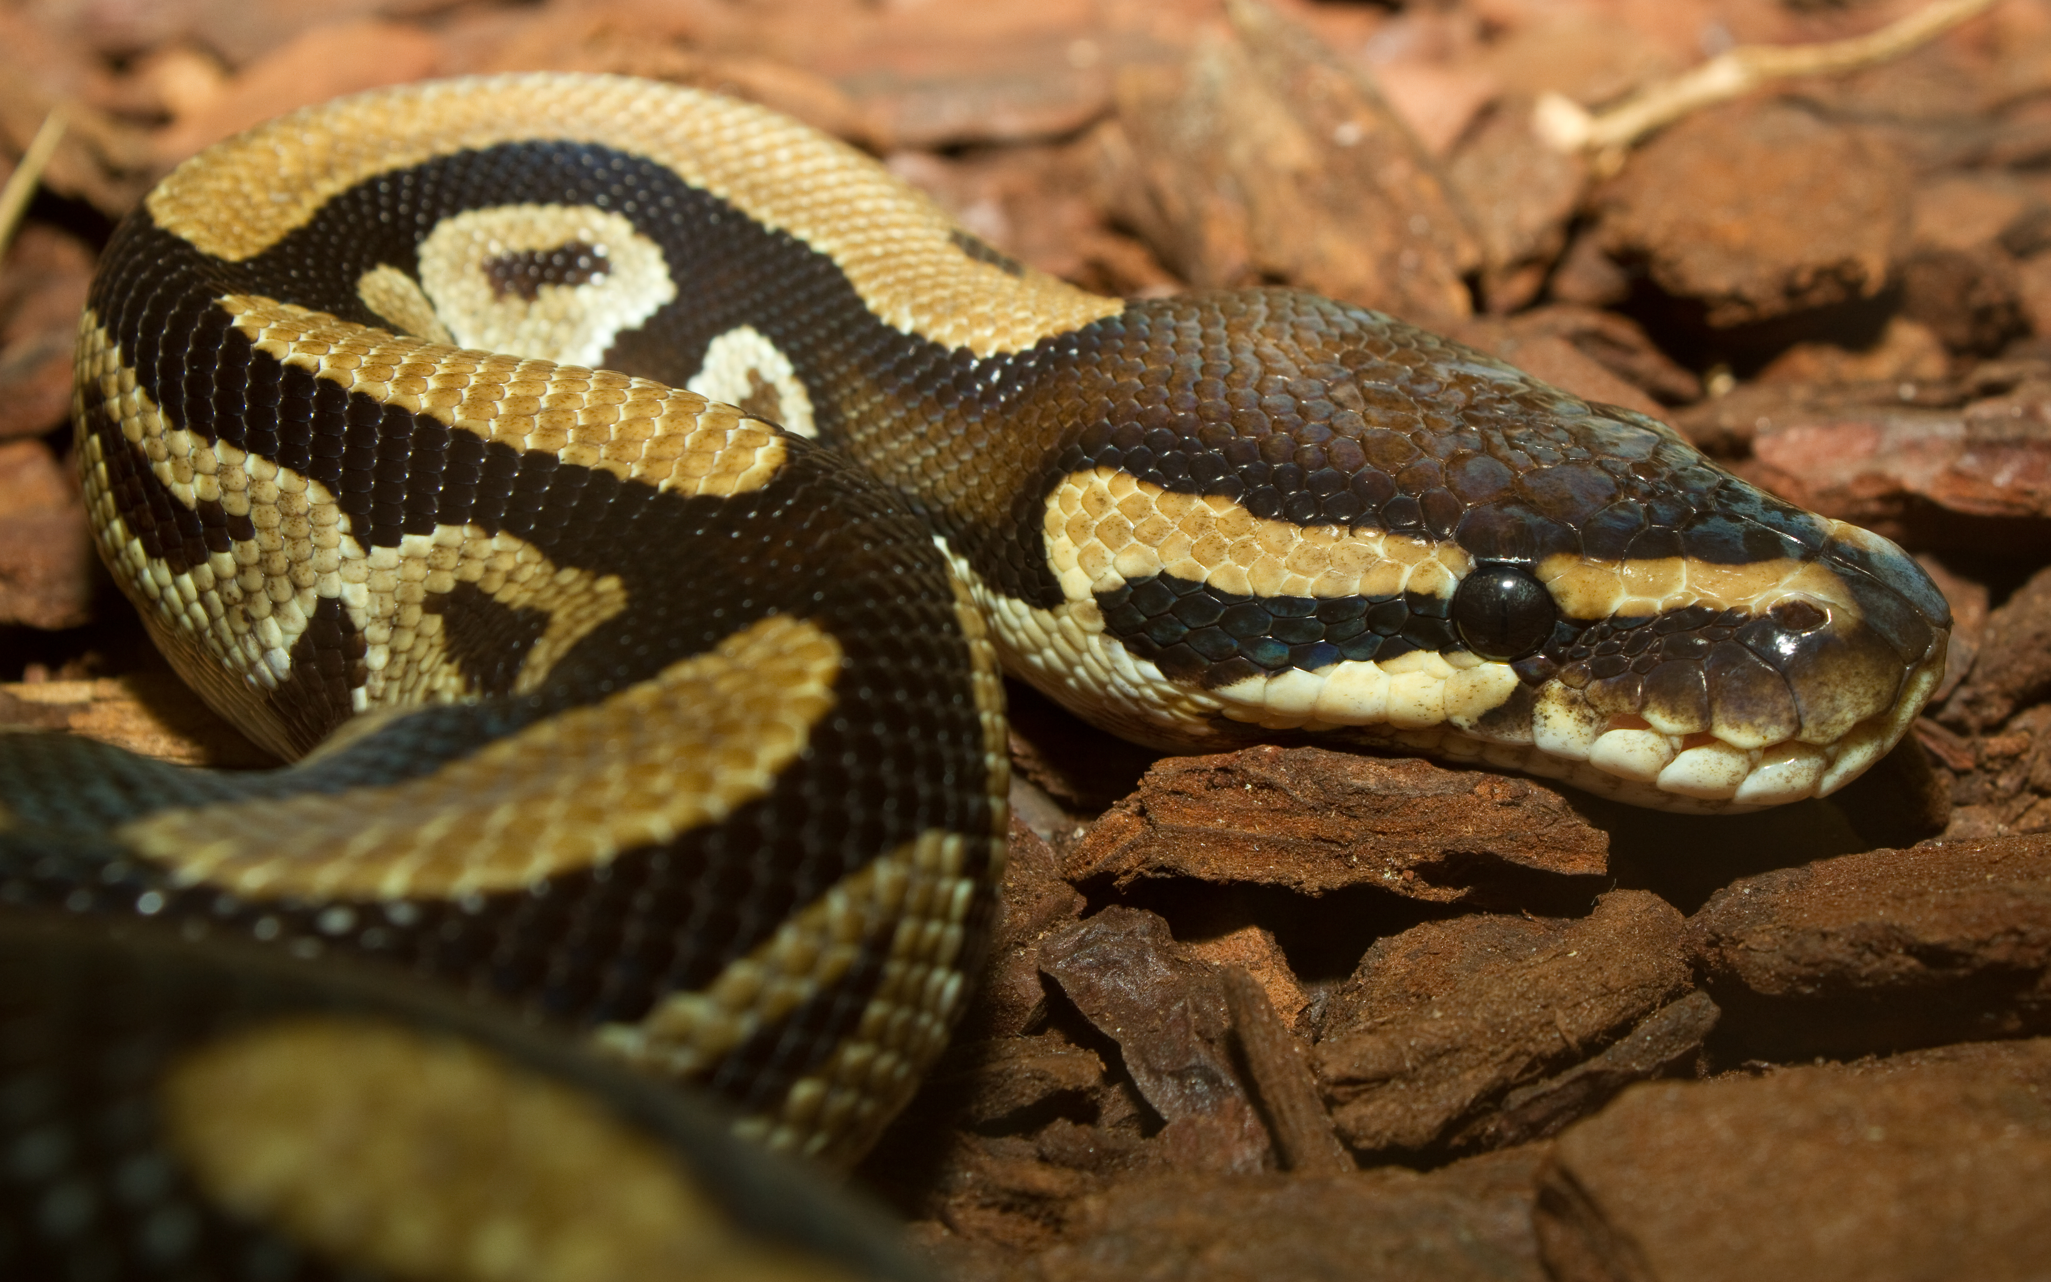
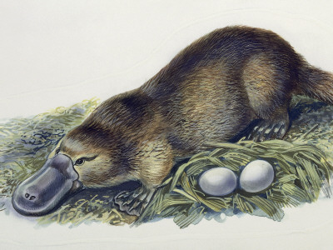
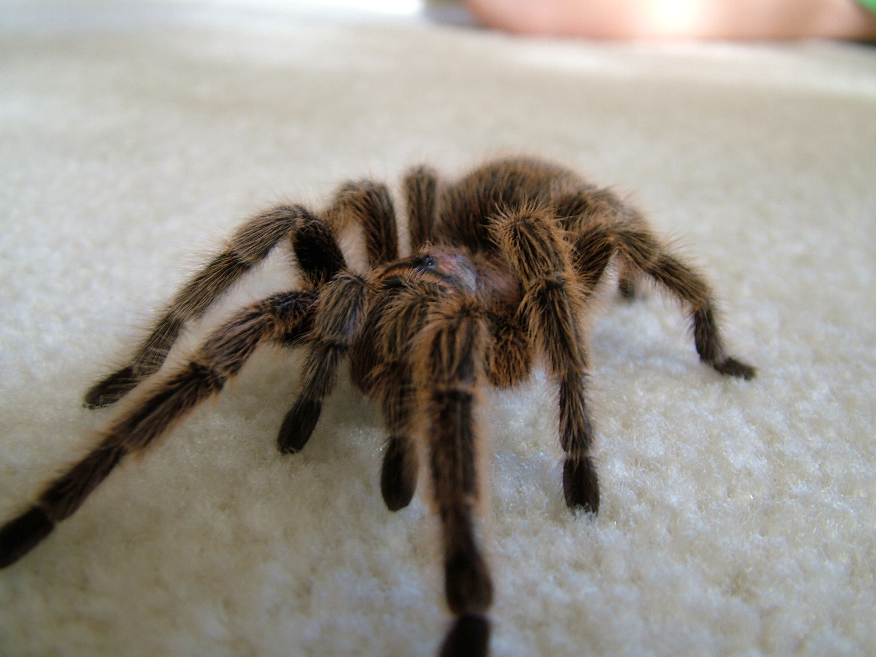
Some more animals
pictures
names
Pythons
Platypuses
Tarantulas

Slide 7

Jungles
The jungle of “I’m a celebrity get me out of here!” is in Australia.

Slide 8
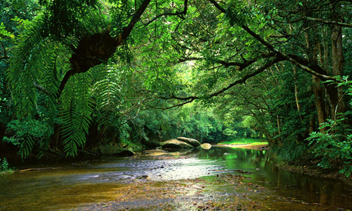
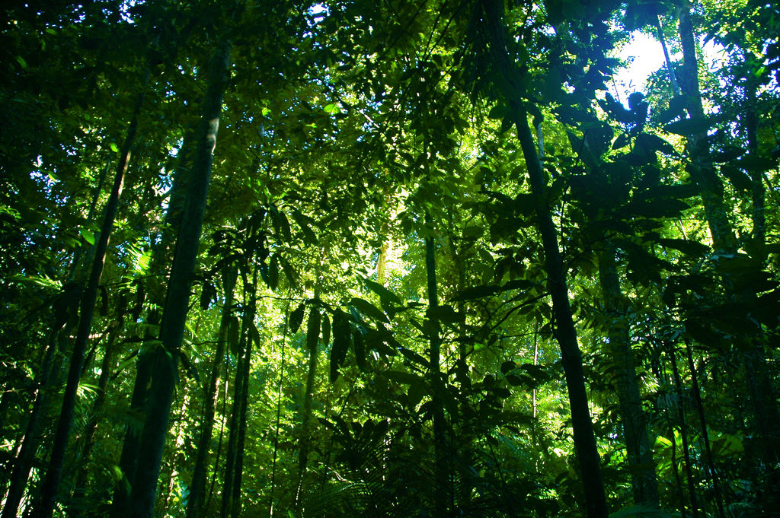
More on the Rainforests
A lot of the animals that I have mentioned live in rainforests
Like the snakes , spiders, possums and more

Slide 9
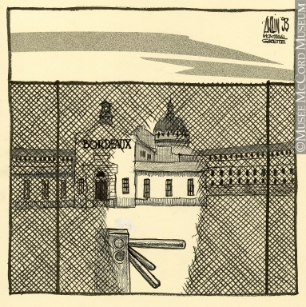
Why British people would have gone there as punishments, in the 1700s
why
why it was bad :
Australia is massive compared to England and only had 7 million people living there and we have 60 million .Our prisons were getting to full so we sent them all the way to Australia because it has loads of space.
They would be sent there with no money, no house ,no nothing.In other words nothing.

Slide 10

About The Commonwealth Games.
How the commonwealth started. Its roots go back to the British empire , when some countries were ruled directly or indirectly by Britain . Some of these countries became self governing while retaining Britain’s monarch as head of state. Then , they formed the commonwealth of nations.
About the Commonwealth. The first commonwealth games were in 1930 in Hamilton , Canada, where 11 countries sent 400 athletes , in 6 sports and 59 events . Since then , the games have been conducted every 4 years ( except 1942 & 1946 due to world war II ) and the events have seen many changes , not least in its name.

Slide 11
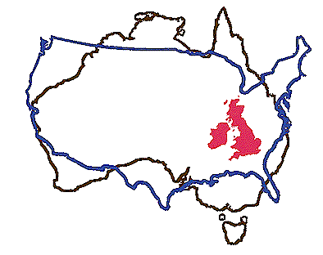

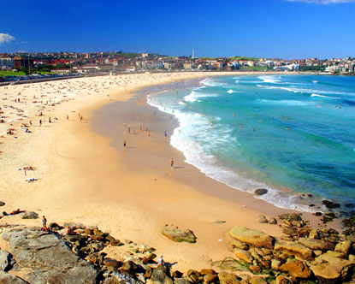
Why it’s a good place to move to from England.
It’ s a lot less busy with only 24.26 million people living there whereas England has 60 million people living here and England goes into Australia 75 times all together
It is way more sunny and warm than England . July is the hottest month in London with the average temperature of 19 degrees in summer in Australia it is around 30 degrees so much hotter .
There are loads of lovely beaches.

Slide 12
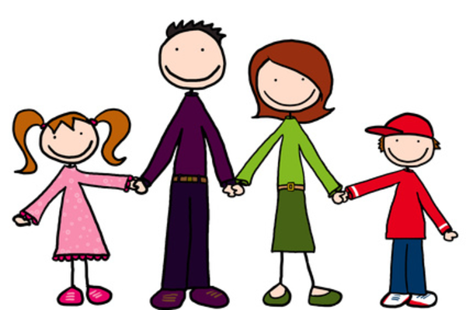
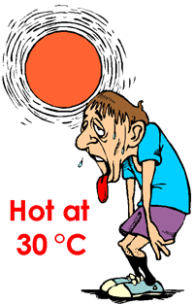
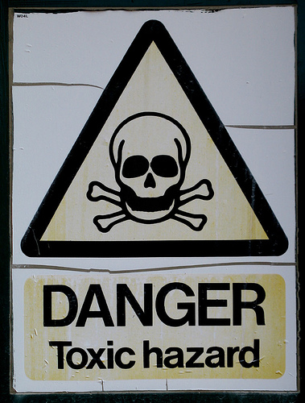
Why you might not move there.
You would miss your family and friends because you will be all the way across the world.
It is extremely hot
There is a lot more poisoinous animals in Australia

Slide 13
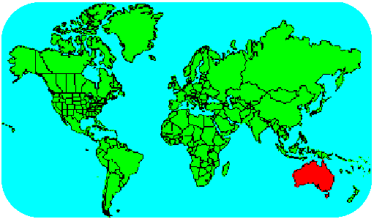
Where Australia is in the world.
where
Where about.
Across to the left and up you can see England witch is a lot smaller then Australia, as I mentioned before.
Straight across to the left you can see Africa , Africa is a lot bigger than Australia as you can see , that should give you a rough understanding of how big and were it is.
The capital is :Canberra.

Slide 14

Facts about the past of Australia.
These are all about the aboriginal people. The first Europeans to discover Australia were waves of seafarers ,land explorers and Dutch navigators , mainly Thomas cook, in 1606 They also mapped Australia . The first documented encounter was that of Dutch navigator Willem Janszoon , also in 1606. Dutch seafarers also visited north and west coasts of the continent , as did the French. In 1788 the war of the two cultures began it was an equally mean comments were traded now of which are offensive & you can go to jail for now. The war finally stopped in 1992 but reduced the population of aboriginal people in Australia to 4 percent ( that is aboriginal people &Torres , strait islanders)

Slide 15


The war between the Europeans and aboriginal people finally stopped in 1992 and now people from the European culture go there on holiday There.
The war ending

Slide 16

A little quiz…
1:What is the capital of Australia?
(all the answers have been in the power point)
A. a town
B. The capital of Australia
C. Canberra
2: How many times does England fit into Australia?
a.75 times
b.2+1
c.10 000 000
Answers
1;c
2;a

Slide 17

Some more questions
3:How many people live there?
a.5
b. 24.26 million
c.800 000
4. How hot is the average day in June in Australia?
a.40000000000000 degrees
b.30 degrees
c.-300 degrees
5. Who were the first people to live there?
Aboriginals
b. Torres
c. both
Answers
3:b
4:b
5:c
How many did you get right?

Slide 18

That is all we have time for &thank you once more
I hope you learnt something new

Slide 19


Thanks for watching
By Charlie Hudson yr6

