Slide 1
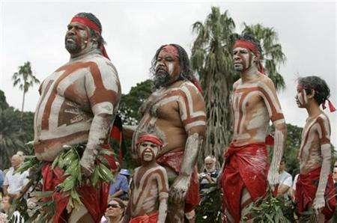
Aboriginals!
By Amelia

Slide 2

Who are Aboriginals?
Aboriginals are the indigenous people of Australia, descended from groups that existed in Australia and surrounding islands prior to British colonisation. They aren’t like us, but that doesn’t mean that they aren’t interesting.

Slide 3
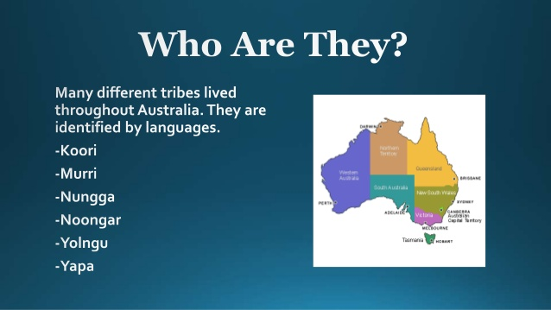
Where do they live?
Australian Aboriginals actually live all around Australia. The mostly live in Western Australia in Perth because it is has very high temperatures there. In fact, the hottest Australia has ever been is 103 degrees! They usually live in deserts because the are quite used to the sun. The are a lot of Aboriginals also in Queensland. Some may live in the Northern Territory or perhaps South Australia.

Slide 4
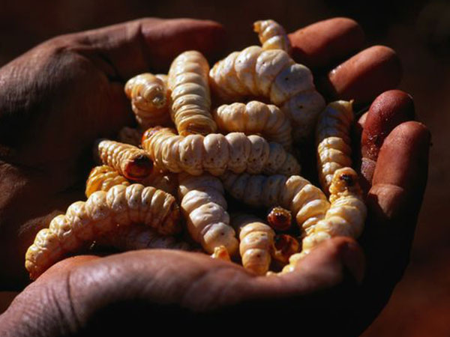
How do they get food?
The Aboriginals get their food by throwing home made spears at animals like kangaroos and emus, then skinning the of their fur by picking up anything sharp of the ground and shed the fur/feathers. They then cook it over a fire in their village. Some Aboriginal women dig in the dirt to find maggots, worms and scraps of meat left to eat. They also picked harmless fruits and berries near by to eat along side their meat filled meal.

Slide 5
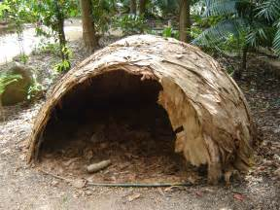
How do they make their homes?
The Aboriginals used sticks, bark, leafs, rocks and long wood to create their homes. Their houses (or huts as you may call them) are called gunyah, humpy or mia mia depending on the tribe. They don’t have a home like us because they don’t have the clay to make bricks and they would have to make it quickly because they only have 24 hours (one day) to make it because otherwise they would have to spend the night alone out in the dangerous deserts of Australia, and no none would want to do that, especiallly not Aboriginals.

Slide 6
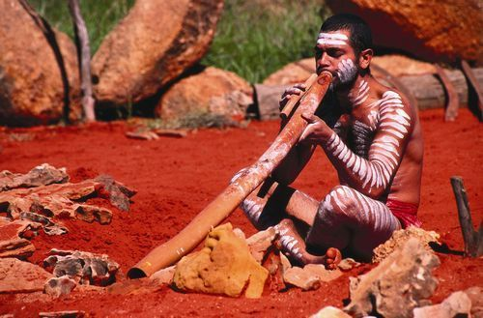
What is the instrument that they play?
The Aboriginals are most famous for playing an instrument called the didgeridoo, a long curved tube made out of wood. Sometimes they created patterns on the instrument to give off a little more flare. It’s formal name is “drone pipe” and is classified as a wind instrument.

Slide 7
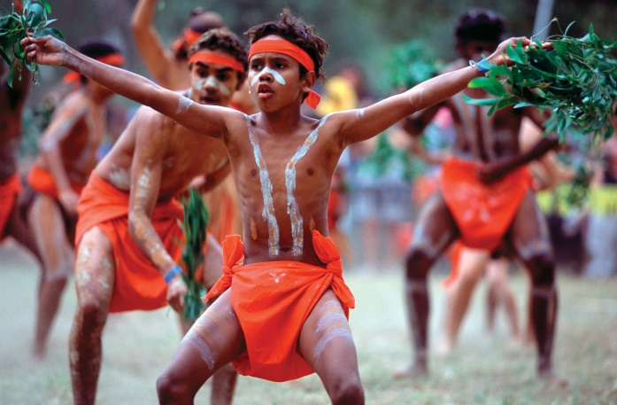
What do the children do?
They explore the woods, chase frogs and lizards and maybe help gather firewood. They learn gender-role skills like archery, spear throwing and tracking for boys and basket-weaving, pottery or mending fish nets for girls. They listen to the stories told by old men of the old days, which develop into legend and become a part of their culture forever. They learn tribal songs, dances, rituals, traditions and what is expected of them as they grow up. Kids left on their own will invent games. If the game is a good one, kids will play it over and over for a period of time.

Slide 8
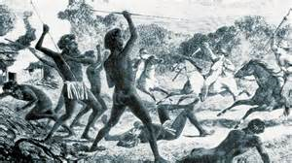
What happened so that there aren’t as many of them now?
In 1788, the English arrived at Australia, which changed the Aboriginals for eternity. Ever since that, Aboriginal people have had their land stolen from them or destroyed. Until 1992, when it was finally over, the legal principle governing British and Australian law regarding Aboriginal land was that if the land was empty before the British arrived, belonged to no-one, it could legally be taken over. Most land has still to be returned today, and the loss of their land has had a devastating social and physical impact on Aboriginal people. The initial invasions also activated huge waves of disease that killed thousands. In just over one hundred years from the first invasion of their land, the number of people were reduced from up to an estimated one million to only 60,000.

Slide 9
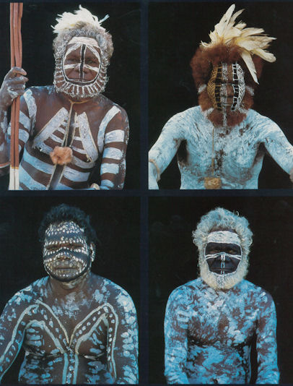
What do they wear?
Their clothes are made from grass, leaves, barks, animal skin and possum cloaks. Boys usually wear shorts, girls a long dress, women skirts belts and lap laps and men wear cloaks. Cloaks are made by sewing pelts together to create a strip of fur. It is unknown who makes the clothes in tribes. They also painted their faces with white paint to show age, initiation or to raise a person's status. They don’t have cotton clothes like us because they didn’t have shops to buy them.

Slide 10
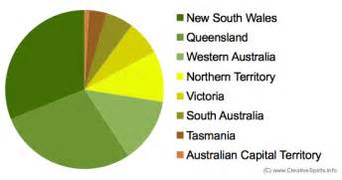
How many of them live in Australia?
It is reported that approximately 200 million people live in Australia, with over 23 million being Aboriginal. That make up 1 percent, 1/100 or 0.001 of the people there. So that means that 87 million are civilised, live in homes and buy from local shops. But, there are over 500 different tribes, languages and religions Aboriginal people have.

Slide 11

Its…
Quiz time!
There are 16 questions, two per slide. Can you answer them all correctly?

Slide 12

Quiz!
1. Which place beginning with Q do they live in?
A:Q-Park
B:Queensland
C:Quenton
2. What did the Aboriginal women do in the dirt?
A:Hunt bugs
B:Make mud pies
C:Punch it
3.The Aboriginals had clay to make bricks
A:True
B:False
4.The didgeridoo is a…
A:Brass instrument
B:Woodwind instrument
C:Neither

Slide 13

Quiz!
5.The children would invent a new…
A: Language
B:Weapon
C: Game
6.When did the English invade the Aboriginals?
A:1877
B:2000000BC
C:1788
7.Men would wear…
A:Paint
B:Cloaks
C:Both
8.There are _______ people who live in Australia
A:2
B:20 thousand
C:200 million

Slide 14

Quiz!
9.The hottest Australia has ever been is…
A:1 million degrees
B:103 degrees
C:84 degrees
10.They threw home-made…
A:spears
B:swords
C:axes
11.They used _______ to build their homes
A:leaves
B:bark
C:both
12.Its formal name is …
A:Mr nose
B:Aboriginalistic
C:drone pipe

Slide 15

Quiz!
13. The children chased rabbits
A:True
B:False
C:Ohh, cute! A bunny!
14. The war between the Aboriginals and the English ended in…
A:1992
B:the 20th century
C:1866
15.The Aboriginal women wore…
A: leans
B:jackets
C:lap laps
16. ________ of Australians are Aboriginals.
A:500
B:1 percent
C:all of it

Slide 16

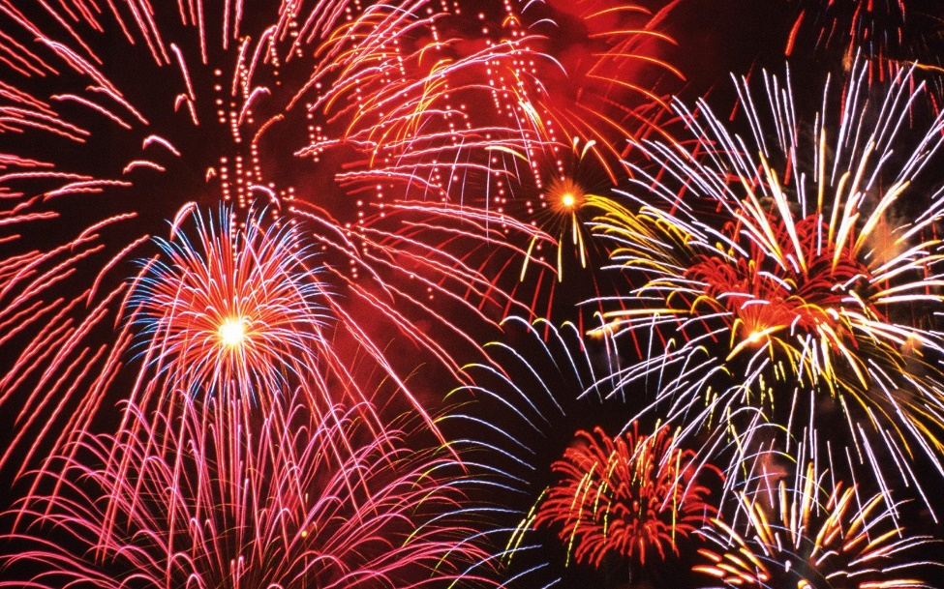
Answers!
How many did you get right?
1.B
2.A
3.B
4.B
5.C
6.C
7.B
8.C
9.B
10.A
11.C
12.C
13.B
14.A
15.C
16.B

Slide 17



