Slide 1

Our window today…is to look at our country and understand better and be thankful for the values it has

Slide 2

Do you know what the 4 British Values are that we focus on in school?

Slide 3
????
Democracy
Individual liberty
Mutual respect
Rule of law

Slide 4

Our mirrors today are to see what these 4 British Values mean …

Slide 5
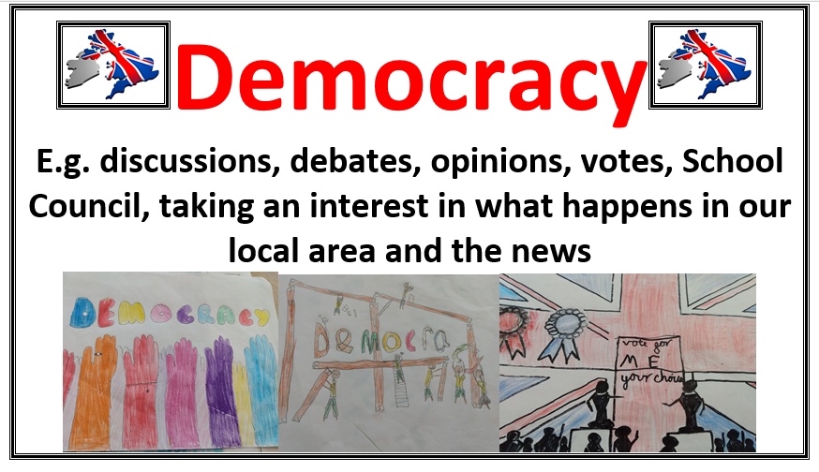
Democracy

Slide 6
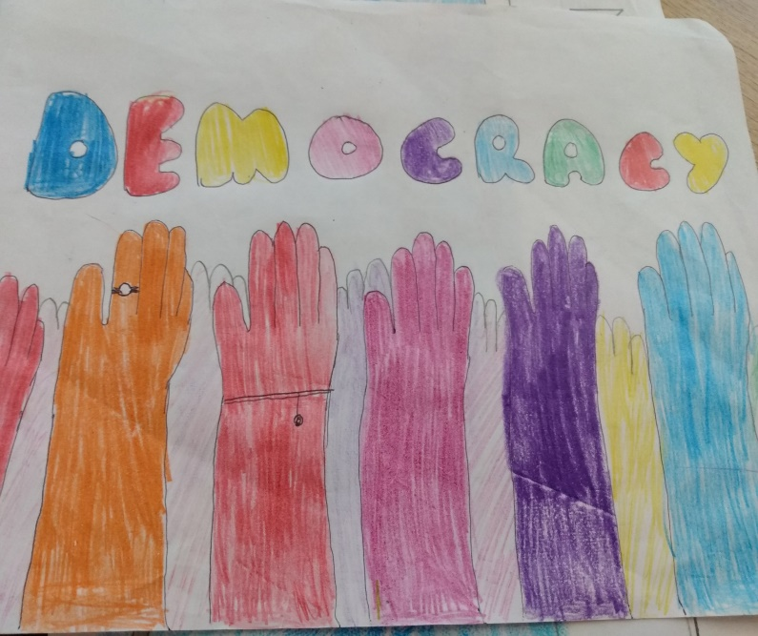
Democracy
Adults get to vote for who runs the country
If we don’t like what they do we can vote to get new leaders
In some countries people do not get to choose who their leaders are
Here in school we have a school council that is a way of getting pupil voices heard about how you want things to be here

Slide 7

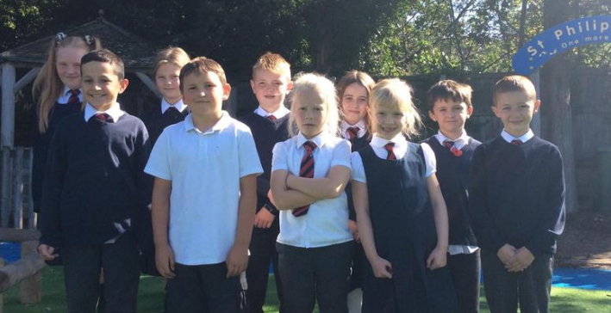
Here in school we have a school council that is a way of getting pupil voices heard about how you want things to be here

Slide 8
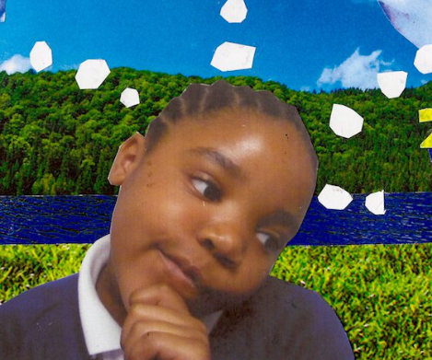
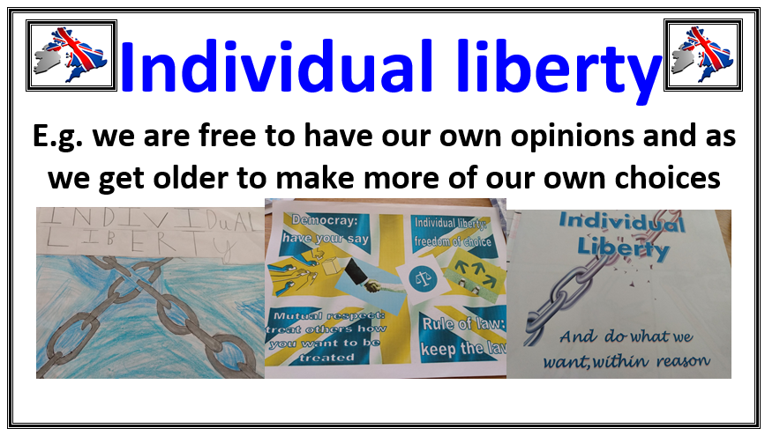
Individual liberty
Imagine….you never got to choose what to do ever…never got asked what you’d like to eat…or watch…or do?

Slide 9
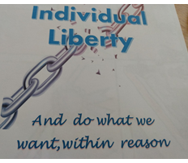
Some countries don’t let people make choices about their lives…some countries block social media like facebook…some won’t let people worship as they want to…
Here we get lots of choices as we get older
We are free to complain and choose new leaders

Slide 10
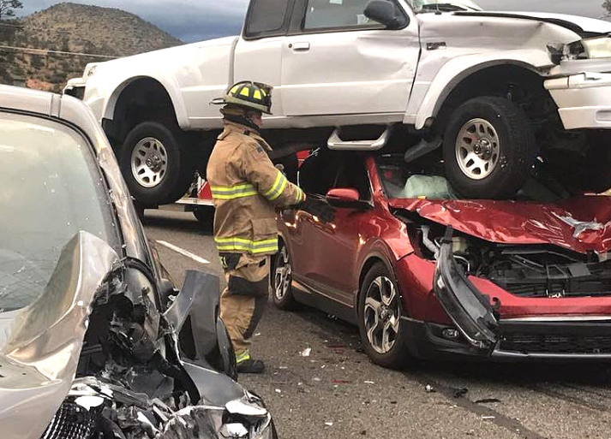
Rule of law
Close your eyes...imagine a world where there were no rules…imagine no traffic rules…no traffic lights…cars driving on either side of the road or pavement!!...no speed limits

Slide 11
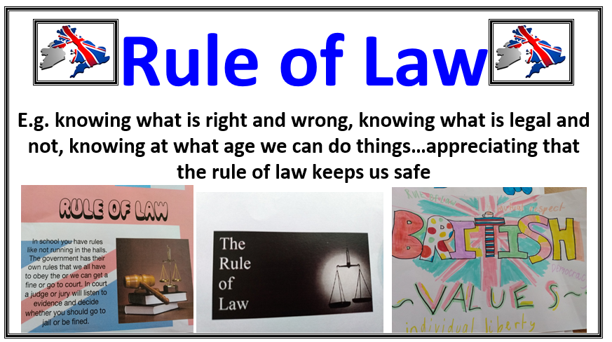
Rule of law
Rules keep us all safe
In some countries, where there is war, there seem to be no rules and people get away with doing bad things

Slide 12
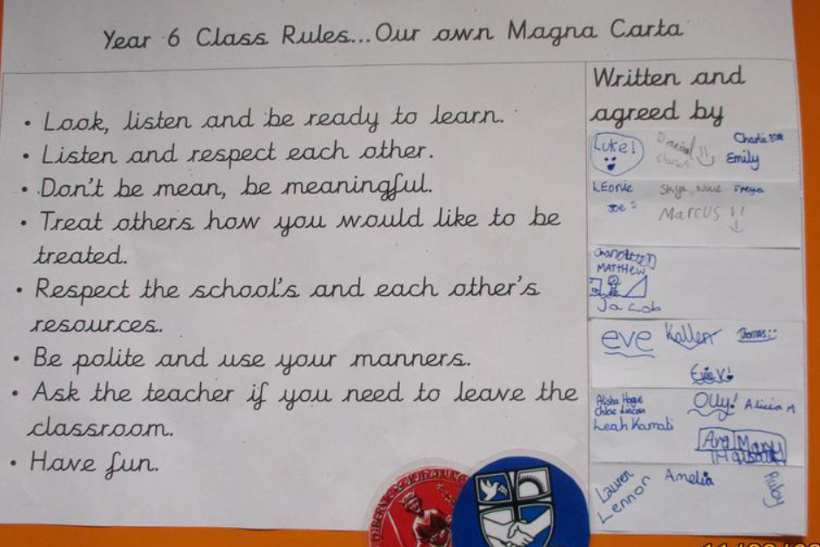


Slide 13
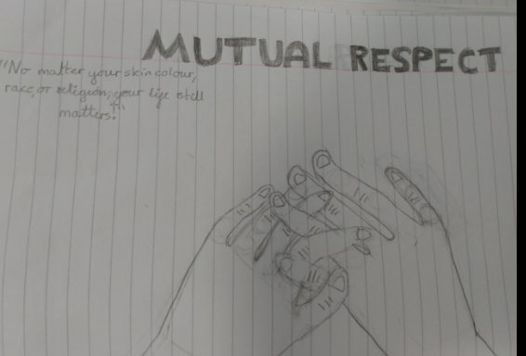
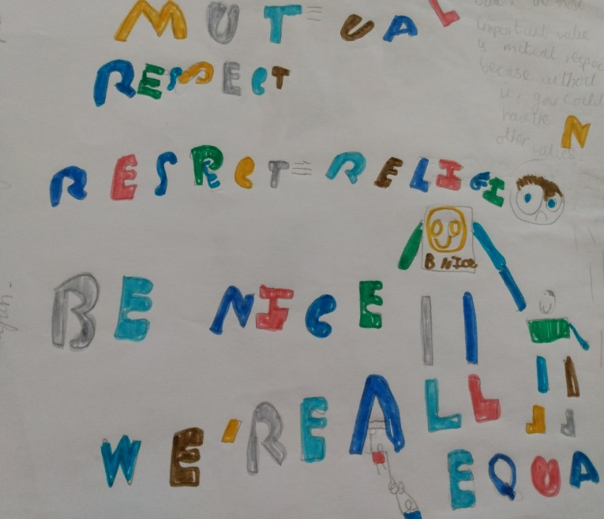
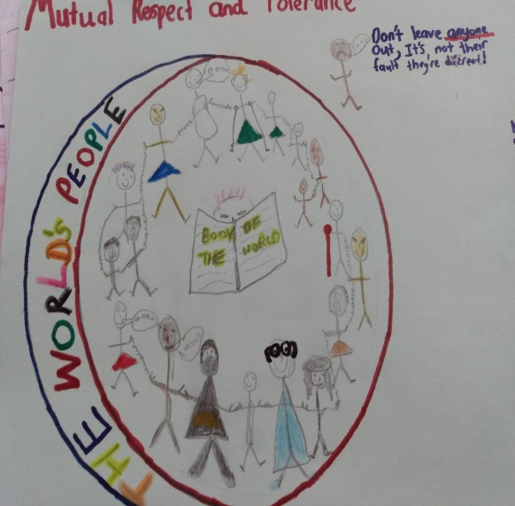
Mutual respect

Slide 14
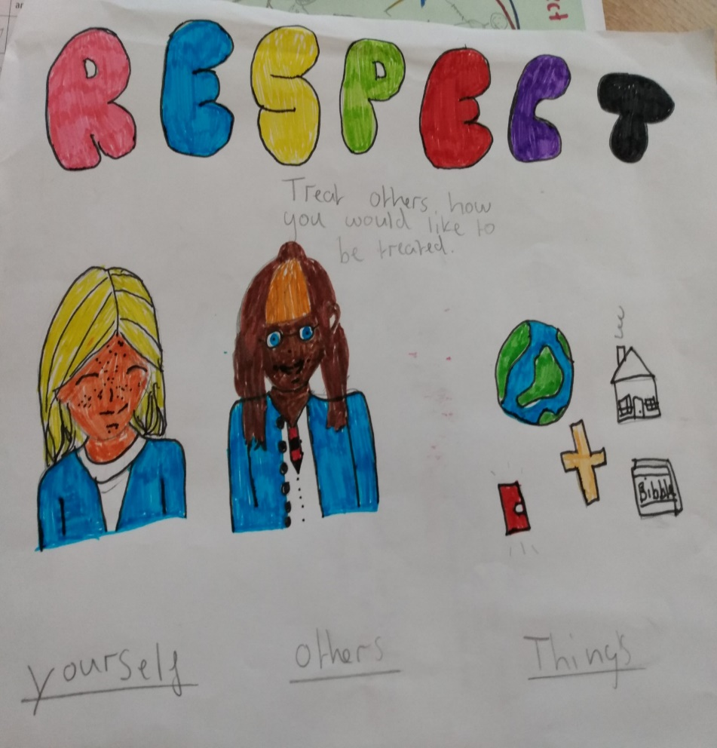
Mutual respect
We are all different
We are all unique
We believe that everyone should be treated equally
In some countries people are treated badly e.g. because of their skin colour and/or gender

Slide 15
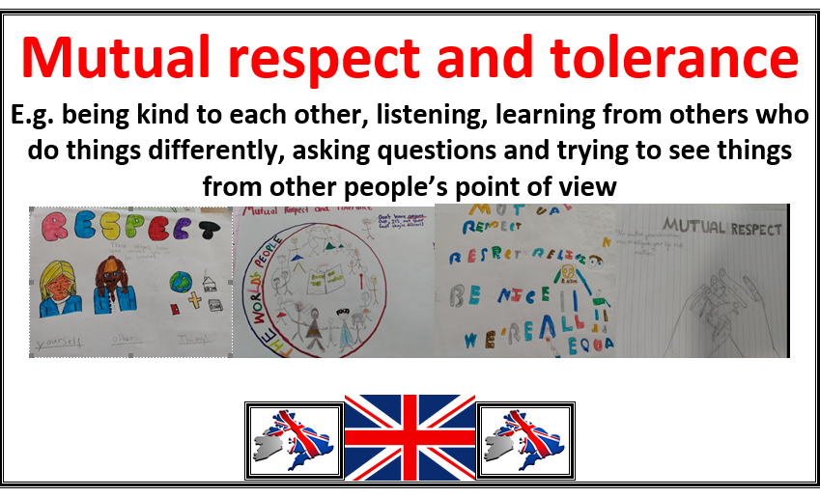
Here, we all get the same opportunities
We learn about other religions and cultures
We know not to be mean to people who are different
We choose to be kind

Slide 16
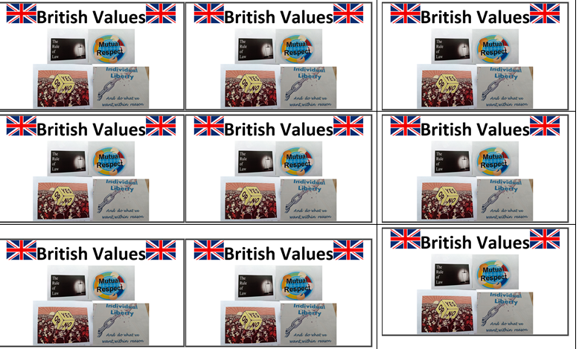
Can you remember the 4 values?

Slide 17

Our door today…is to be grateful for these values…we need to play our part in keeping these values alive

Slide 18
So we’d like you to consider creating a poster we can use in your classroom – like Year 6 have done here on this PowerPoint.
Choose one value or all four
Use your space well and have a mixture of words and pictures
Now let us pray

