Slide 1
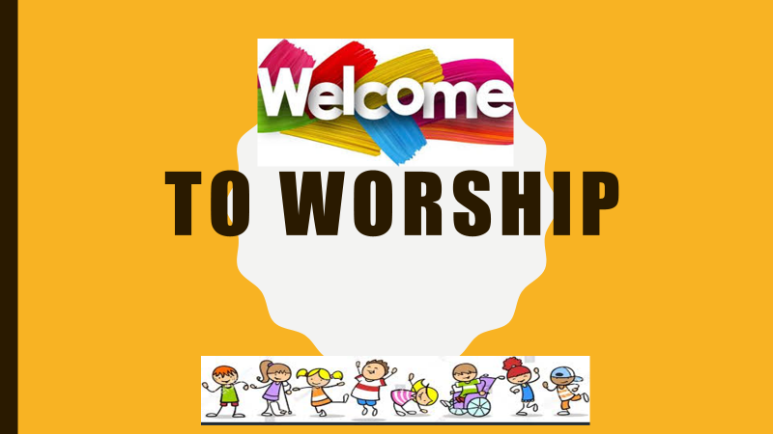

Slide 2
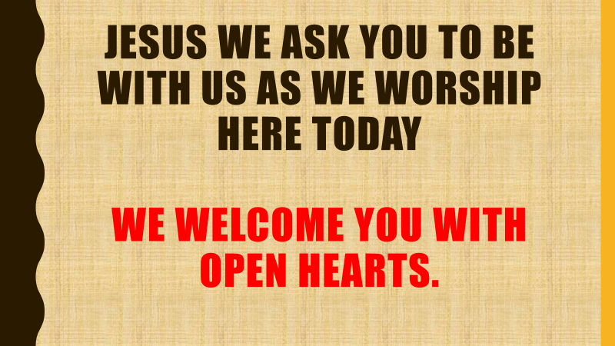

Slide 4
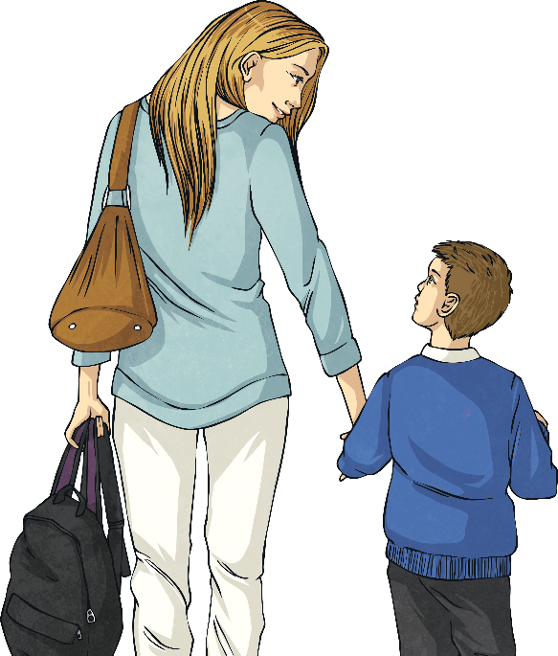
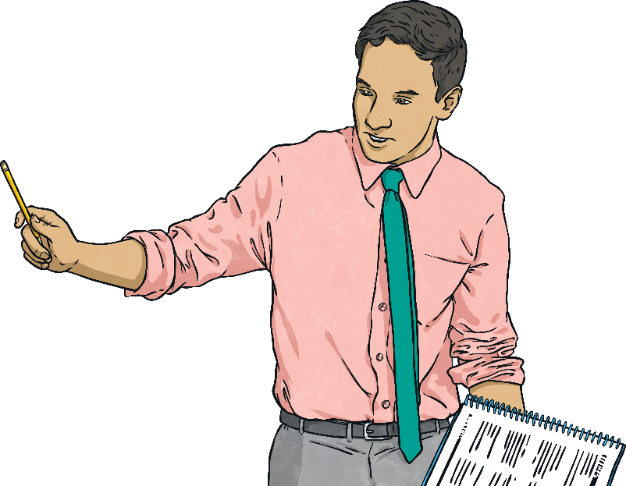
What Is Peace?
Peace is a word that gets used a lot.
Parents might say…
Teachers might say…
Give me a few minutes peace!
Let’s have five minutes of peace and quiet!
So what is ‘peace’?
Think for a moment about
what you think peace is.

Slide 5

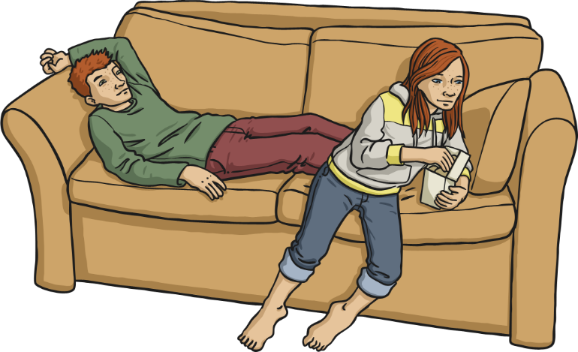
Peace Is…
One definition of peace is: freedom from disturbance; a time of tranquillity when you are not disturbed by anyone or anything.
Peace is also a state or period in which there is no war or a war
has ended.

Slide 6

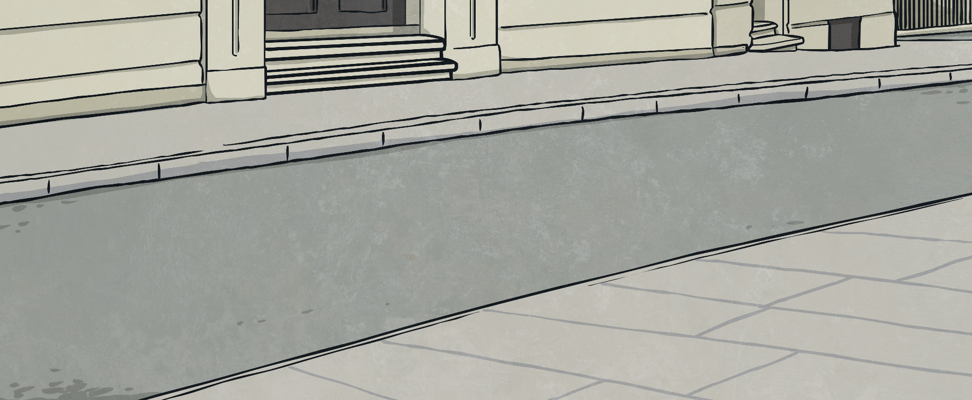
The United Nations
The United Nations organisation was formed after the
Second World War ended.
The world was in a mess. Neighbouring countries could
no longer trust one another and there was no peace.
In 1945, representatives from 51 countries met in San Francisco, USA. The representatives signed an important document with four very important agreements within it.

Slide 7
The UN Agreements
The representatives from the 51 countries were promising the following:
To maintain international peace and security.
To develop friendly relations among nations
based on respect for equal rights.
To achieve international co-operation in solving international problems.
To be a centre for harmonizing the actions of nations
in the attainment of these goals.
Basically, they were all agreeing to seek and
maintain peace around the world.

Slide 8

The International Day of Peace
This special day was agreed upon in 1981 by the United Nations General Assembly with the first official International Day of Peace happening on the 21st of September 1982.
The purpose of International Day of Peace is to:
‘provide a globally-shared date for all humanity to commit to peace above all differences and to contribute to building a culture of peace.’

Slide 9
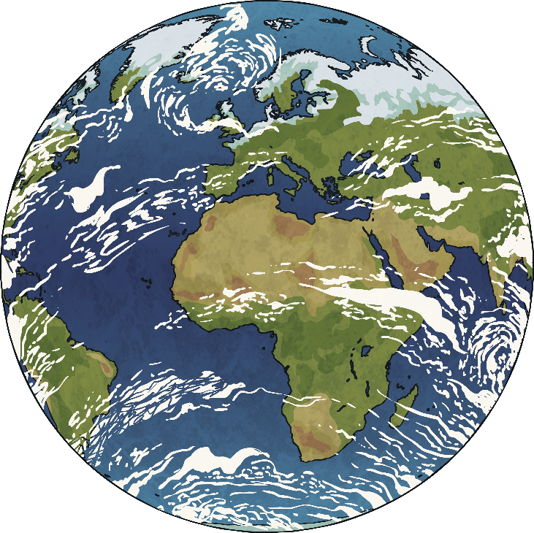
The 2021 Theme
The theme of this year’s day of peace is:
Recovering Better for an Equitable and Sustainable World
As we recover from the COVID-19 pandemic, it gives us time to think about how to help everyone recover better and transform our world into one that is more equal.
Equitable means ‘fair and impartial’.

Slide 10
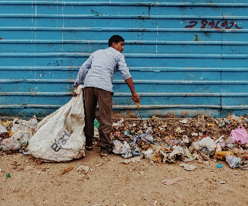
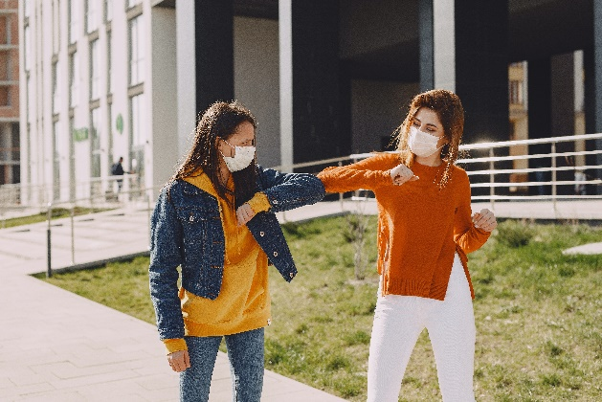
Recovering Better for an Equitable and Sustainable World
This virus has threatened our health, security and way of life as we know it. It’s important that we all stand together and fight against the worst public health crisis of our time.
Sustained Humanitarian Pause
We have confronted a common enemy of humankind, reminding us that we are not each other’s enemy. To recover from the devastation of the pandemic, we must make peace with each other.
Click Here

Slide 11
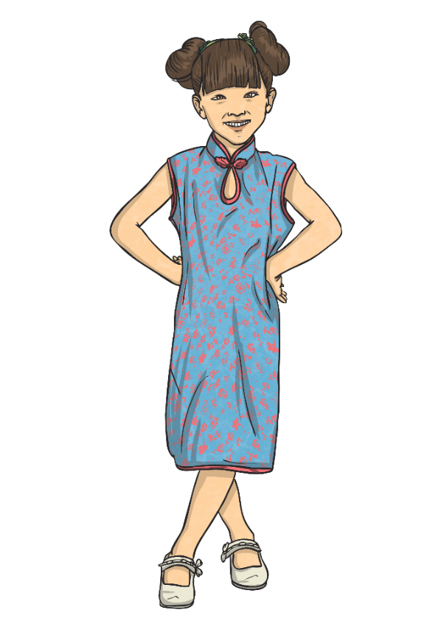
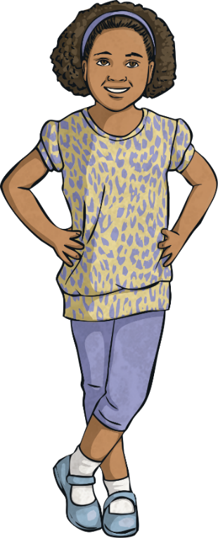
Our Responsibility
We can help by spreading kindness, compassion and hope throughout the pandemic and win the new fight.
We can continue to social distance wherever possible.
We can wear masks to prevent spreading the virus.
We can wash our hands often.
By combating the pandemic, we can hopefully have a positive impact on the world. This is a time to focus on recovering better for a more equitable, peaceful and sustainable world.

Slide 12

Let’s Create a Culture of Peace

Slide 13
Let us Pray

Slide 14
Let us go out into the world rejoicing and dazzle people with our St Philip’s Sparkle!
With Gods help we will Be Awesome.

